Slide 1
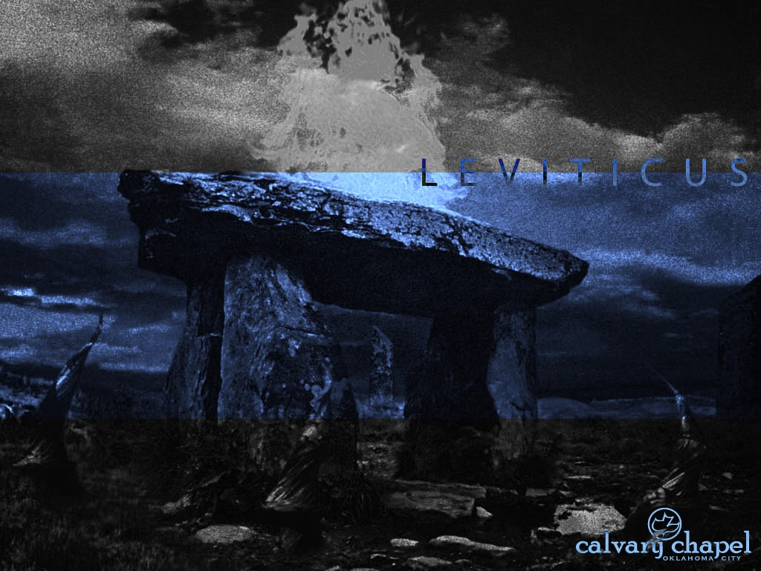
L E V I T I C U S
A CD OF THIS MESSAGE WILL BE AVAILABLE IMMEDIATELY FOLLOWING THE SERVICE
3 : 1 – 5 : 1 9
It will also be available for podcast later this week at calvaryokc.com

Slide 2
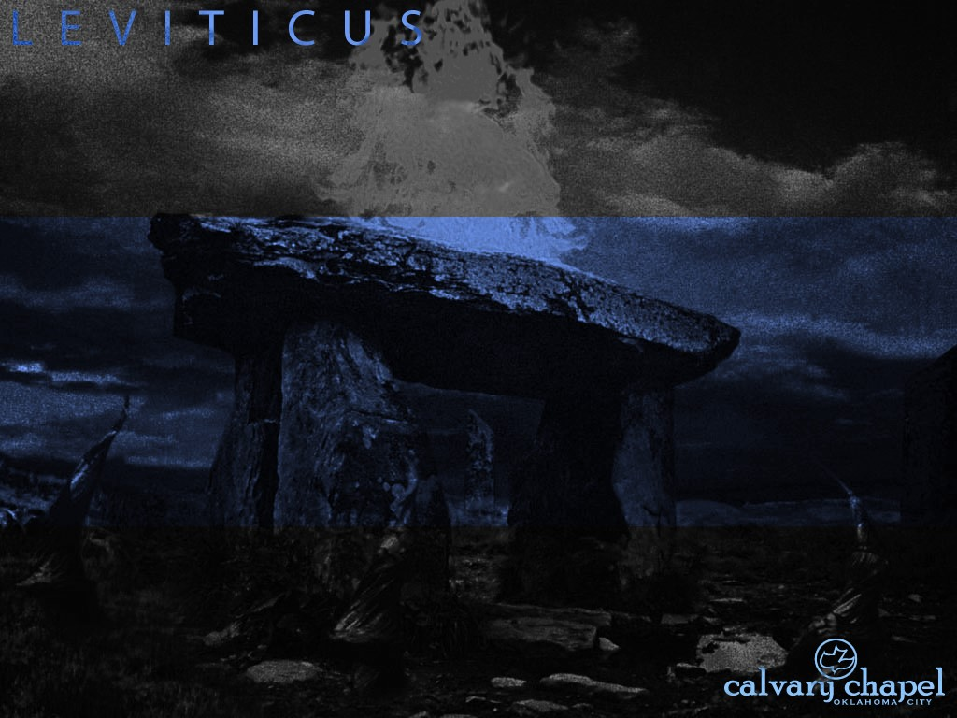
3 : 1 – 4 : 3 5
L E V I T I C U S 3 : 1 – 5 : 1 9
Peace offering ~ shelem – NIV, fellowship offering

Slide 3
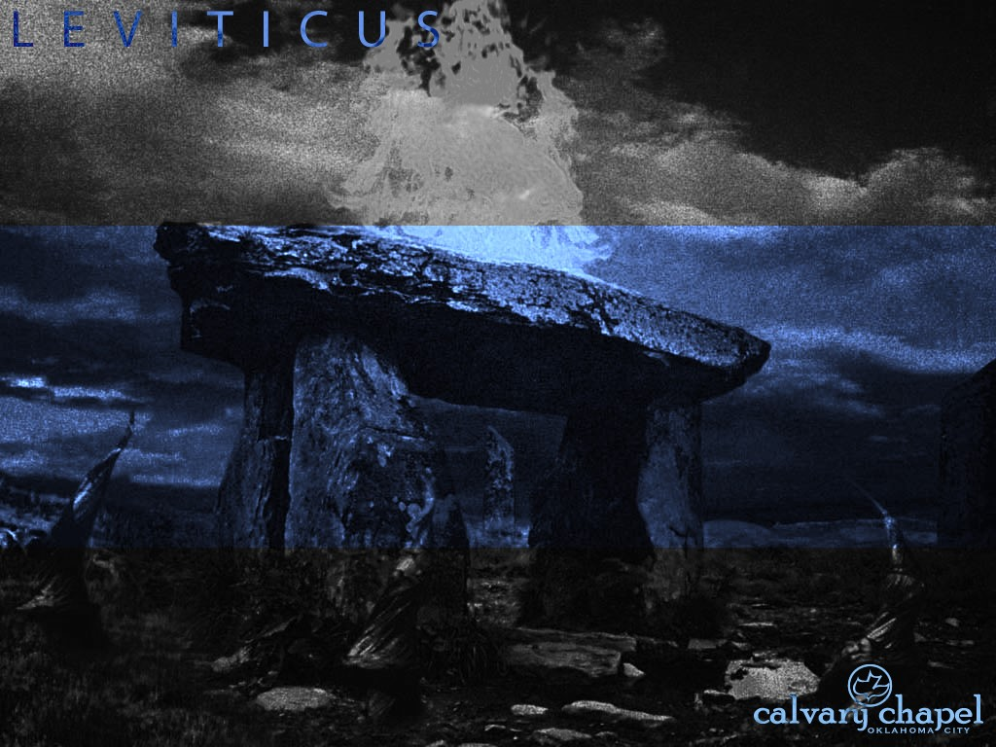
3 : 1 – 4 : 3 5
L E V I T I C U S 3 : 1 – 5 : 1 9

Slide 4
3 : 1 – 4 : 3 5
L E V I T I C U S 3 : 1 – 5 : 1 9
Rom. 5:1 ~ Therefore, having been justified by faith, we have peace with God through our Lord Jesus Christ …

Slide 5
3 : 1 – 4 : 3 5
L E V I T I C U S 3 : 1 – 5 : 1 9

Slide 6
3 : 1 – 4 : 3 5
L E V I T I C U S 3 : 1 – 5 : 1 9
Chapters 1-3 ~ Christ's person
Chapters 4-5 ~ Christ’s work

Slide 7
3 : 1 – 4 : 3 5
L E V I T I C U S 3 : 1 – 5 : 1 9
J. Vernon McGee ~ “Where the burnt offering leaves off, the sin offering begins. The burnt offering tells who Christ is; the sin offering tells what Christ did. In the burnt offering Christ meets the demands of God's high and holy standard; in the sin offering Christ meets the deep and desperate needs of man. In the burnt offering we see the preciousness of Christ; in the sin offering we see the hatefulness of sin.”

Slide 8
3 : 1 – 4 : 3 5
L E V I T I C U S 3 : 1 – 5 : 1 9

Slide 9
3 : 1 – 4 : 3 5
L E V I T I C U S 3 : 1 – 5 : 1 9
Unintentionally ~ KJV, through ignorance
Unpremeditated

Slide 10
1 : 1 – 2 : 1 6
L E V I T I C U S 3 : 1 – 5 : 1 9

Slide 11
3 : 1 – 4 : 3 5
L E V I T I C U S 3 : 1 – 5 : 1 9
2 Cor. 5:21 ~ For He made Him who knew no sin to be sin for us, that we might become the righteousness of God in Him.

Slide 12
1 : 1 – 2 : 1 6
L E V I T I C U S 3 : 1 – 5 : 1 9

Slide 13
3 : 1 – 4 : 3 5
L E V I T I C U S 3 : 1 – 5 : 1 9
Prayers of the saints
150 '
Ark
Table of Showbread
Golden Altar
Menorah
75'
15 '
45 '
Bronze Laver
Bronze Altar
Layout of the Tabernacle

Slide 14
1 : 1 – 2 : 1 6
L E V I T I C U S 3 : 1 – 5 : 1 9

Slide 15
3 : 1 – 4 : 3 5
L E V I T I C U S 3 : 1 – 5 : 1 9
Offal ~ NASB, refuse

Slide 16
3 : 1 – 4 : 3 5
L E V I T I C U S 3 : 1 – 5 : 1 9
Heb. 13:11-13 ~ ¹¹ For the bodies of those animals, whose blood is brought into the sanctuary by the high priest for sin, are burned outside the camp. ¹² Therefore Jesus also, that He might sanctify the people with His own blood, suffered outside the gate. ¹³ Therefore let us go forth to Him, outside the camp, bearing His reproach.

Slide 17
1 : 1 – 2 : 1 6
L E V I T I C U S 3 : 1 – 5 : 1 9

Slide 18
3 : 1 – 4 : 3 5
L E V I T I C U S 3 : 1 – 5 : 1 9
Before the Lord ~ altar of incense

Slide 19
1 : 1 – 2 : 1 6
L E V I T I C U S 3 : 1 – 5 : 1 9

Slide 20
3 : 1 – 4 : 3 5
L E V I T I C U S 3 : 1 – 5 : 1 9
Heb. 9:13-14 ~ ¹³ For if the blood of bulls and goats and the ashes of a heifer, sprinkling the unclean, sanctifies for the purifying of the flesh, ¹⁴ how much more shall the blood of Christ, who through the eternal Spirit offered Himself without spot to God, cleanse your conscience from dead works to serve the living God?

Slide 21
1 : 1 – 2 : 1 6
L E V I T I C U S 3 : 1 – 5 : 1 9

Slide 22
3 : 1 – 4 : 3 5
L E V I T I C U S 3 : 1 – 5 : 1 9
James 4:17 ~ Therefore, to him who knows to do good and does not do it, to him it is sin.

Slide 23
1 : 1 – 2 : 1 6
L E V I T I C U S 3 : 1 – 5 : 1 9

Slide 24
3 : 1 – 4 : 3 5
L E V I T I C U S 3 : 1 – 5 : 1 9
1/10 ephah (22 liters) = one omer (2.2 liters)

Slide 25
1 : 1 – 2 : 1 6
L E V I T I C U S 3 : 1 – 5 : 1 9

Slide 26
3 : 1 – 4 : 3 5
L E V I T I C U S 3 : 1 – 5 : 1 9
According to offerings ~ literally, upon the offerings

Slide 27
1 : 1 – 2 : 1 6
L E V I T I C U S 3 : 1 – 5 : 1 9

Slide 28
3 : 1 – 4 : 3 5
L E V I T I C U S 3 : 1 – 5 : 1 9
1 John 1:7 ~ But if we walk in the light as He is in the light, we have fellowship with one another, and the blood of Jesus Christ His Son cleanses us from all sin.

Slide 29
1 : 1 – 2 : 1 6
L E V I T I C U S 3 : 1 – 5 : 1 9

Slide 30
3 : 1 – 4 : 3 5
L E V I T I C U S 3 : 1 – 5 : 1 9
Two categories of trespasses:
1) Against “the holy things of the Lord”
2) Against one's neighbor (6:1-7)

Slide 31
1 : 1 – 2 : 1 6
L E V I T I C U S 3 : 1 – 5 : 1 9

Slide 32
3 : 1 – 4 : 3 5
L E V I T I C U S 3 : 1 – 5 : 1 9
KJV, though he wist it not

Slide 33
1 : 1 – 2 : 1 6
L E V I T I C U S 3 : 1 – 5 : 1 9

Slide 34
3 : 1 – 4 : 3 5
L E V I T I C U S 3 : 1 – 5 : 1 9
Burnt Offering ~ our consecration to God
Grain Offering ~ our thanksgiving to God
Peace Offering ~ our peace with God
Sin Offering ~ our relationship to God
Trespass Offering ~ fellowship with God

Slide 35
1 : 1 – 2 : 1 6
L E V I T I C U S 3 : 1 – 5 : 1 9

