Slide 1
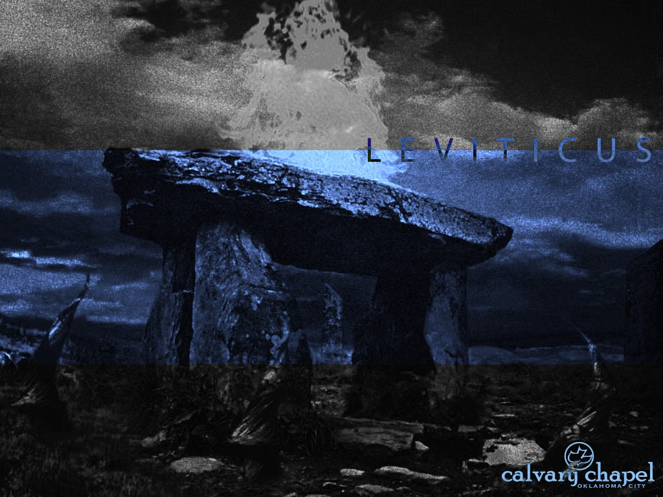
L E V I T I C U S
A CD OF THIS MESSAGE WILL BE AVAILABLE IMMEDIATELY FOLLOWING THE SERVICE
1 : 1 – 2 : 1 6
It will also be available for podcast later this week at calvaryokc.com

Slide 2
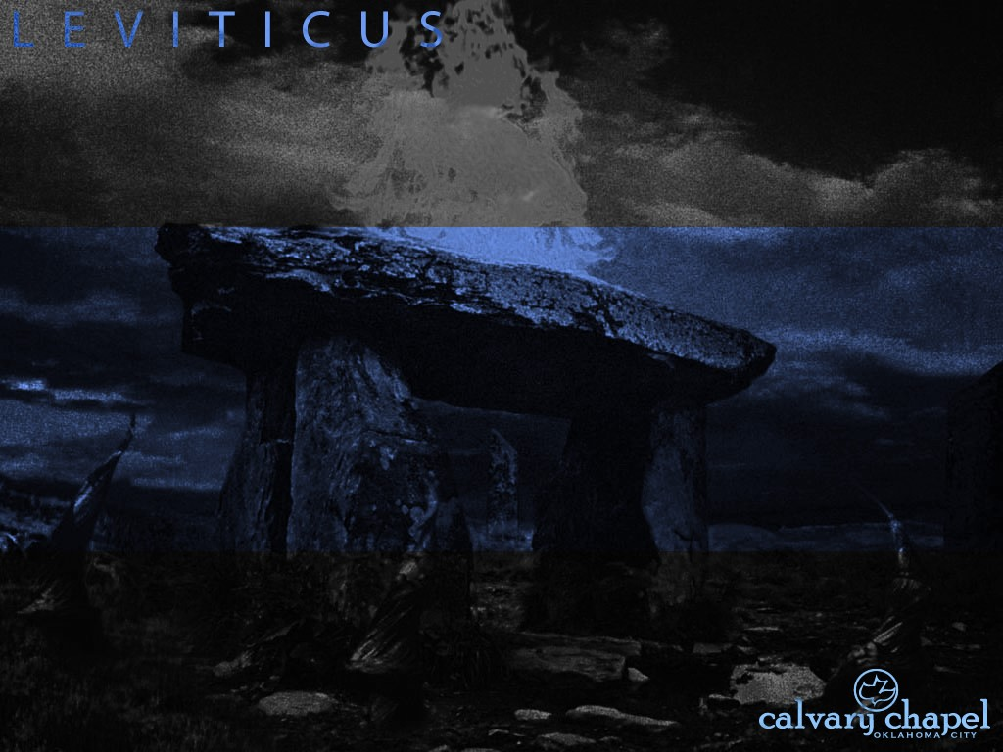
L E V I T I C U S 1 : 1 – 2 : 1 6
Name comes from LXX ~ Leuitikon – “priestly”
Hebrew ~ “And He called”
Quoted 40x in New Testament

Slide 3
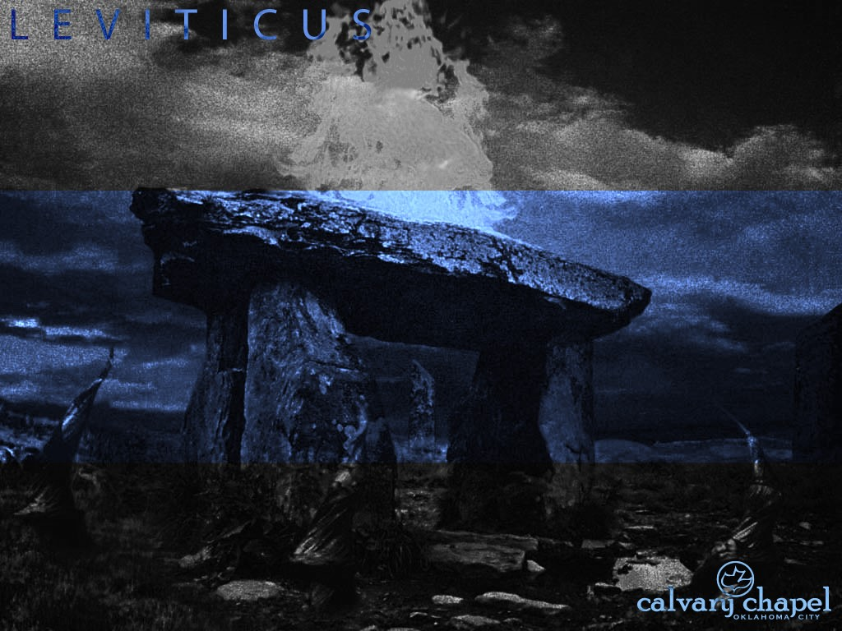
L E V I T I C U S 1 : 1 – 2 : 1 6

Slide 4
L E V I T I C U S 1 : 1 – 2 : 1 6
Psalms
Proverbs
Ecclesiastes
Isaiah
Jeremiah
Lamentations
Ezra
Ezekiel
Hosea
Joel
Nehemiah
Amos
Esther
Judges
Job
Ruth
Samuel
Kings
Genesis
Chronicles
Exodus
Leviticus
Obadiah
Numbers
Jonah
Joshua
Deuteronomy
Song of Songs
Daniel
Ephesians
Philippians
Timothy
John
Titus
Acts
Romans
James
Hebrews
Corinthians
Peter
Haggai
Galatians
Zechariah
Malachl
Luke
John’s Letters
Jude
Micah
Matthew
Revelation
Nahum
Mark
Colossians
Habakkuk
Zephaniah
Philemon
Thessalonians
Jesus

Slide 5
L E V I T I C U S 1 : 1 – 2 : 1 6
Exodus: Jesus as Savior
Leviticus: Jesus as Sanctifier

Slide 6
L E V I T I C U S 1 : 1 – 2 : 1 6

Slide 7
L E V I T I C U S 1 : 1 – 2 : 1 6
William Tyndale ~ “Though sacrifices and ceremonies can be no ground or foundation to build upon – that is, though we can prove naught with them – yet when we have once found Christ and His mysteries, then we may borrow figures, that is to say, allegories, similitudes, and examples, to open Christ, and the secrets of God hid in Christ, even unto the quick: and declare them more lively and sensibly with them than all the words of the world.”

Slide 8
L E V I T I C U S 1 : 1 – 2 : 1 6
Major theme: holiness ~ "holy" occurs over 150x in Leviticus
Atonement ~ 45x (a covering)
kaphar ~ to cover
at
-
New Testament ~
one
ment

Slide 9
L E V I T I C U S 1 : 1 – 2 : 1 6

Slide 10
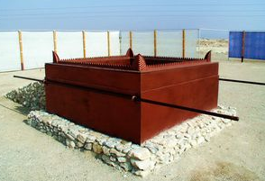
L E V I T I C U S 1 : 1 – 2 : 1 6
* Grain offering
Chapter 2
* Burnt offering
Chapter 1
* Peace offering
Chapter 3
Sin offering
Chapter 4
Trespass offering
Chapter 5
* Freewill offerings

Slide 11
L E V I T I C U S 1 : 1 – 2 : 1 6

Slide 12
L E V I T I C U S 1 : 1 – 2 : 1 6
Sweet ~ NASB, soothing
Literally, tranquilizing

Slide 13
L E V I T I C U S 1 : 1 – 2 : 1 6

Slide 14
L E V I T I C U S 1 : 1 – 2 : 1 6
Rom. 12:1 ~ I beseech you therefore, brethren, by the mercies of God, that you present your bodies a living sacrifice, holy, acceptable to God, which is your reasonable service.

Slide 15
L E V I T I C U S 1 : 1 – 2 : 1 6
Significance: Uncompromised dedication of our lives to God
Typology: Christ wholly dedicated to the will of the Father

Slide 16
L E V I T I C U S 1 : 1 – 2 : 1 6

Slide 17
L E V I T I C U S 1 : 1 – 2 : 1 6
Explained in Lev. 23:9-21

Slide 18
L E V I T I C U S 1 : 1 – 2 : 1 6

Slide 19
L E V I T I C U S 1 : 1 – 2 : 1 6
Covenant of salt ~ mentioned 3x in the Old Testament
Here and Num. 18:19; 2 Chron. 13:5
Salt seasons, purifies and preserves
Represents the eternality of the covenant
NLT ~ Season all your grain offerings with salt to remind you of God's eternal covenant.

Slide 20
L E V I T I C U S 1 : 1 – 2 : 1 6

Slide 21
L E V I T I C U S 1 : 1 – 2 : 1 6
Significance: Uncompromised dedication of the work of our hands
Typology: Jesus' purity and perfection

Slide 22
L E V I T I C U S 1 : 1 – 2 : 1 6

