Slide 1
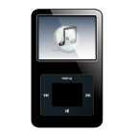
A CD of this message will be available (free of charge immediately following today's message
This message will be available via podcast later this week at calvaryokc.com
Lamentations
1:1 – 3:33
Michelangelo, "Jeremiah" (Sistine Chapel)

Slide 2
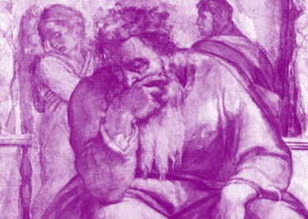
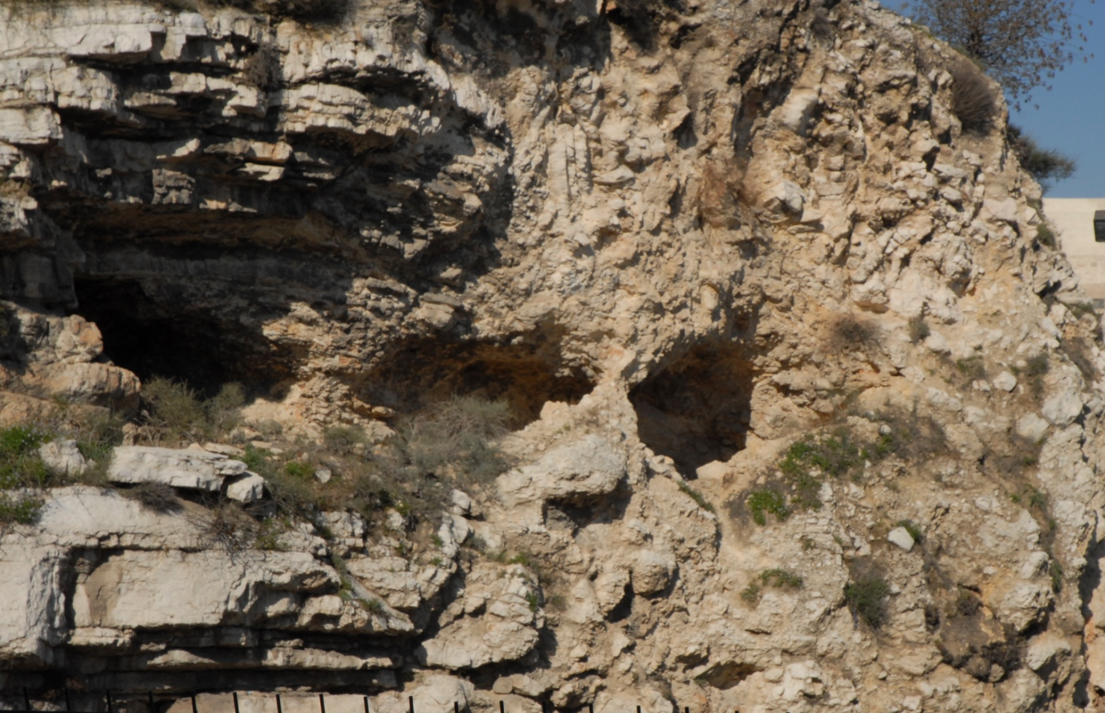
Jeremiah's Grotto
Lamentations
1:1 – 3:33
Michelangelo, "Jeremiah" (Sistine Chapel)

Slide 3
Read on 9th of Av (Tisha B'Av) (July-August)
Commemorating the fall of the both the 1st and 2nd Temples (occurred on the same day)
Lamentations
1:1 – 3:33
Michelangelo, "Jeremiah" (Sistine Chapel)

Slide 4
Lamentations
1:1 – 3:33
Michelangelo, "Jeremiah" (Sistine Chapel)

Slide 5
Chapters 1, 2 and 4 are acrostic (22 verses each)
Chapter 3 is also an acrostic (66 verses, 3 verses for each letter)
Lamentations
1:1 – 3:33
Michelangelo, "Jeremiah" (Sistine Chapel)

Slide 6
Chapter 1:
Provocation against God
Chapter 2:
Punishment from God
Chapter 3:
Prophet and God
Chapter 4:
People of God
Lamentations
1:1 – 3:33
Michelangelo, "Jeremiah" (Sistine Chapel)

Slide 7
Jeremiah
1:1 – 2:24
Michelangelo, "Jeremiah" (Sistine Chapel)

Slide 8
Downfall ~ KJV, sabbaths
Lamentations
1:1 – 3:33
Michelangelo, "Jeremiah" (Sistine Chapel)

Slide 9
Jeremiah
1:1 – 2:24
Michelangelo, "Jeremiah" (Sistine Chapel)

Slide 10
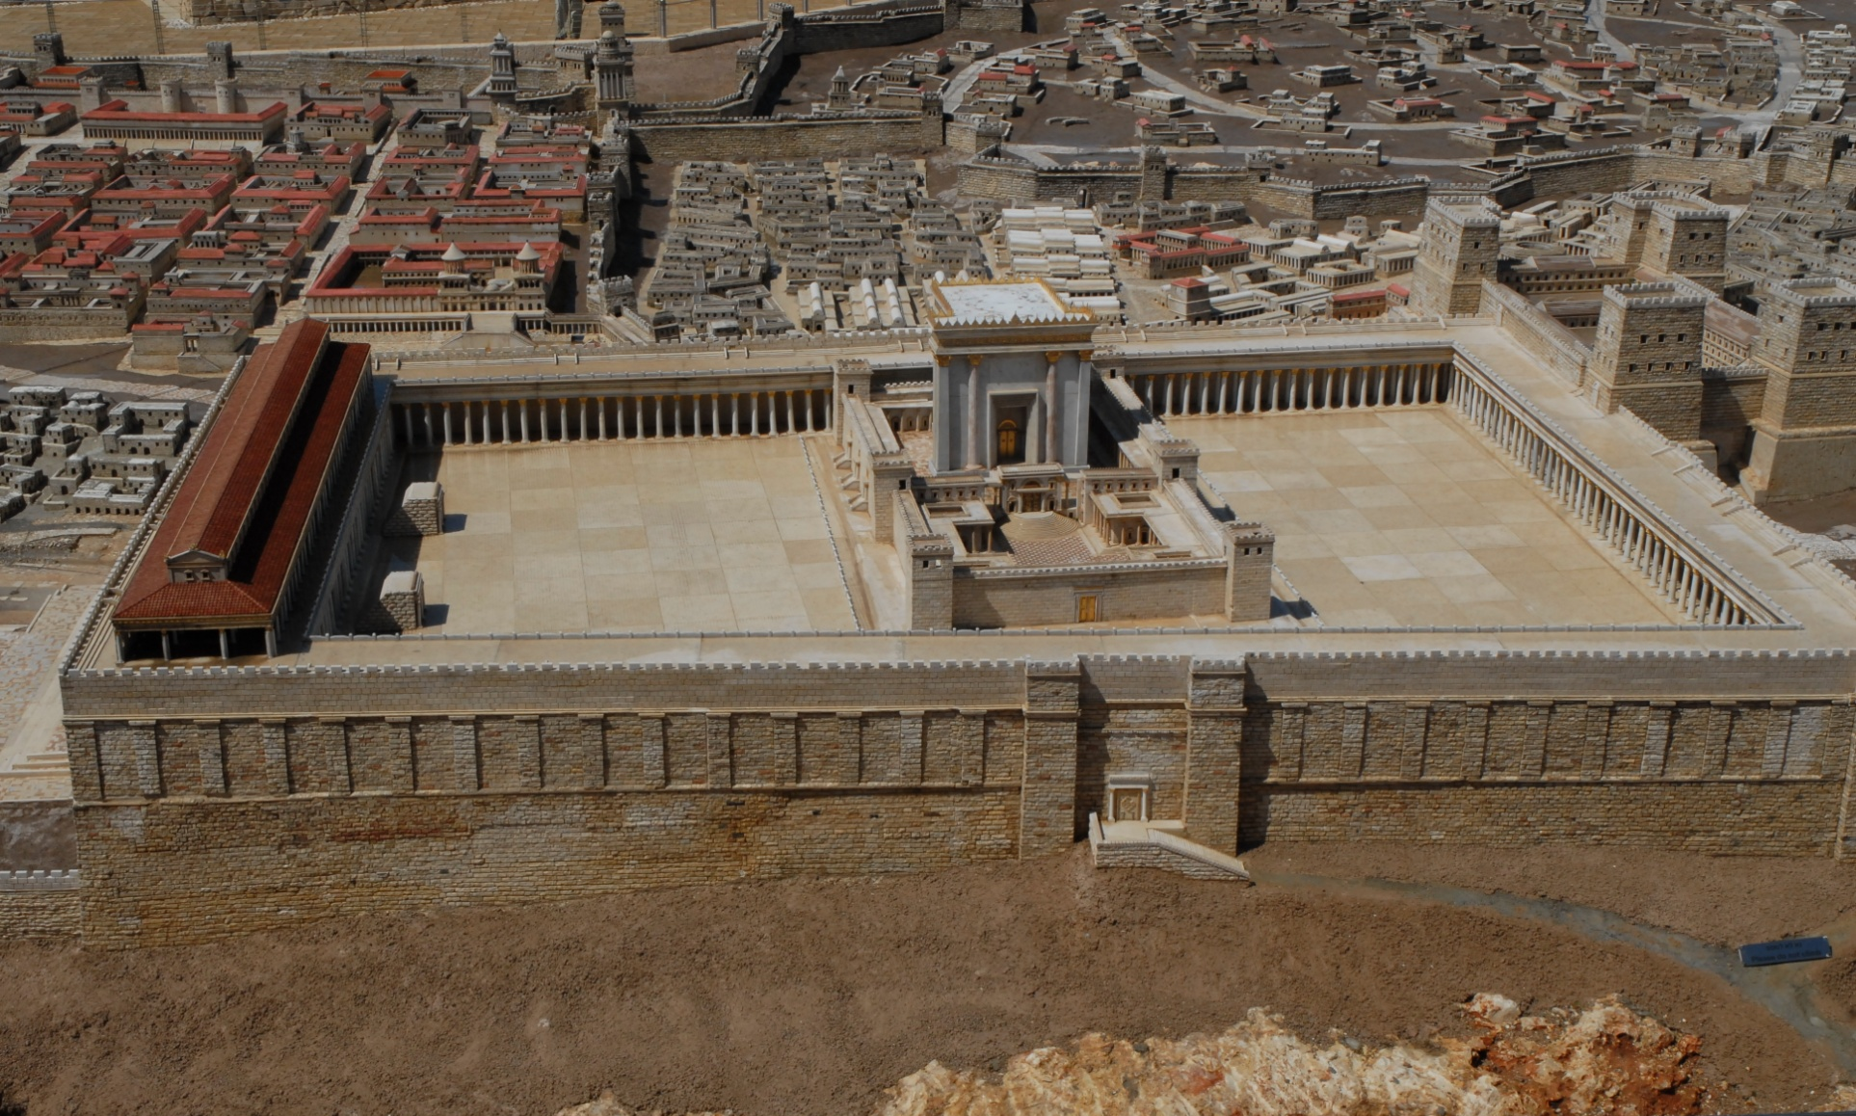
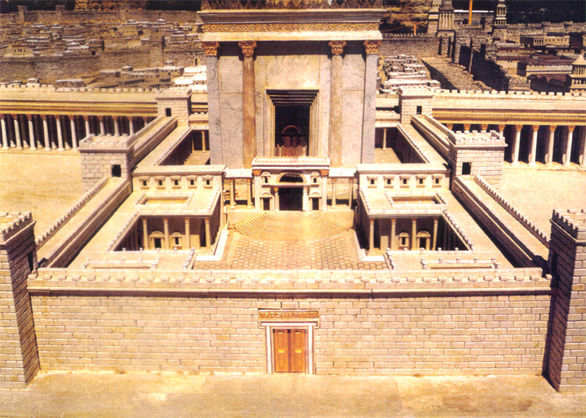
Holy of Holies
Court of
the Priests
Court of the Gentiles
Court of
the Women
Lamentations
1:1 – 3:33
Michelangelo, "Jeremiah" (Sistine Chapel)

Slide 11
Lamentations
1:1 – 2:24
Michelangelo, "Jeremiah" (Sistine Chapel)

Slide 12
Unclean thing ~ KJV, menstruous woman
Spell checker: monstrous
Lamentations
1:1 – 2:24
Michelangelo, "Jeremiah" (Sistine Chapel)

Slide 13
Lamentations
1:1 – 2:24
Michelangelo, "Jeremiah" (Sistine Chapel)

Slide 14
Soul ~ literally, bowels (KJV)
Lamentations
1:1 – 2:24
Michelangelo, "Jeremiah" (Sistine Chapel)

Slide 15
Lamentations
1:1 – 2:24
Michelangelo, "Jeremiah" (Sistine Chapel)

Slide 16
Horn ~ strength
Lamentations
1:1 – 2:24
Michelangelo, "Jeremiah" (Sistine Chapel)

Slide 17
Lamentations
1:1 – 2:24
Michelangelo, "Jeremiah" (Sistine Chapel)

Slide 18
Heart ~ KJV, bowels
Bile ~ literally liver (KJV)
Lamentations
1:1 – 2:24
Michelangelo, "Jeremiah" (Sistine Chapel)

Slide 19
Lamentations
1:1 – 2:24
Michelangelo, "Jeremiah" (Sistine Chapel)

Slide 20
Cuddled ~ KJV, span long
From a root meaning to nurse
Lamentations
1:1 – 2:24
Michelangelo, "Jeremiah" (Sistine Chapel)

Slide 21
Lamentations
1:1 – 2:24
Michelangelo, "Jeremiah" (Sistine Chapel)

Slide 22
Loins ~ literally kidneys
KJV, reins
Lamentations
1:1 – 2:24
Michelangelo, "Jeremiah" (Sistine Chapel)

Slide 23
Lamentations
1:1 – 2:24
Michelangelo, "Jeremiah" (Sistine Chapel)

Slide 24
There once was a man named Jeremiah
Who, to us, has become a pariah
He's such a buffoon
Prophesying his doom
Whilst sitting atop Mt. Moriah
Lamentations
1:1 – 2:24
Michelangelo, "Jeremiah" (Sistine Chapel)

Slide 25
Lamentations
1:1 – 2:24
Michelangelo, "Jeremiah" (Sistine Chapel)

Slide 26
Ps 103:14 ~ He knows our frame that we are dust
Lamentations
1:1 – 2:24
Michelangelo, "Jeremiah" (Sistine Chapel)

Slide 27
Lamentations
1:1 – 2:24
Michelangelo, "Jeremiah" (Sistine Chapel)

