Slide 1
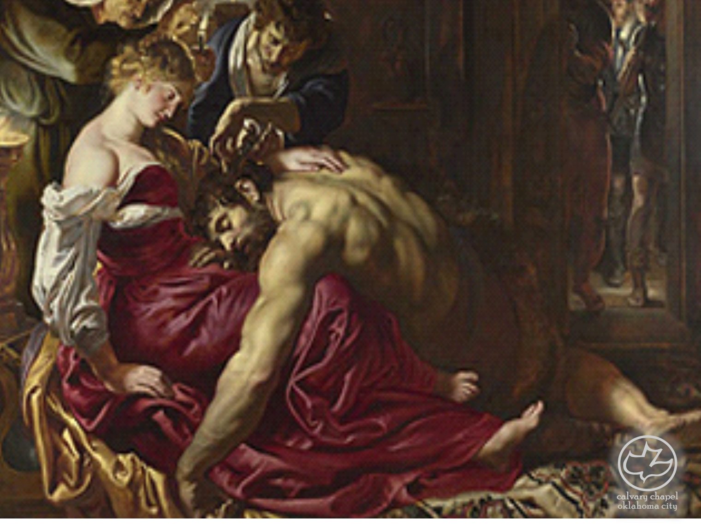

Judges
19-21
A CD of this message will be available (free of charge) immediately following the service.
It will also be available for podcast later this week at calvaryokc.com

Slide 2
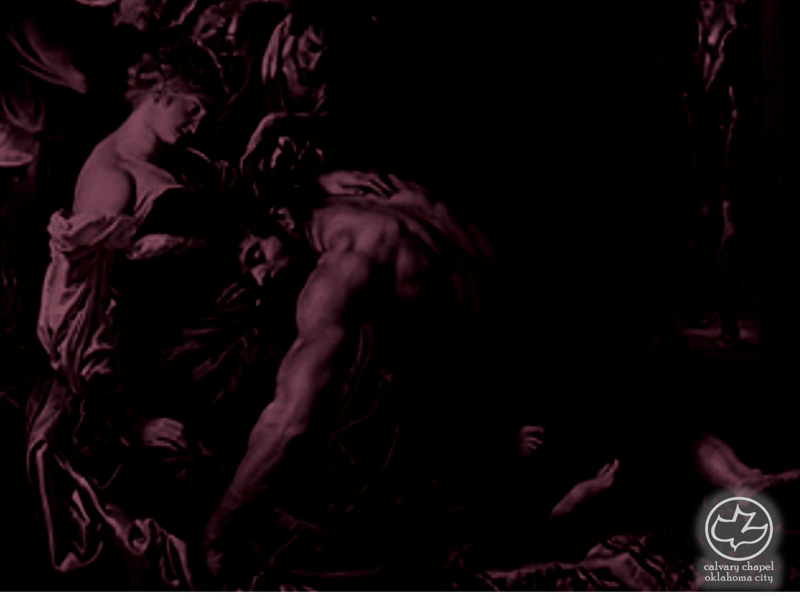
Judges
19-21
Judg. 21:25 ~ In those days there was no king in Israel; everyone did what was right in his own eyes.
Prov. 12:15 ~ The way of a fool is right in his own eyes,
But he who heeds counsel is wise.
Prov. 16:2 ~ All the ways of a man are pure in his own eyes,
But the Lord weighs the spirits.

Slide 3
Judges
19-21
Prov. 21:2 ~ Every way of a man is right in his own eyes,
But the Lord weighs the hearts.

Slide 4
Judges
19-21

Slide 5
Judges
19-21
Adam Clarke ~ "I have passed over the abominable transactions of this chapter as lightly as I could, and shall make no apology to the learned or unlearned reader for leaving some things untranslated."

Slide 6
Judges
19-21

Slide 7
Judges
19-21
Perverted men ~ literally, without worth
KJV, Sons of Belial
Adam Clarke ~ ”These were genuine sodomites as to their practice; sons of Belial, rascals and miscreants of the deepest dye; worse than brutes, being a compound of beast and devil inseparably blended."

Slide 8
Judges
19-21

Slide 9
Judges
19-21
House of God ~ NASB, NIV – Bethel
Probably Shiloh (location of Tabernacle - 18:31)

Slide 10
Judges
19-21

Slide 11
Judges
19-21
Phinehas ~ Aaron's grandson

Slide 12
Judges
19-21

Slide 13
Judges
19-21
26,700 (v. 15) – 25,100 = 1,600 men

Slide 14
Judges
19-21

