Slide 1
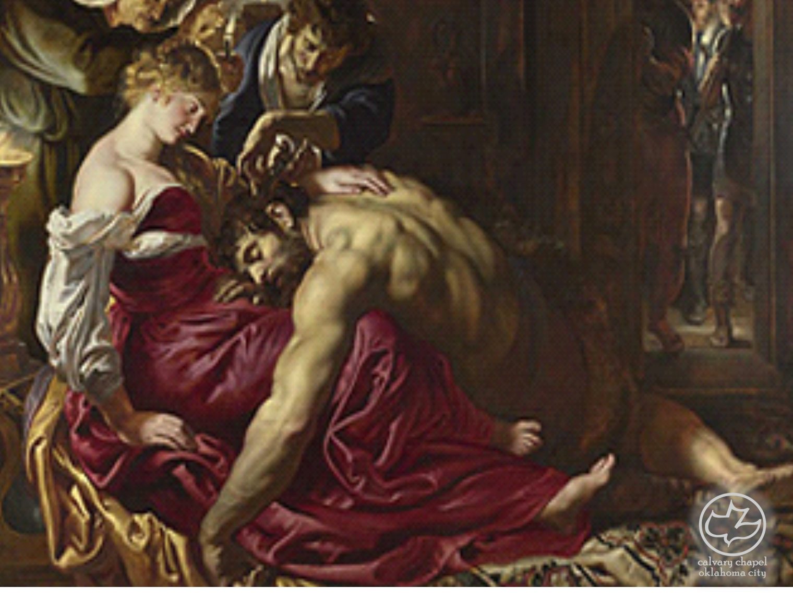

Judges
17-18
A CD of this message will be available (free of charge) immediately following the service.
It will also be available for podcast later this week at calvaryokc.com

Slide 2
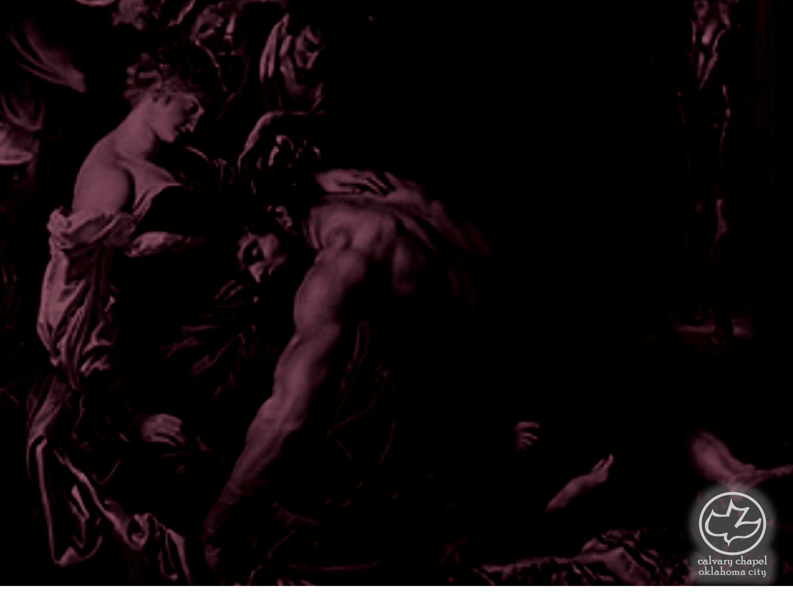
Judges
17-18
Micah ~ who is like Jehovah?

Slide 3
Judges
17-18

Slide 4
Judges
17-18
Shrine ~ beit elohim – literally house of gods

Slide 5
Judges
17-18

Slide 6
Judges
17-18
Vance Havner ~ "We shouldn’t worry because the government won’t allow children to have Bibles in school. They’ll get free Bibles when they go to prison."

Slide 7
Judges
17-18

Slide 8
Judges
17-18
John 10:12-13 ~ ¹² But a hireling, he who is not the shepherd, one who does not own the sheep, sees the wolf coming and leaves the sheep and flees; and the wolf catches the sheep and scatters them. ¹³ The hireling flees because he is a hireling and does not care about the sheep.
NIV ~ hired hand

Slide 9
Judges
17-18

Slide 10
Judges
17-18
1. "A god exists who created and ordered the world and watches over human life on earth."
2. "God wants people to be good, nice, and fair to each other, as taught in the Bible and by most world religions."
3. "The central goal of life is to be happy and to feel good about oneself."
4. "God does not need to be particularly involved in one's life except when God is needed to resolve a problem."

Slide 11
Judges
17-18
5. "Good people go to heaven when they die."

Slide 12
Judges
17-18

Slide 13
Judges
17-18
Judges 1:34 ~ And the Amorites forced the children of Dan into the mountains, for they would not allow them to come down to the valley;

Slide 14
Judges
17-18

Slide 15
Judges
17-18
Thomas Watson ~ "Providence should be the Christian’s diary but never his Bible."

Slide 16
Judges
17-18

Slide 17
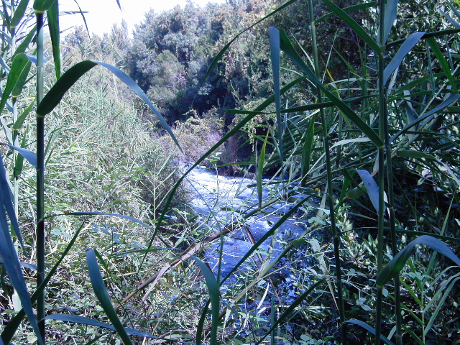
Judges
17-18

Slide 18
Judges
17-18

Slide 19
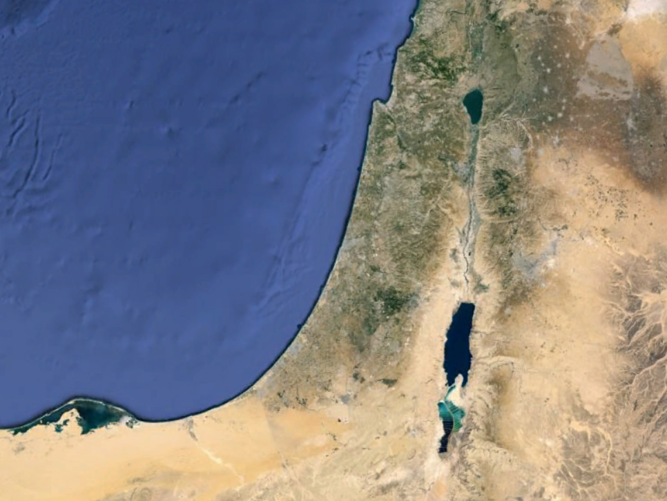
Judges
17-18
Laish
DAN

Slide 20
Judges
17-18

Slide 21
Judges
17-18
Manasseh ~ Name is actually Moses
מֹשֶׁה (mōšeh) Moses
מְנַשֶּׁה (mĕnaššeh) Manasseh
nun would be superscripted
kethibh (word written)
qere (word spoken)

Slide 22
Judges
17-18

Slide 23
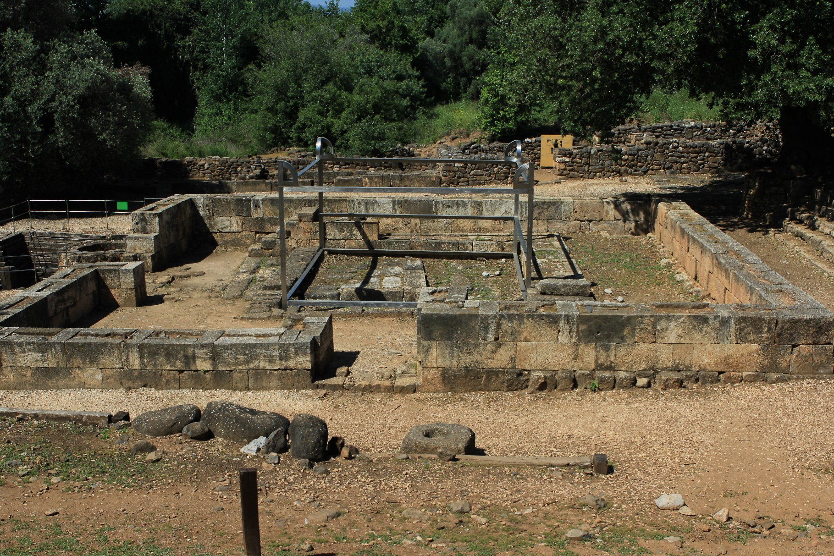
Judges
17-18

Slide 24
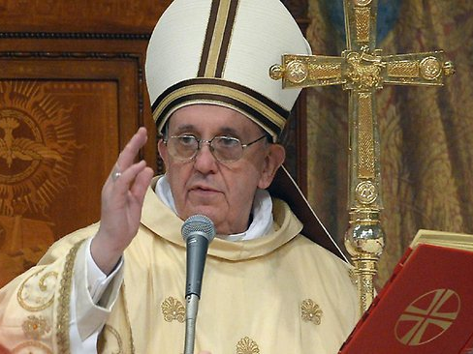
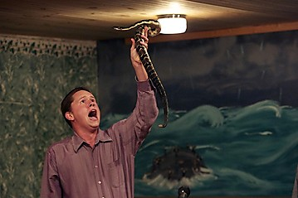
Judges
17-18
?

Slide 25
Judges
17-18
How do you determine when a religious practice is right?
Not by size
Not by feeling
Ps. 51:17 ~ The sacrifices of God are a broken spirit,
A broken and a contrite heart—
These, O God, You will not despise.

Slide 26
Judges
17-18

