Slide 1
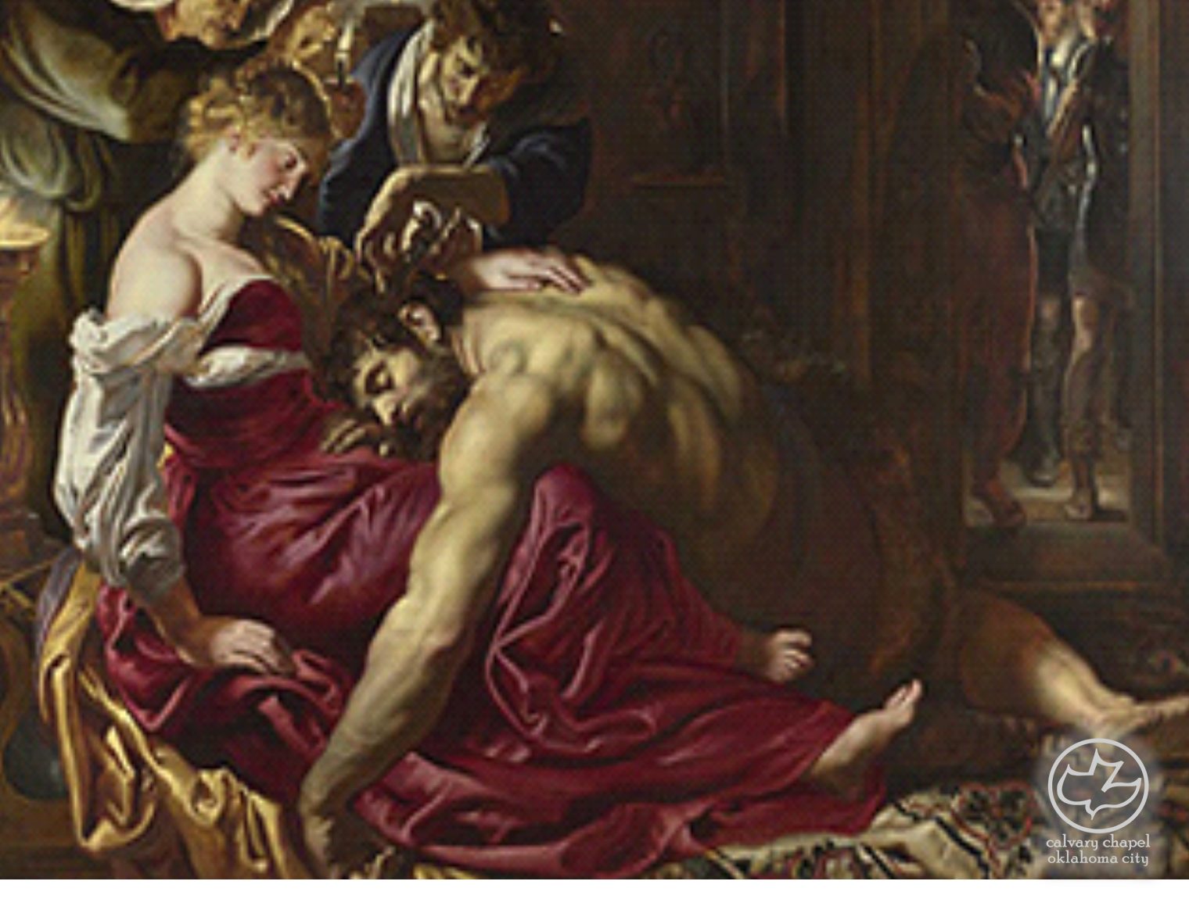

Judges
14-16
A CD of this message will be available (free of charge) immediately following the service.
It will also be available for podcast later this week at calvaryokc.com

Slide 2
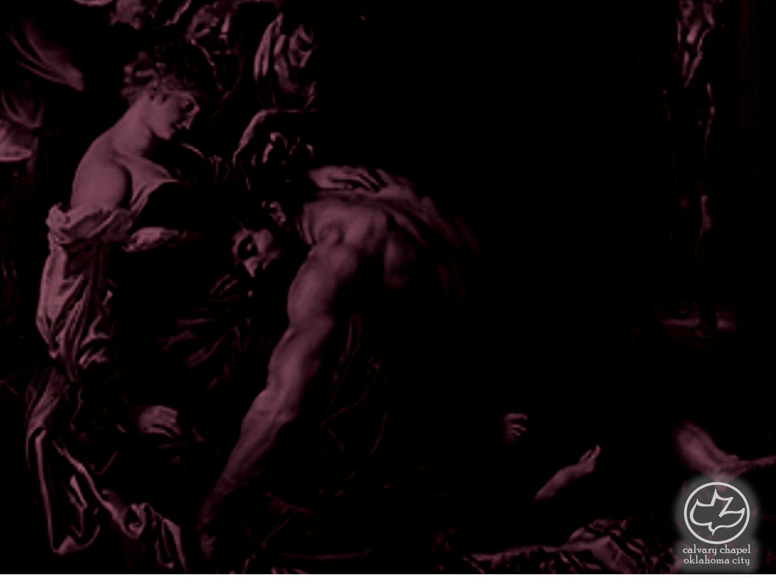
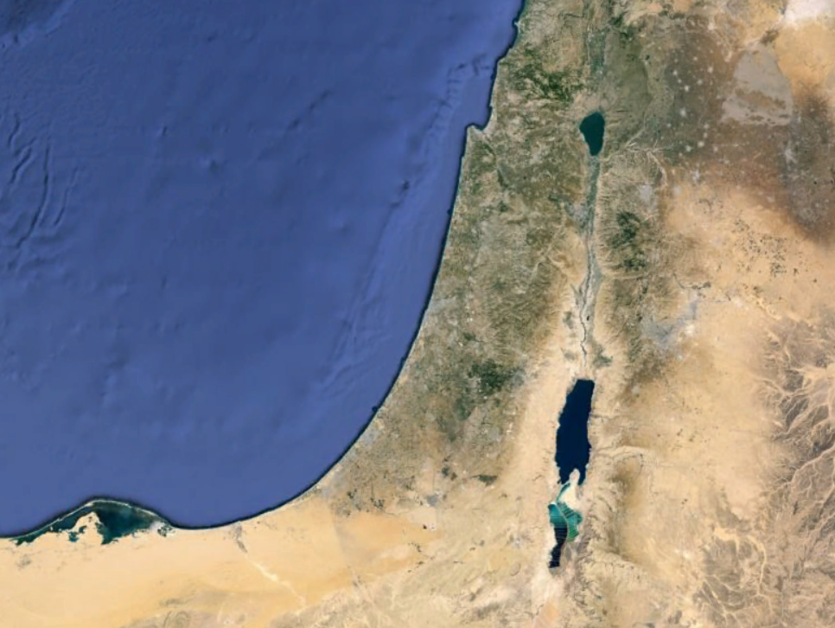
Judges
14-16
Zorah
Timnah

Slide 3
Judges
14-16

Slide 4
Judges
14-16
Pleases me well ~ same phrase as Judge. 17:6; 21:25
Everyone did what was right in his own eyes

Slide 5
Judges
14-16

Slide 6
Judges
14-16
Wheat harvest ~ late spring (50 days following Passover)

Slide 7
Judges
14-16

Slide 8
Judges
14-16
Foxes ~ possibly jackals (literally, a burrower)

Slide 9
Judges
14-16

Slide 10
Judges
14-16
Lehi ~ jawbone
NIV ~ I have made donkeys of them
Heaps ~ chamorah; donkey ~ chamor

Slide 11
Judges
14-16

Slide 12
Judges
14-16
Ramath Lehi ~ Jawbone Heights

Slide 13
Judges
14-16

Slide 14
Judges
14-16
En Hakkore ~ Spring of the Caller

Slide 15
Judges
14-16
Hebron
Gaza
40 mi.

Slide 16
Judges
14-16

Slide 17
Judges
14-16
Valley of Sorek ~ choice vines
Delilah ~ feeble or weak

Slide 18
Judges
14-16

Slide 19
Judges
14-16
Locks ~ braids (NIV) or dreads

Slide 20
Judges
14-16

Slide 21
Judges
14-16
Ps. 51:11 ~ Do not cast me away from your presence,
And do not take your Holy Spirit from me.

Slide 22
Judges
14-16

Slide 23
Judges
14-16
Put out ~ literally, bored

Slide 24
Judges
14-16

