Slide 1
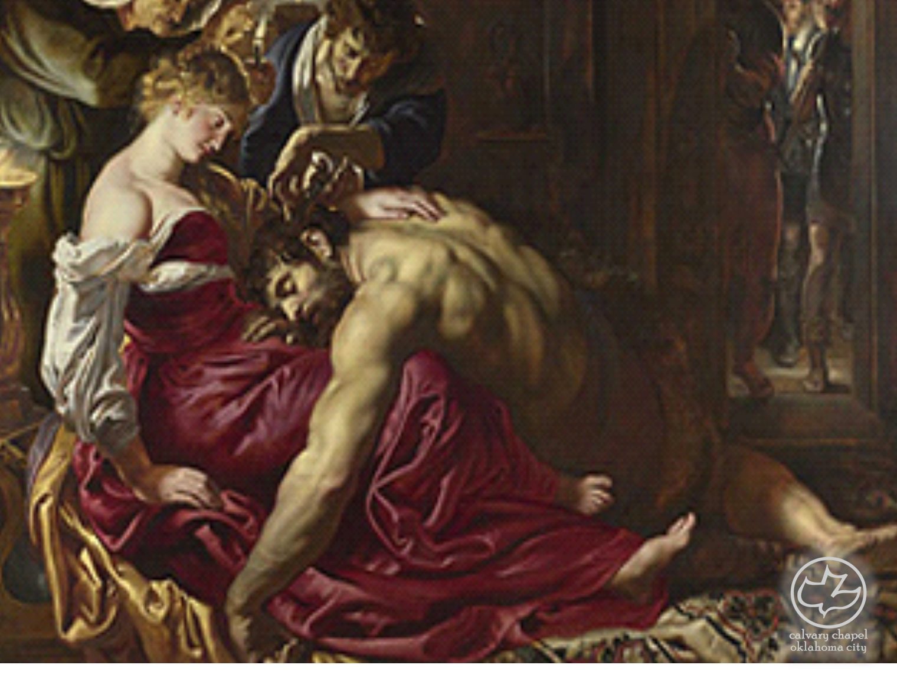

Judges
11-13
A CD of this message will be available (free of charge) immediately following the service.
It will also be available for podcast later this week at calvaryokc.com

Slide 2
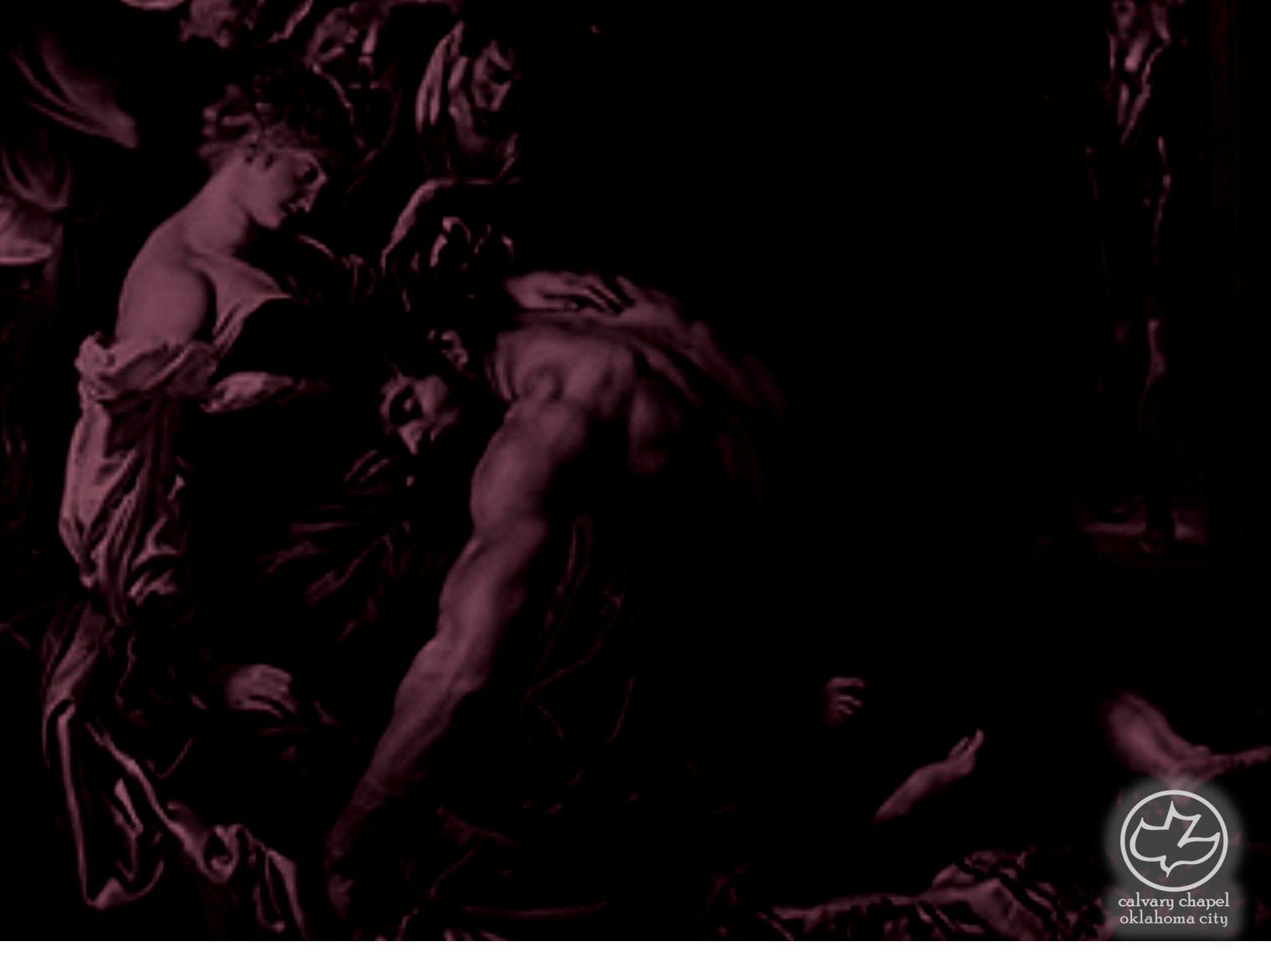
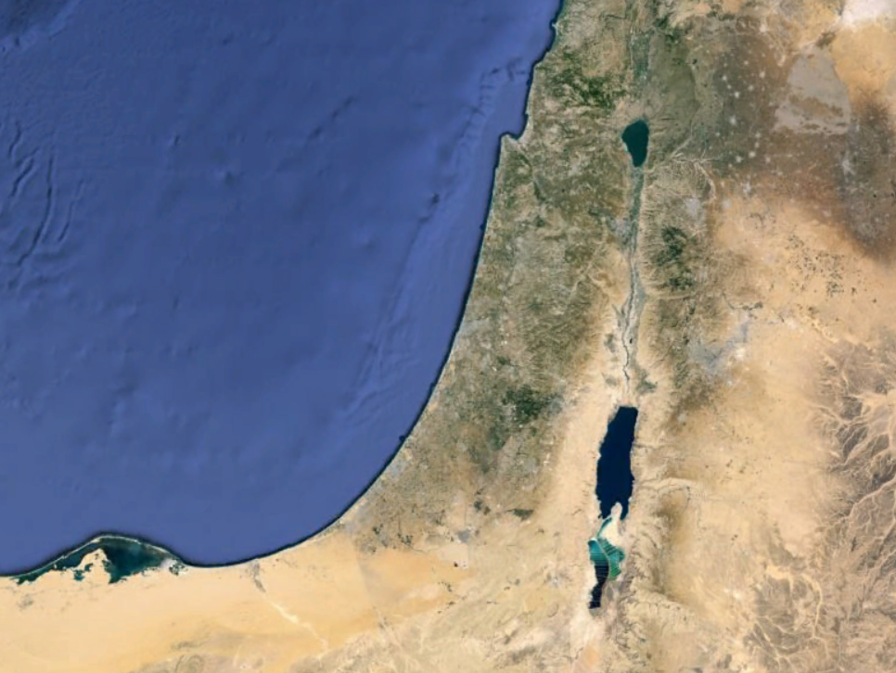
Judges
11-13
Shamgar
Elon
Gideon
Jair
Tola
Abdon
Jephthah
Debra
Samson
Ehud
Ibzan
Othniel

Slide 3
Judges
11-13

Slide 4
Judges
11-13
Worthless men ~ NIV, adventurers

Slide 5
Judges
11-13

Slide 6
Judges
11-13
Witness ~ literally, God is listening

Slide 7
Judges
11-13

Slide 8
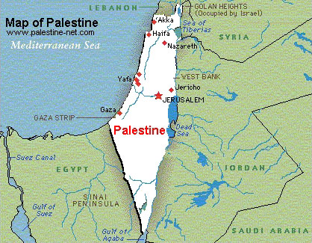
Judges
11-13

Slide 9
Judges
11-13

Slide 10
Judges
11-13
I have given my word ~ literally, I have opened my mouth

Slide 11
Judges
11-13

Slide 12
Judges
11-13
Lament ~ NASB, NIV better – commemorate

Slide 13
Judges
11-13

Slide 14
Judges
11-13
EPHRAIM
GILEAD

Slide 15
Judges
11-13

Slide 16
Judges
11-13
Samson ~ like the sun

Slide 17
Judges
11-13

Slide 18
Gideon ~ Judges 6:12-23
Gideon ~ Judges 6:12-23
Judges
11-13
The Angel of the LORD ~ at least 14 references in the Old Testament
Hagar ~ Gen. 16:7-13
Abraham ~ Gen. 18:1-5, 10ff
Abraham ~ Gen. 22:14-15
Burning bush ~ Ex. 3:2-7, 14
Commander of the Army of the Lord ~ Josh. 5:3-6:2
Gideon ~ Josh. 6:12-23
Manoah and wife ~ Judges 13:8-2

Slide 19
Gideon ~ Judges 6:12-23
Judges
11-13

Slide 20
Gideon ~ Judges 6:12-23
Gideon ~ Judges 6:12-23
Judges
11-13
Nazirite ~ devoted or separated
Usually for a fixed period of time (Mishna 30, 60, 100 days)
Num. 6:1-21
1) Abstained from wine or any contact with grapes
2) Abstained from cutting his hair
3) Abstained from contact with any dead body

Slide 21
Gideon ~ Judges 6:12-23
Judges
11-13

Slide 22
Gideon ~ Judges 6:12-23
Gideon ~ Judges 6:12-23
Judges
11-13
Wonderful ~ supernatural, ineffable
NIV ~ beyond understanding; KJV ~ secret

Slide 23
Gideon ~ Judges 6:12-23
Judges
11-13

Slide 24
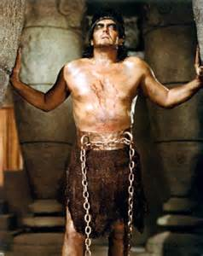
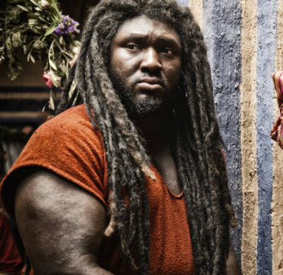
Judges
11-13

Slide 25
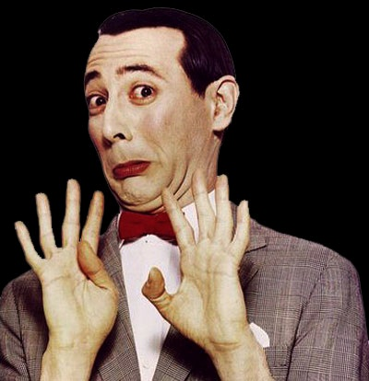
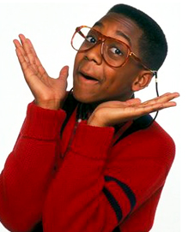
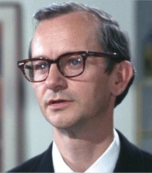
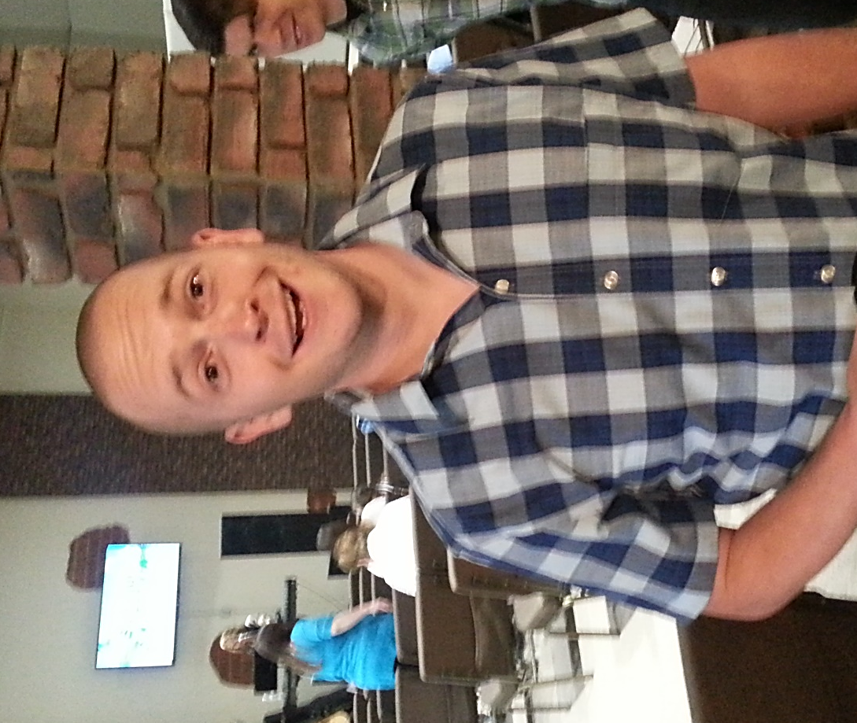
Judges
11-13
Pee-wee Herman
Steve Urkel
Wally Cox

Slide 26
Judges
11-13

