Slide 1
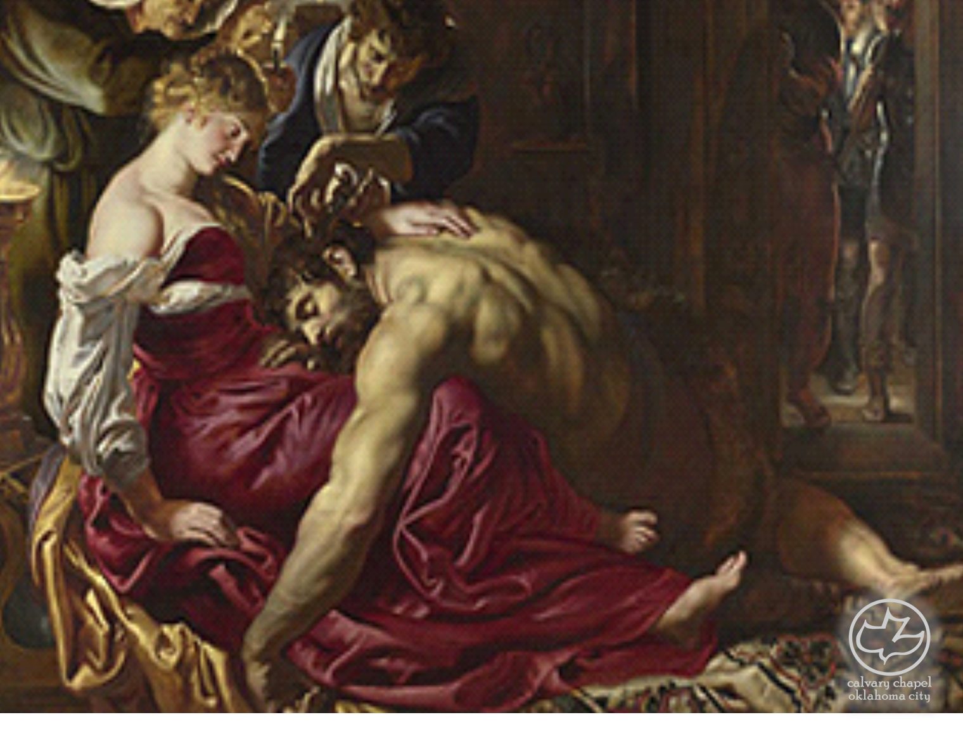
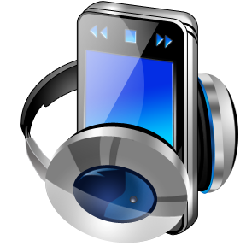
Judges
08-10
A CD of this message will be available (free of charge) immediately following the service.
It will also be available for podcast later this week at calvaryokc.com

Slide 2
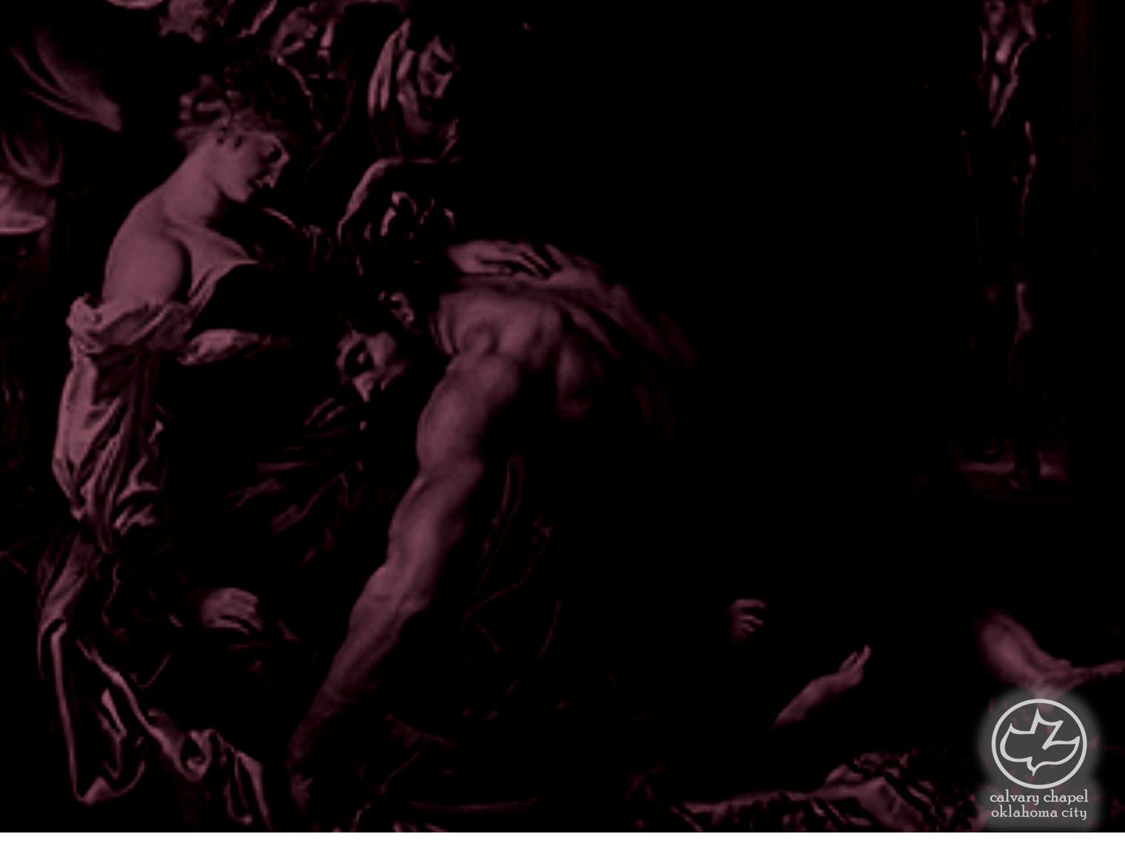
Judges
08-10
From the Ascent of Heres ~ KJV, before the sun was up

Slide 3
Judges
08-10

Slide 4
Judges
08-10
1,700 shekels of gold ~ between $800,000 and $1,000,000 by today's standards ($1278 oz.)

Slide 5
Judges
08-10

Slide 6
Judges
08-10
Abimelech ~ ab (father), i (possessive suffix – my); melech (king)
My father is king

Slide 7
Judges
08-10

Slide 8
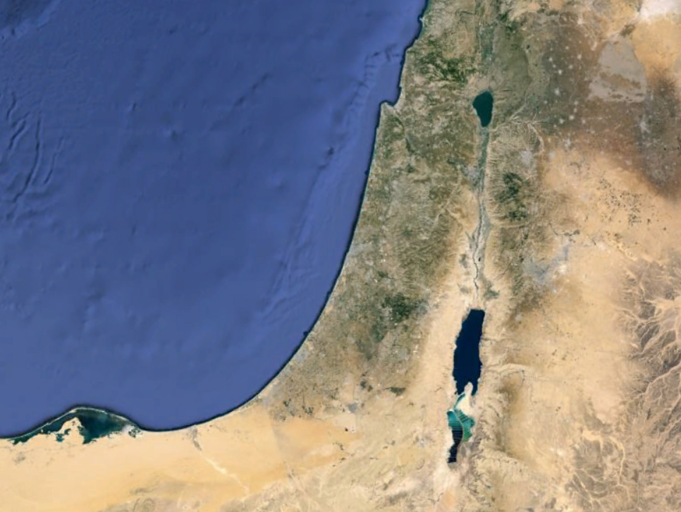
Judges
08-10
Shechem

Slide 9
Judges
08-10

Slide 10
Judges
08-10
All the men ~ ba'als – i.e. the lords of Shechem

Slide 11
Judges
08-10

Slide 12
Judges
08-10
Mt. Ebal
Shechem
Mt. Gerizim

Slide 13
Judges
08-10

Slide 14
Judges
08-10
God ~ elohim – NIV, gods (also in v. 13)

Slide 15
Judges
08-10

Slide 16
Judges
08-10
Spirit of ill will ~ ra' ruach – evil spirit

Slide 17
Judges
08-10

Slide 18
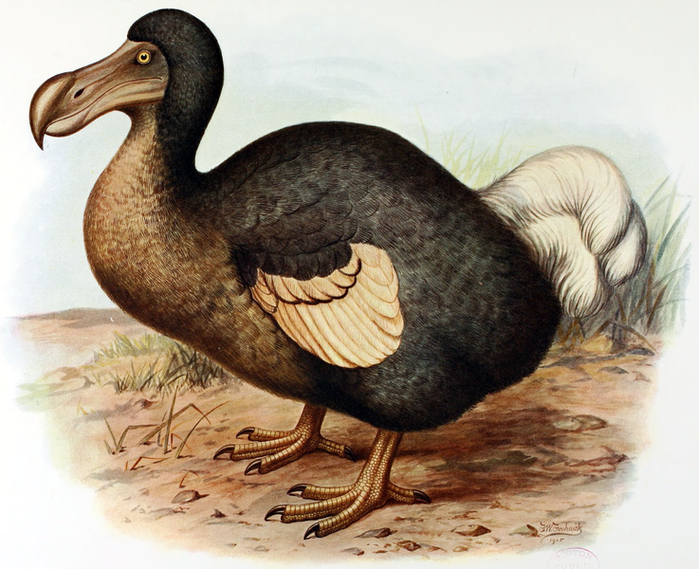
Judges
08-10
Tola ~ worm
Puah ~ splendid
Dodo ~ beloved

Slide 19
Judges
08-10

Slide 20
Judges
08-10
Here Lies Fred
Born
????
died
????
–

Slide 21
Judges
08-10

