Slide 1
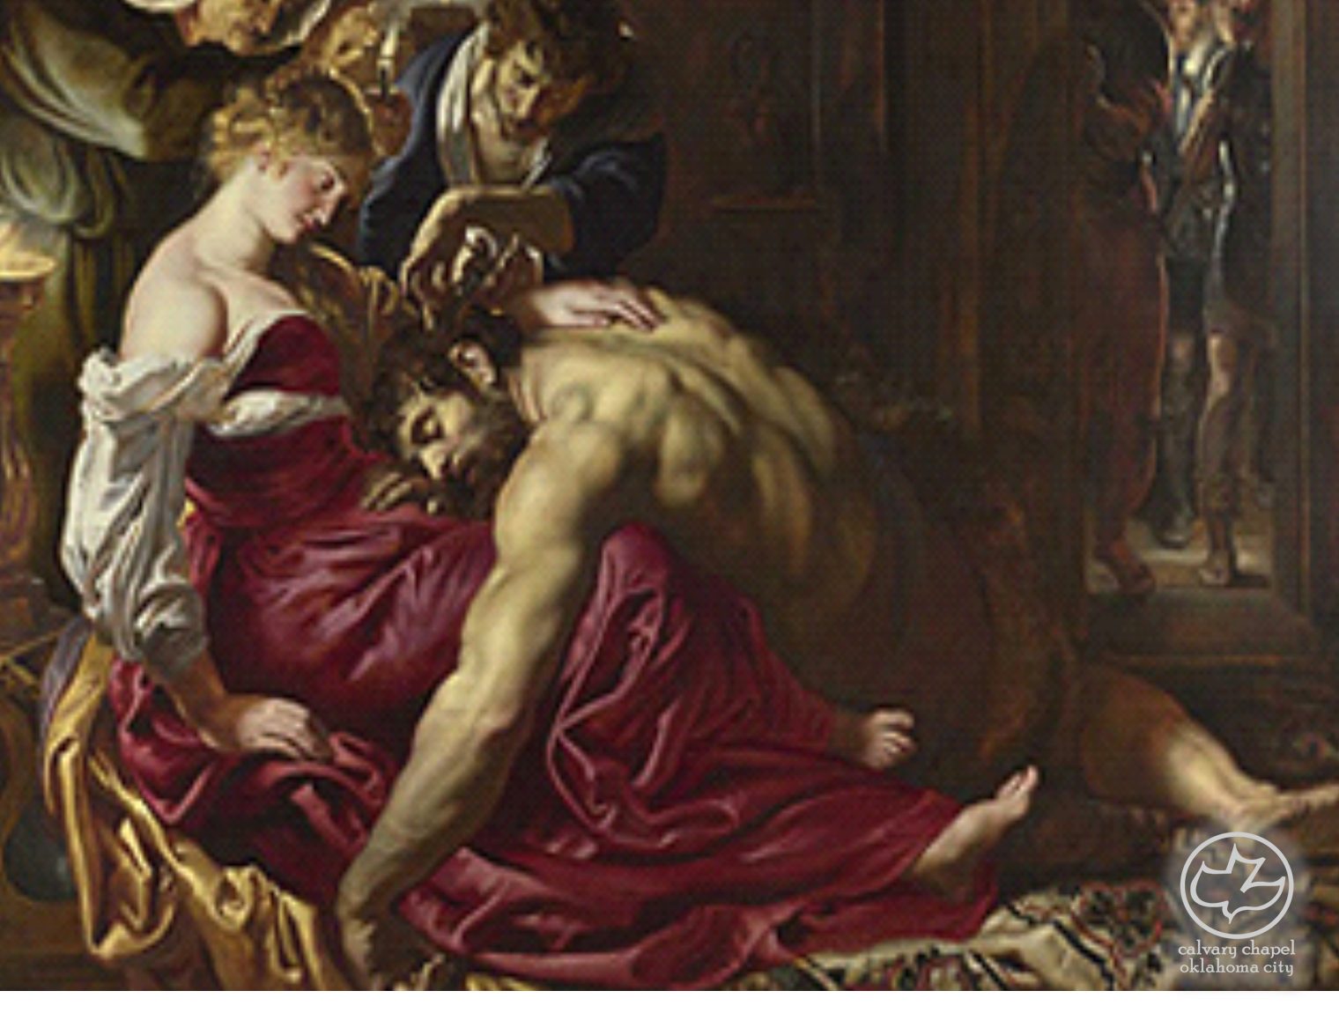

Judges
05-07
A CD of this message will be available (free of charge) immediately following the service.
It will also be available for podcast later this week at calvaryokc.com

Slide 2
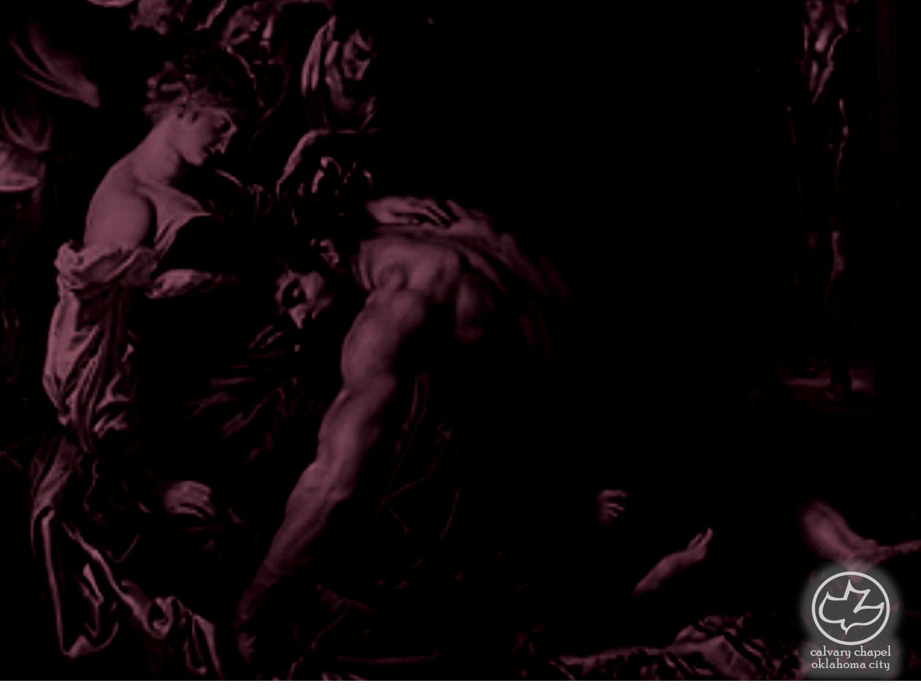
Judges
05-07
Book of Jasher: Josh. 10:13; 2 Sam. 1:18
Book of the Wars of the Lord: Num. 21:14

Slide 3
Judges
05-07

Slide 4
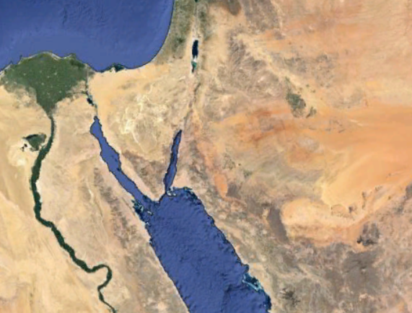
Judges
05-07
Amalekites
Midianites

Slide 5
Judges
05-07

Slide 6
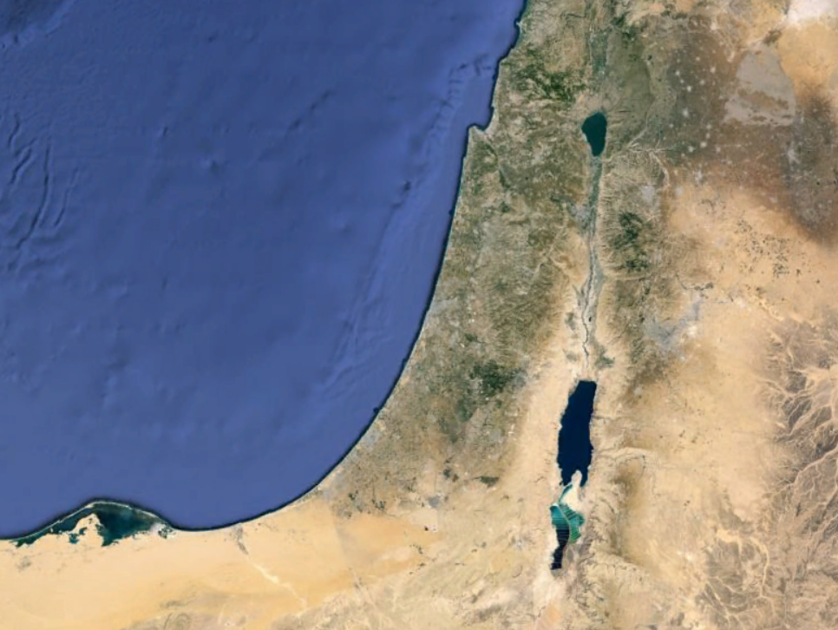
Judges
05-07
Ophrah
Kishon River

Slide 7
Judges
05-07

Slide 8
Judges
05-07
LORD ~ the Tetragrammaton –Yahweh

Slide 9
Judges
05-07

Slide 10
Judges
05-07
2 Cor. 12:9-10 ~ ⁹ And He said to me, "My grace is sufficient for you, for My strength is made perfect in weakness." Therefore most gladly I will rather boast in my infirmities, that the power of Christ may rest upon me. ¹⁰ Therefore I take pleasure in infirmities, in reproaches, in needs, in persecutions, in distresses, for Christ's sake. For when I am weak, then I am strong.

Slide 11
Judges
05-07

Slide 12
Judges
05-07
Jerubbaal ~ let Baal contend

Slide 13
Judges
05-07

Slide 14
Judges
05-07
Came upon ~ literally clothed

Slide 15
Judges
05-07

Slide 16
Judges
01-02
Harod Springs
Kishon River

Slide 17
Judges
05-07

Slide 18
Judges
05-07
135,000 Midianites vs.
32,000 Israelites
4:1 odds
135,000 Midianites vs.
10,000 Israelites
14:1 odds

Slide 19
Judges
05-07
May 14, 1948 ~ Rebirth of the State of Israel
War for Independence, 1948-49
1/2 million Israelis vs. 40 million Arabs
By July 1949, Israel occupied 2/3 more territory than before

Slide 20
Judges
05-07
May, 1967 6-day war (outnumbered 20:1)
Egypt heavily armed by Soviets
Expanded from 8,000 sq mi to 34, 000 sq mi
Jerusalem under complete Jewish control for 1st time in over 2,000 years

Slide 21
Judges
05-07
Oct. 6, 1973 (Yom Kippur) War
Outnumbered 12:1
Egypt, Syria, Iraq, Jordan, Algeria, Morocco, Kuwait, hand Saudi Arabia
6x more land than in 1948

Slide 22
Judges
05-07

Slide 23
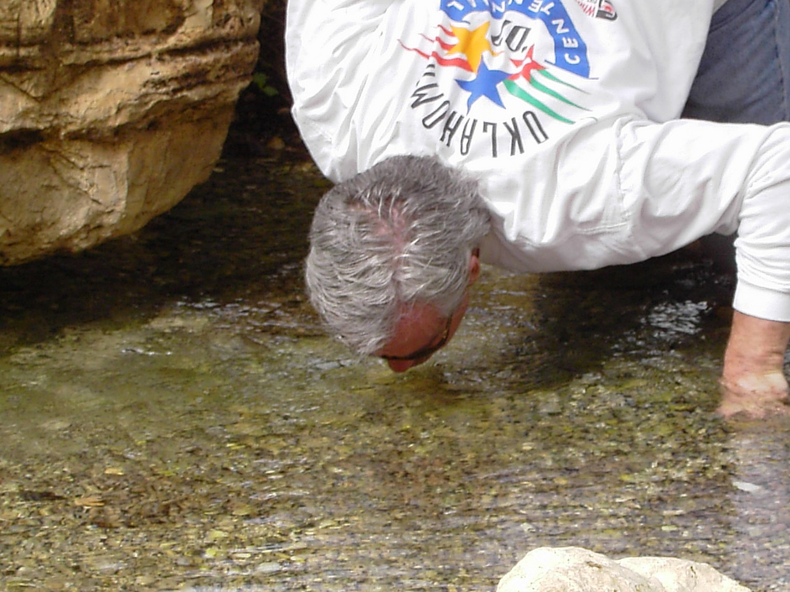
Judges
05-07

Slide 24
Judges
05-07

Slide 25
Judges
05-07
1 John 4:4b ~ …because He who is in you is greater than he who is in the world.

Slide 26
Judges
05-07

