Slide 1
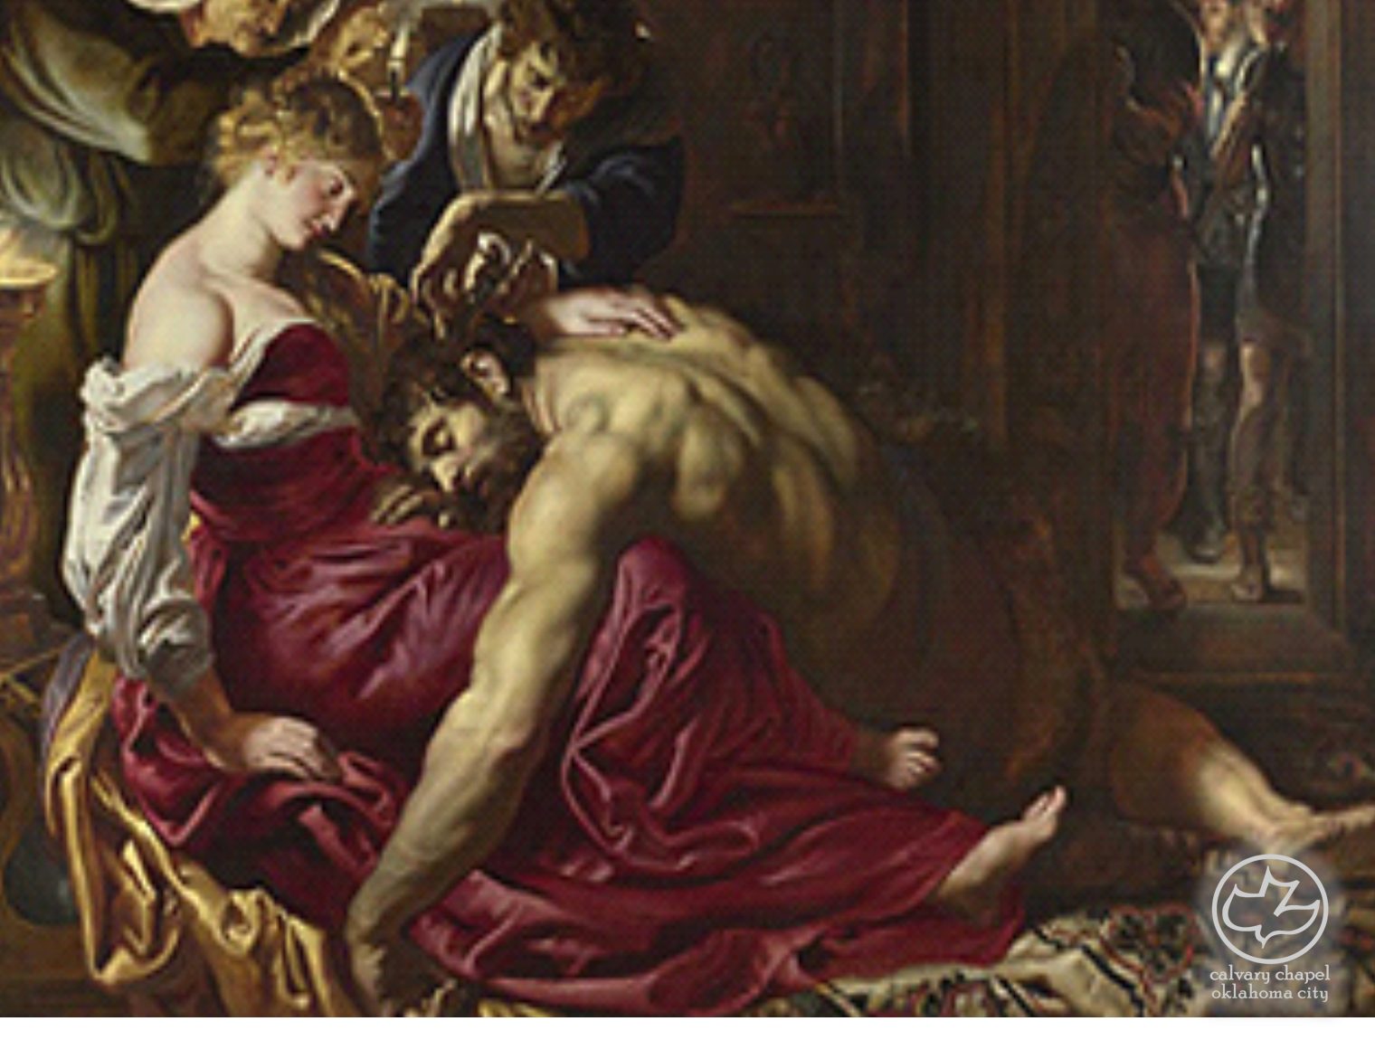

Judges
03-04
A CD of this message will be available (free of charge) immediately following the service.
It will also be available for podcast later this week at calvaryokc.com

Slide 2
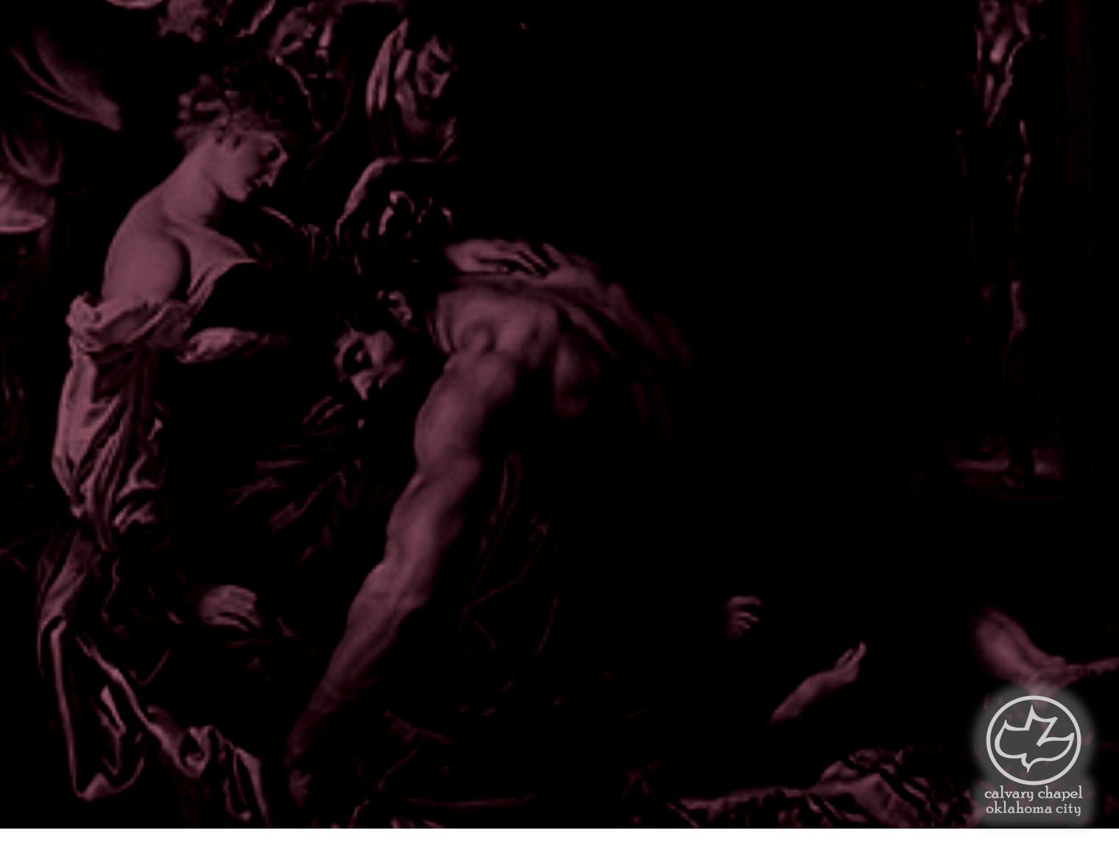
Judges
03-04
Warren Wiersbe ~ "When God goes to war, He usually chooses the most unlikely soldiers, hands them the most unusual weapons, and accomplishes through them the most unpredictable results."

Slide 3
Judges
03-04

Slide 4
Judges
03-04
The ABCs of backsliding
Abiding with the pagans
Becoming unequally yoked in marriage
Consecrating to their gods

Slide 5
Judges
03-04
1350
1300
1250
1200
1150
Othniel 1382-1386 BC
Ehud 1328-1313 BC
Deborah 1293-1257 BC
Gideon 1250-1214 BC
Abimelech 1213-1211 BC
Tola 1210-1190 BC
Jair 1189-1170 BC
Jephthah 1152-1147 BC
Ibzan 1146-1141 BC
Elon 1140-1131 BC
Abdon 1130-1123 BC
Samson 1122-1105 BC

Slide 6
Judges
03-04

Slide 7
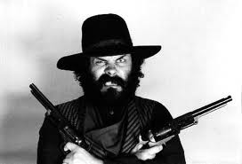
Judges
03-04
Cushan-Rishathaim ~ Darkness of the double wickedness

Slide 8
Judges
03-04

Slide 9
Judges
03-04
Midrash (rabbinic expansion on the Hebrew Scriptures):
Balak
Ehud
Ruth and Orpah

Slide 10
Judges
03-04

Slide 11
Judges
03-04
Left-handed ~ literally, impeded in the use of the right hand

Slide 12
Judges
03-04

Slide 13
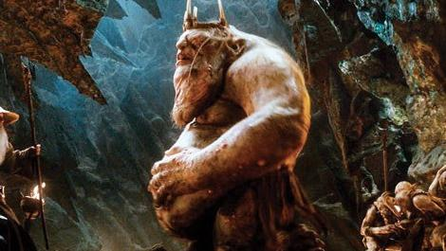
Judges
03-04

Slide 14
Judges
03-04

Slide 15
Judges
03-04
Entrails ~ KJV, dirt – related to the word for crotch
Adam Clarke ~ "This is variously understood: either the contents of the bowels issued through the wound, or he had an evacuation in the natural way through the fright and anguish."

Slide 16
Judges
03-04

Slide 17
Judges
03-04
Harosheth ~ to cut or carve
Hagoyim ~ the Gentiles

Slide 18
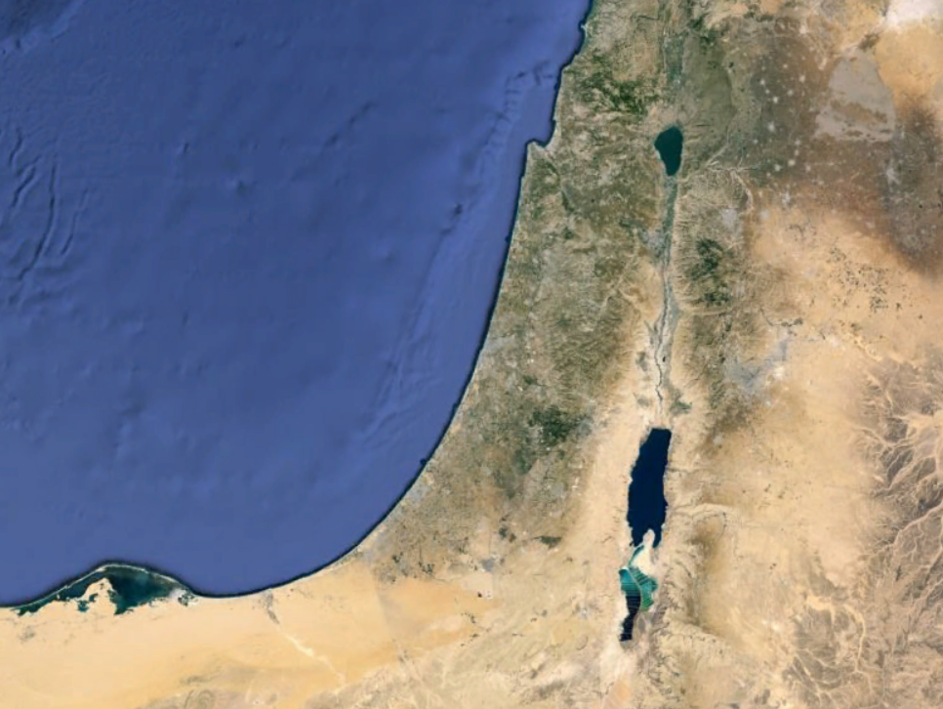
Judges
03-04
Haroseth-Hagoyim
Kishon River

Slide 19
Judges
03-04

Slide 20


Judges
03-04
"Passive Men and the Women Who Pacify Them" – the next Dr. Phil

Slide 21
Judges
03-04

Slide 22
Judges
03-04
NAPHTALI
ZEBULON
Mt. Tabor
ISSACHAR

Slide 23
Judges
03-04

Slide 24
Judges
03-04
Heb. 11:32 ~ And what more shall I say? For the time would fail me to tell of Gideon and Barak and Samson and Jephthah, also of David and Samuel and the prophets:

Slide 25
Judges
03-04

Slide 26
Judges
03-04
NIV ~ Hobab, Moses' brother-in-law
Literally, in-law

Slide 27
Judges
03-04

Slide 28
Judges
03-04
Routed ~ KJV, discomfited

Slide 29
Judges
03-04

Slide 30
Judges
03-04
cf. 5:21 ~ The torrent of Kishon swept them away,

Slide 31
Judges
03-04

