Slide 1
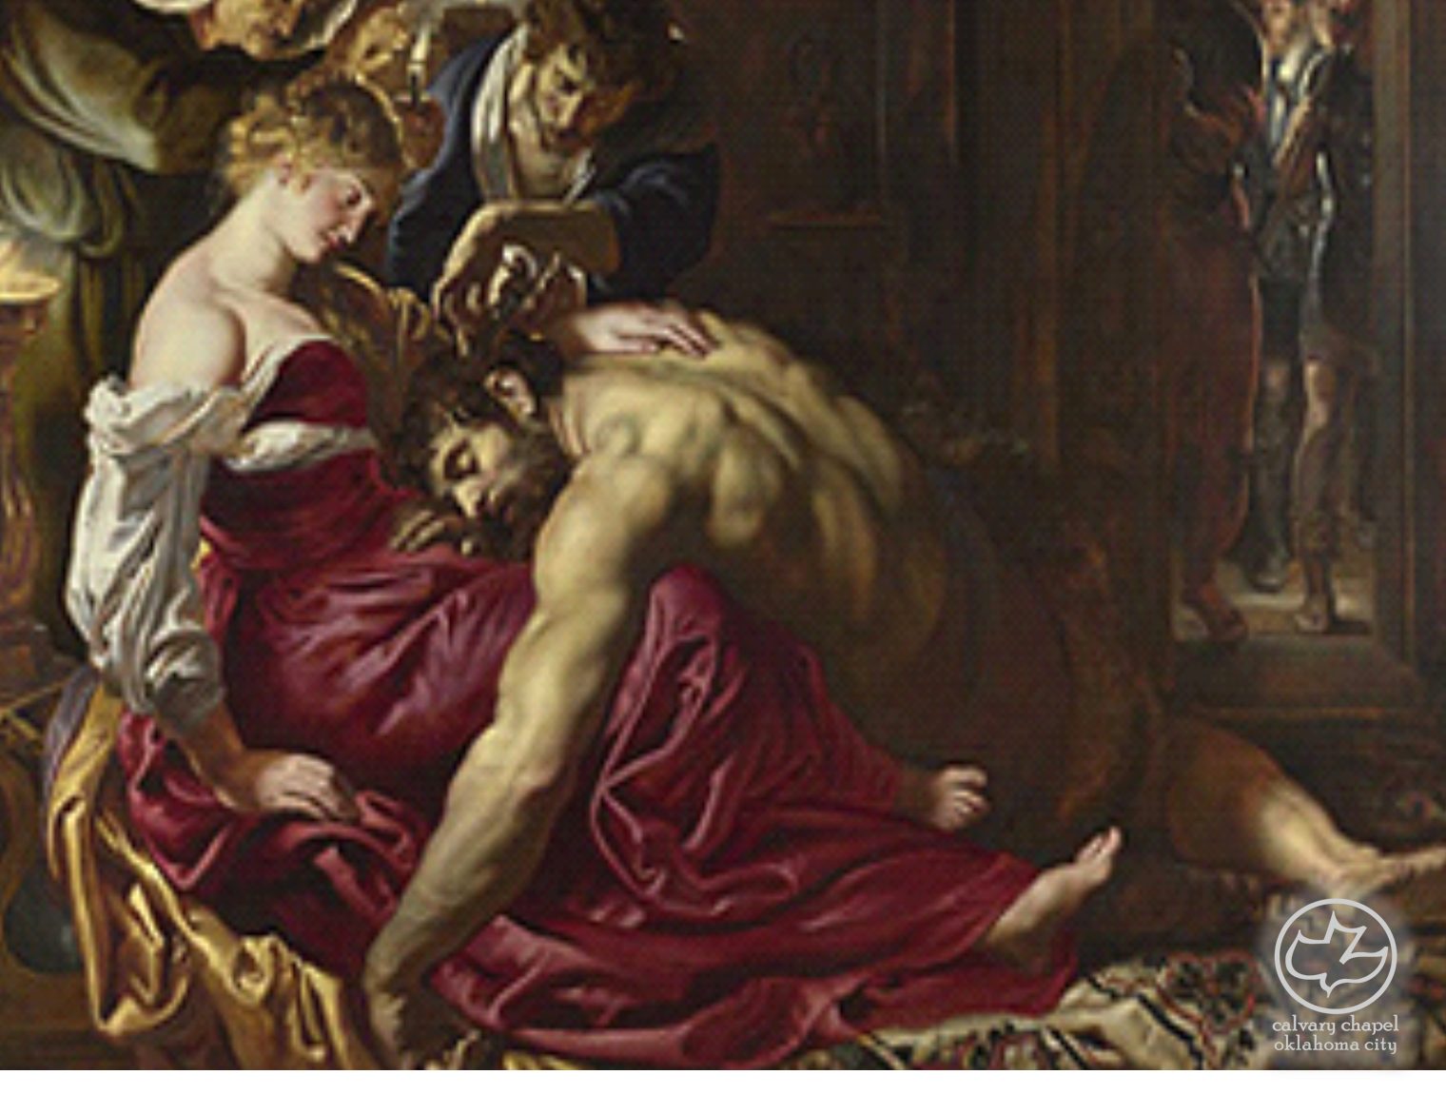

Judges
01-02
A CD of this message will be available (free of charge) immediately following the service.
It will also be available for podcast later this week at calvaryokc.com

Slide 2
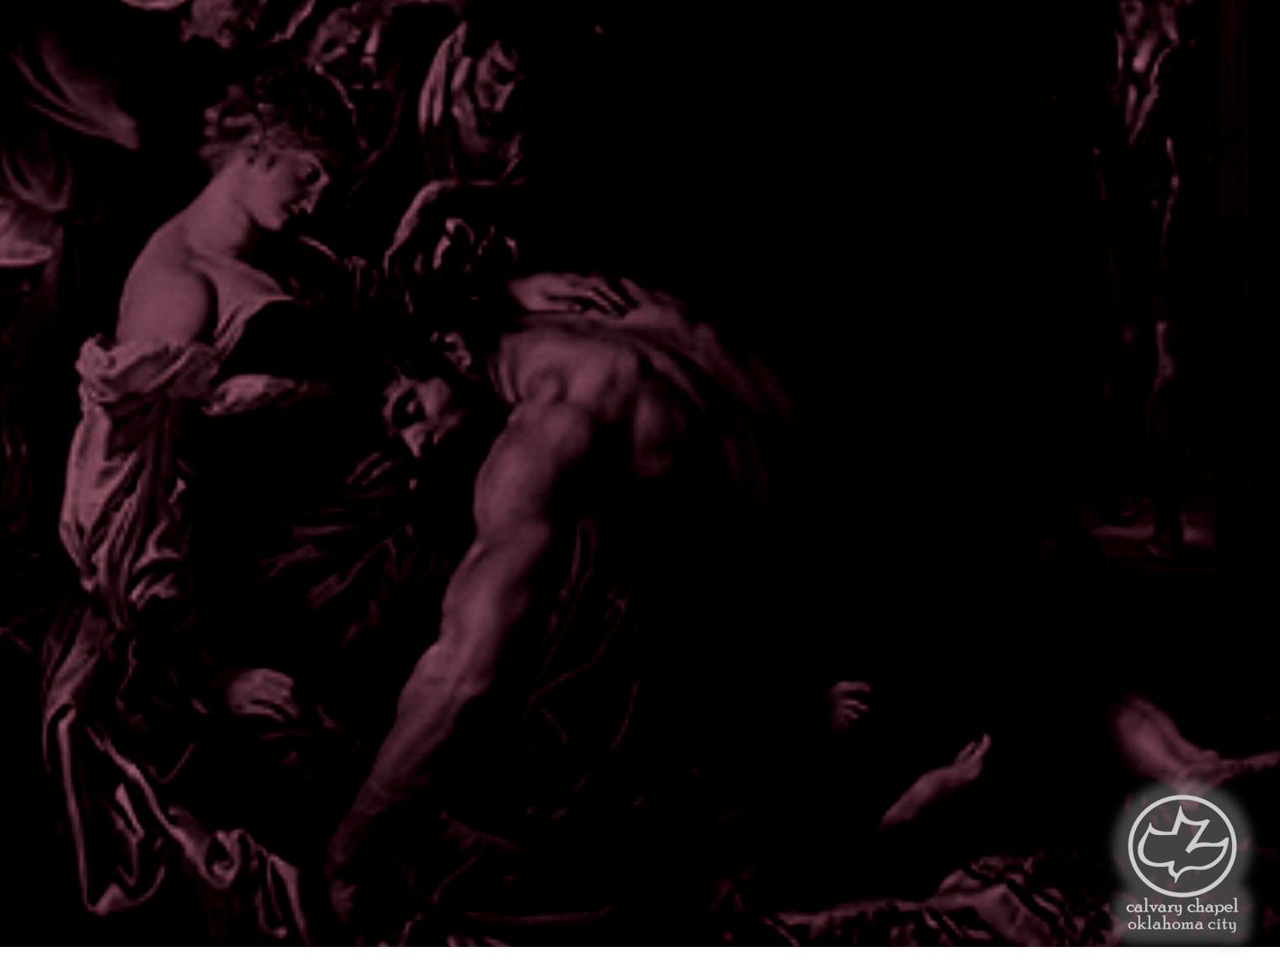
Judges
01-02
Charles Dickens, A Tale of Two Cities ~ "It was the best of times, it was the worst of times, it was the age of wisdom, it was the age of foolishness, it was the epoch of belief, it was the epoch of incredulity, it was the season of Light, it was the season of Darkness, it was the spring of hope, it was the winter of despair, we had everything before us, we had nothing before us, we were all going direct to heaven, we were all going direct the other way - in short, the period was so far like the present period,

Slide 3
Judges
01-02
that some of its noisiest authorities insisted on its being received, for good or for evil, in the superlative degree of comparison only."

Slide 4
Judges
01-02
Acts 13:20 ~ After that He gave them judges for about four hundred and fifty years, until Samuel the prophet.
Hebrew ~ shaphat – to save, deliver or avenge

Slide 5
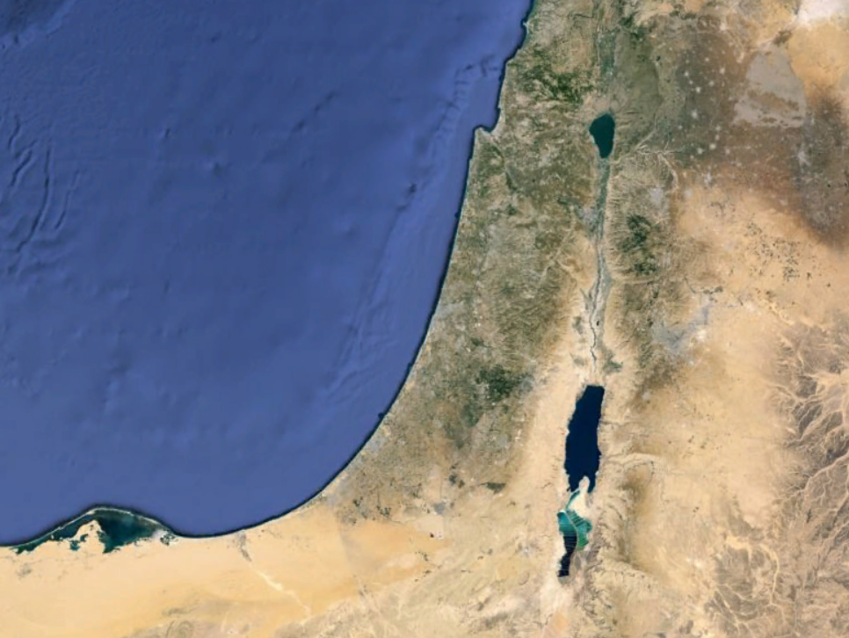
Judges
01-02
NAPHTALI
ASHER
ZEBULON
MANASSEH
ISSACHAR
MANASSEH
EPHRAIM
DAN
GAD
BENJAMIN
JUDAH
REUBEN
SIMEON

Slide 6
Judges
01-02

Slide 7
Judges
01-02
God ~ elohim – maybe the gods?

Slide 8
Judges
01-02
Bezek
Ekron
Jerusalem
Askelon
Hebron
Gaza
Debir

Slide 9
Judges
01-02
Among ~ qereb – inward parts

Slide 10
Judges
01-02

Slide 11
Judges
01-02
KJV, an angel of the Lord

Slide 12
Judges
01-02

Slide 13
Judges
01-02
Know ~ yada – to consider, comprehend, acknowledge
Prov. 3:6 ~ In all your ways acknowledge Him,
And He shall direct your paths.

Slide 14
Judges
01-02

Slide 15
Judges
01-02
James 4.4b ~ Do you not know that friendship with the world is enmity with God?

Slide 16
Judges
01-02

Slide 17
Judges
01-02
Retribution
Rebellion
Repentance
Rest
Restoration

Slide 18
Judges
01-02

Slide 19
Judges
01-02
Jer. 29:11–14 ~ ¹¹ For I know the thoughts that I think toward you, says the Lord, thoughts of peace and not of evil, to give you a future and a hope. ¹² Then you will call upon Me and go and pray to Me, and I will listen to you. ¹³ And you will seek Me and find Me, when you search for Me with all your heart. ¹⁴ I will be found by you, says the Lord, and I will bring you back from your captivity; I will gather you from all the nations and from all the places where I have driven you, says the Lord, and I will bring you to the place from which I cause you to be carried away captive.

Slide 20
Judges
01-02

