Slide 1


Slide 2
Judges 15:2
Her father said, "I really thought that you thoroughly hated her; therefore I gave her to your companion. Is not her younger sister better than she? Please, take her instead."

Slide 3
Thoroughly Hated Her
Saw-nay'
- to hate (personally): enemy, foe, odious, utterly

Slide 4
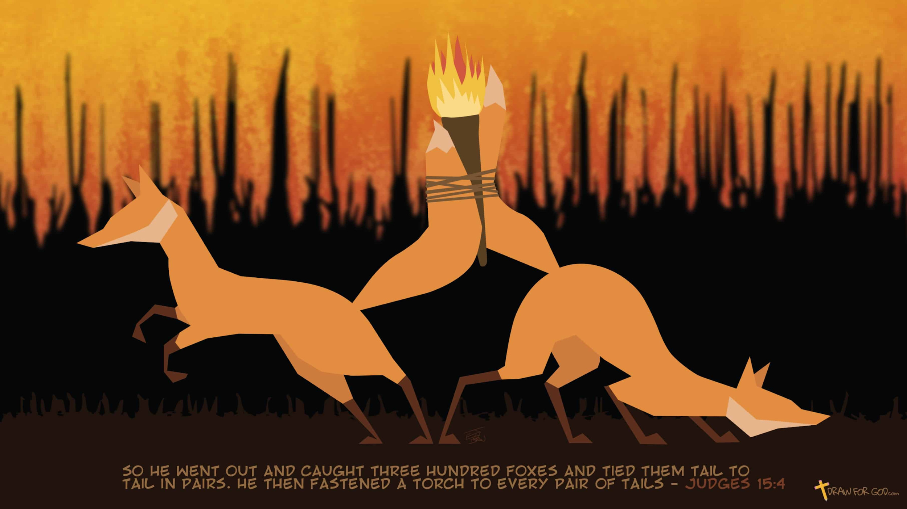

Slide 5


Slide 7
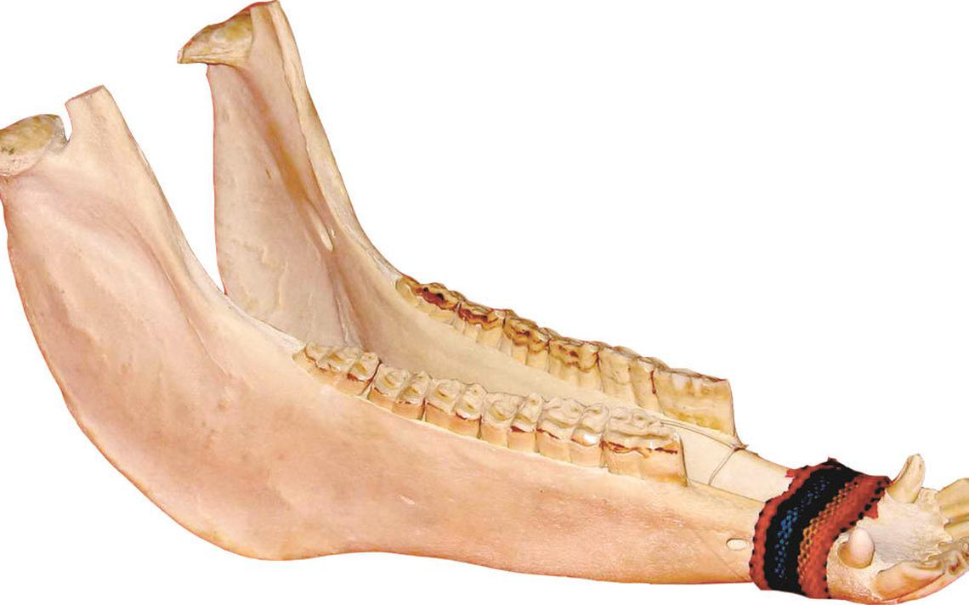

Slide 8
Romans 8:11
But if the Spirit of Him who raised Jesus from the dead dwells in you,
He who raised Christ from the dead will also give life to your mortal bodies through His Spirit who dwells in you.

Slide 10
so he cried out to the LORD
Samson’s first prayer

Slide 11
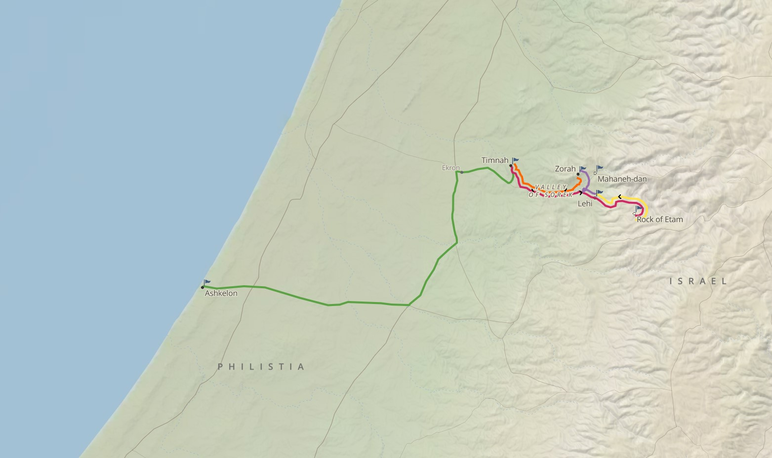

Slide 12
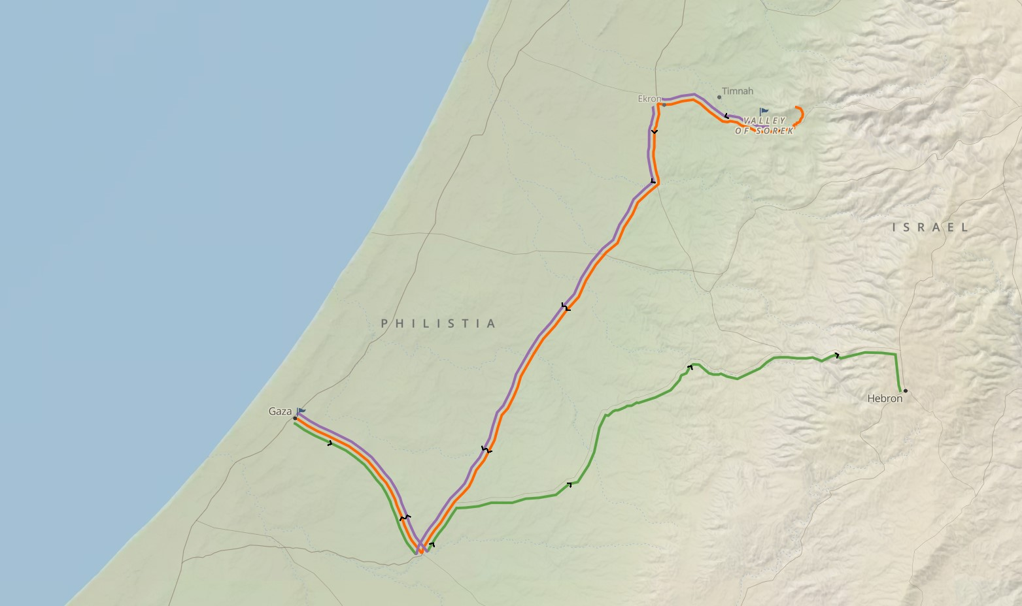

Slide 13
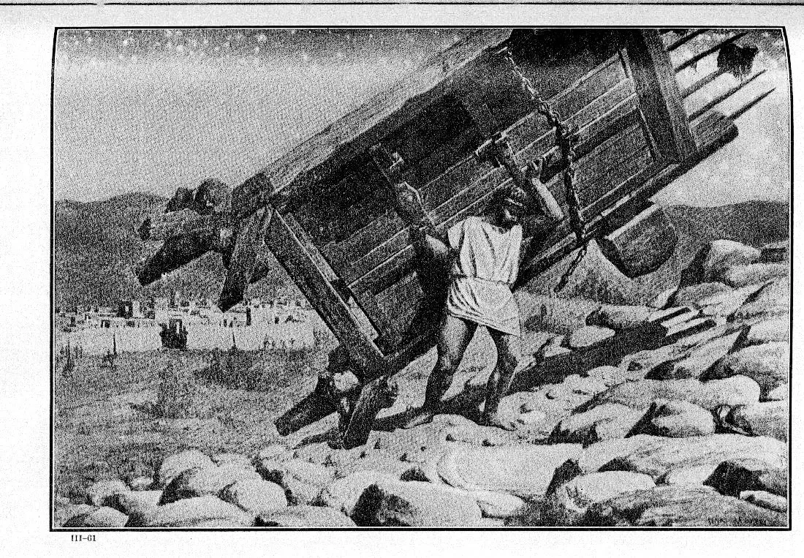

Slide 14
Afflict
aw-naw'
- to be afflicted, humbled, surrender, to put down, become low

Slide 15
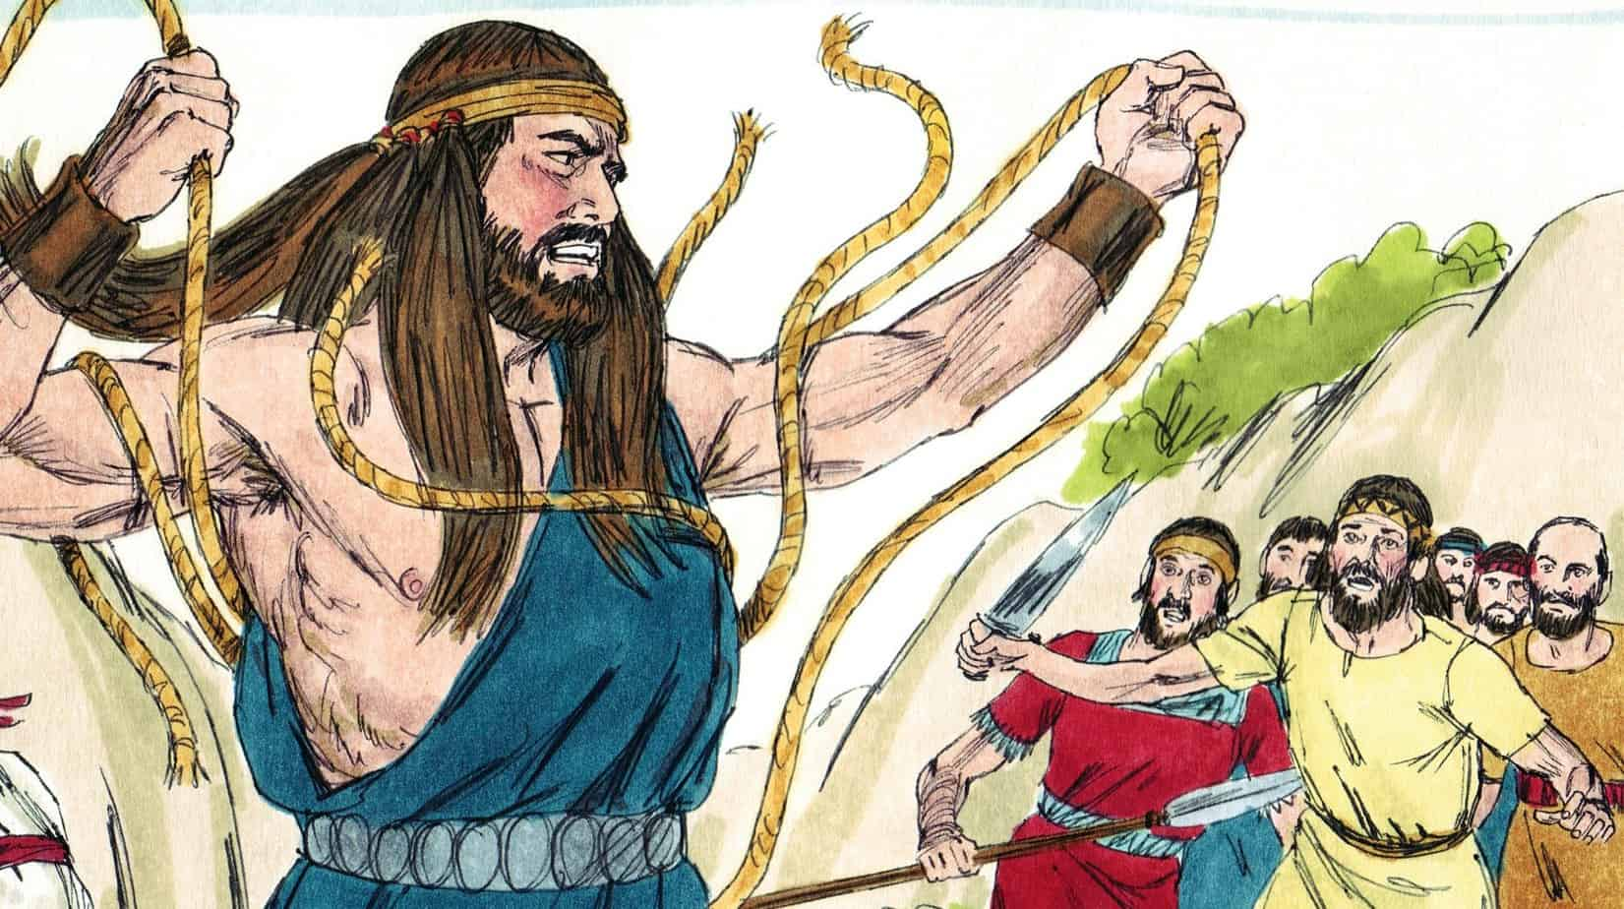

Slide 16
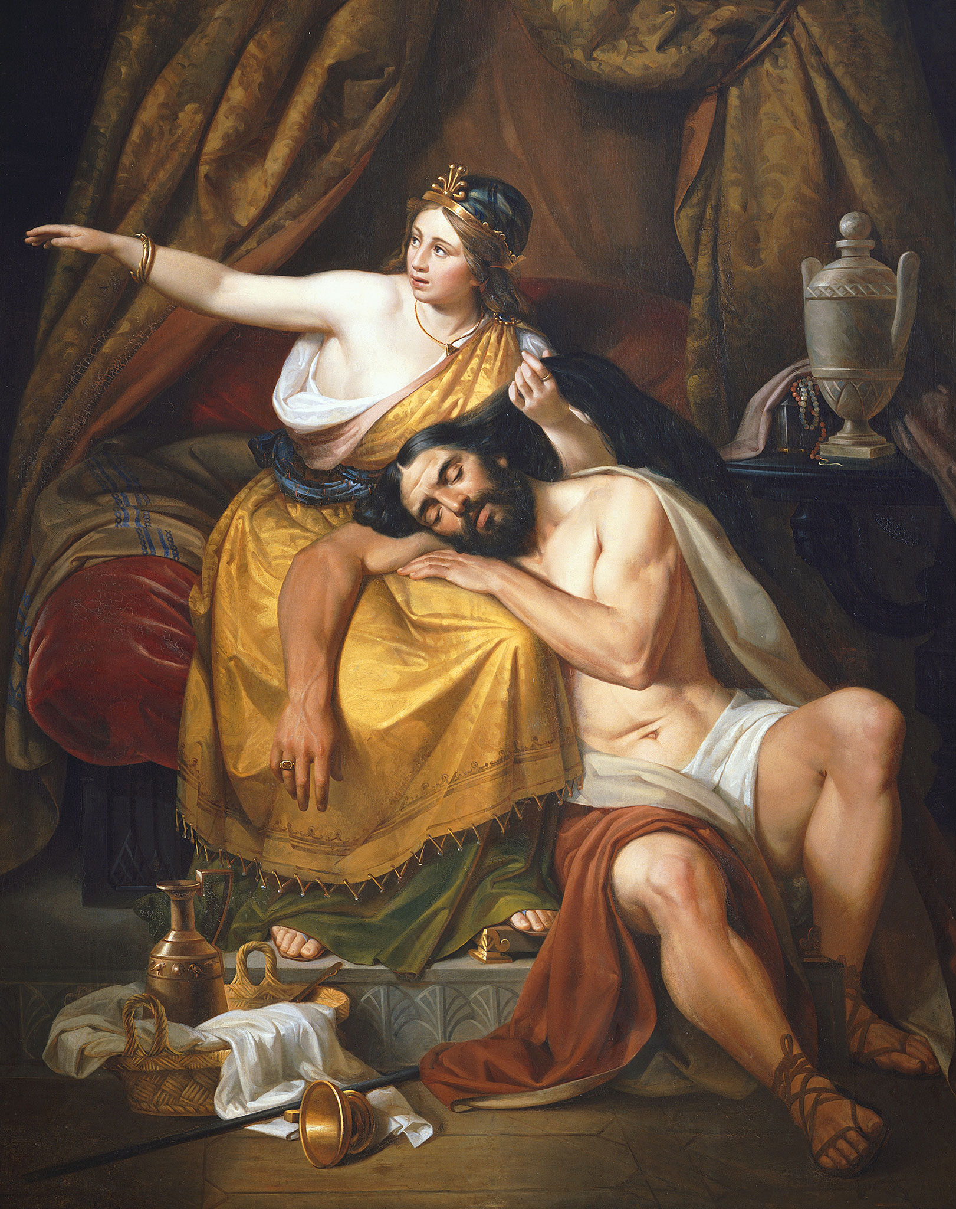

Slide 17
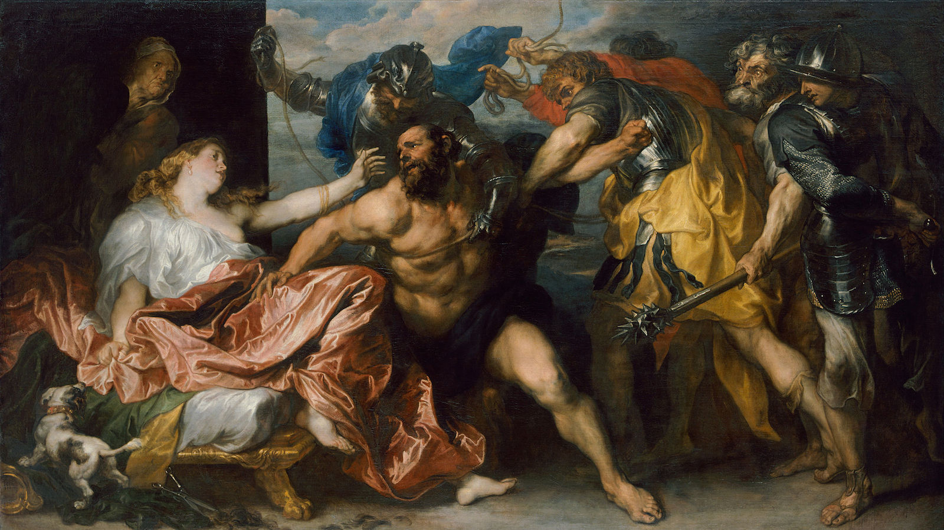

Slide 18
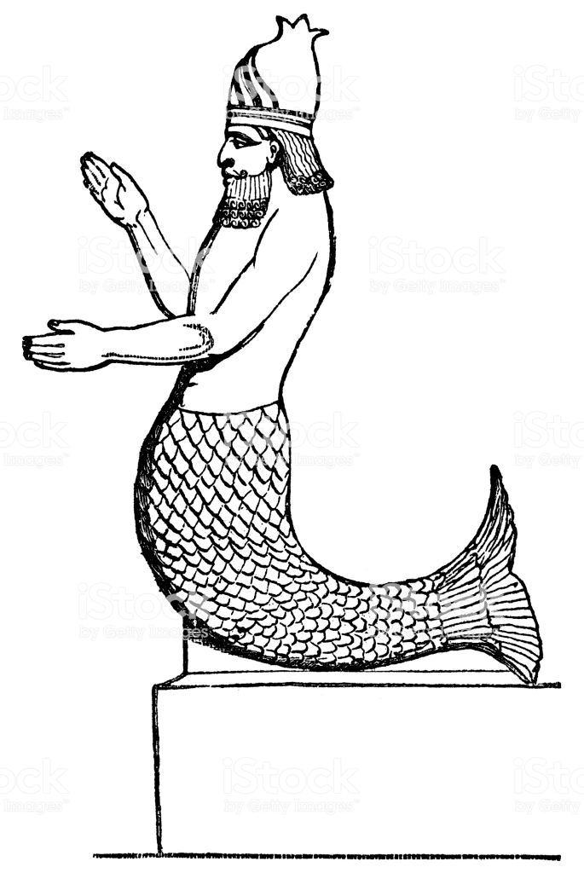

Slide 19


Slide 20
Judges 16:28
"O Lord GOD, remember me, I pray! Strengthen me, I pray, just this once, O God, that I may with one blow take vengeance on the Philistines for my two eyes!"

