Slide 2
JUDGES 6-8
GIDEON

Slide 3
Circle of Death… again
5
1
4
2
3

Slide 4
Judges so far
Othniel - Descendant of Caleb, brave warrior
Ehud - Spy
Shamgar - Farmer Ninja
Deborah - Prophetess, mother of Israel

Slide 5
Judges 6:11
Now the Angel of the LORD...

Slide 6
The Angel of the LORD
Jos 5:13 And it came to pass, when Joshua was by Jericho, that he lifted his eyes and looked, and behold, a Man stood opposite him with His sword drawn in His hand. And Joshua went to Him and said to Him, "Are You for us or for our adversaries?"
Jos 5:14 So He said, "No, but as Commander of the army of the LORD I have now come." And Joshua fell on his face to the earth and worshiped, and said to Him, "What does my Lord say to His servant?"
Jos 5:15 Then the Commander of the LORD's army said to Joshua, "Take your sandal off your foot, for the place where you stand is holy." And Joshua did so.

Slide 7
Now the Angel of the LORD came & sat under the terebinth at Ophrah, which belonged to Joash the Abiezrite, while his son Gideon was beating out wheat in the winepress to hide it from the Midianites.

Slide 8
“Doubt is a pain too lonely to know
that faith is his twin brother.”
-Khalil Gibran

Slide 9
“We can easily forgive a child who is afraid of the dark; the real tragedy of life is when men are afraid of the light.”
— Plato

Slide 10
“Your faith can move mountains & your doubt can create them.” - Anonymous

Slide 11
Mat 21:21
So Jesus answered and said to them, "Assuredly, I say to you, if you have faith and do not doubt, you will not only do what was done to the fig tree, but also if you say to this mountain, 'Be removed and be cast into the sea,' it will be done.

Slide 12
FEAR:
“False Evidence Appearing Real”

Slide 13
“Fear is pain arising from
the anticipation of evil.”
— Aristotle

Slide 14
“I learned that courage was not the absence of fear, but the triumph over it.
The brave man is not he who does not feel afraid, but he who conquers that fear.”
— Nelson Mandela

Slide 15
Judges 6:12
And the Angel of the LORD appeared to him, and said to him, "The LORD is with you, you mighty man of valor!"

Slide 16
Jdg 6:14 Then the LORD turned to him and said, "Go in this might of yours, and you shall save Israel from the hand of the Midianites. Have I not sent you?"

Slide 17
2Peter 1:3
His divine power has given to us all things that pertain to life and godliness

Slide 18
1- through the knowledge of Him who called us by glory and virtue,
2- by which have been given to us exceedingly great and precious promises
3- that through these you may be partakers of the divine nature
4- having escaped the corruption that is in the world through lust.

Slide 19
Trying to convince God why His plans won’t work
=
your plan includes me, and I don’t believe

Slide 20
"But I will be with you”

Slide 21
Rom 8:31 What then shall we say to these things? If God is for us, who can be against us?

Slide 22
Judges 6:23
But the LORD said to him,
"Peace be to you.
Do not fear;
you shall not die."

Slide 23
Jdg 6:34 But the Spirit of the LORD clothed Gideon, and he sounded the trumpet, and the Abiezrites were called out to follow him.

Slide 24
Military Matchup
Midianite Army = 135,000
Israel’s Army = 32,000
(23% 1:4+ ratio)

Slide 25
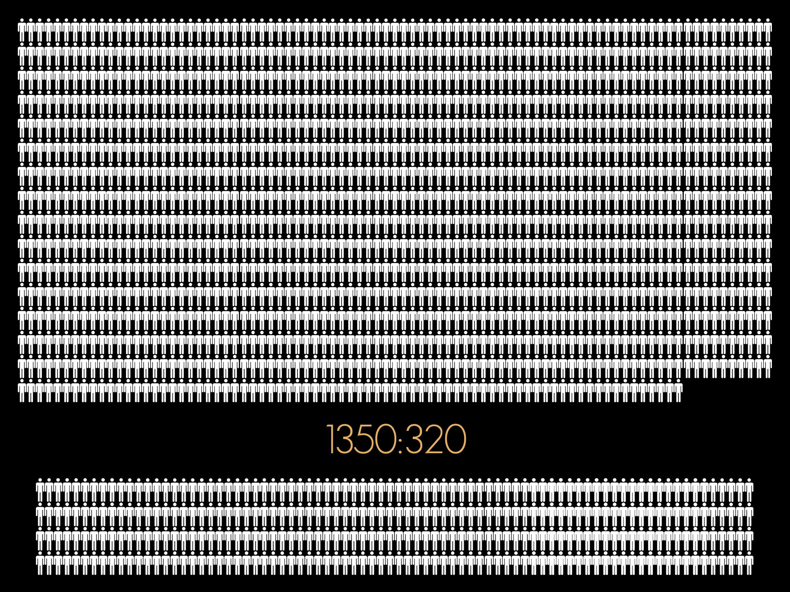

Slide 26
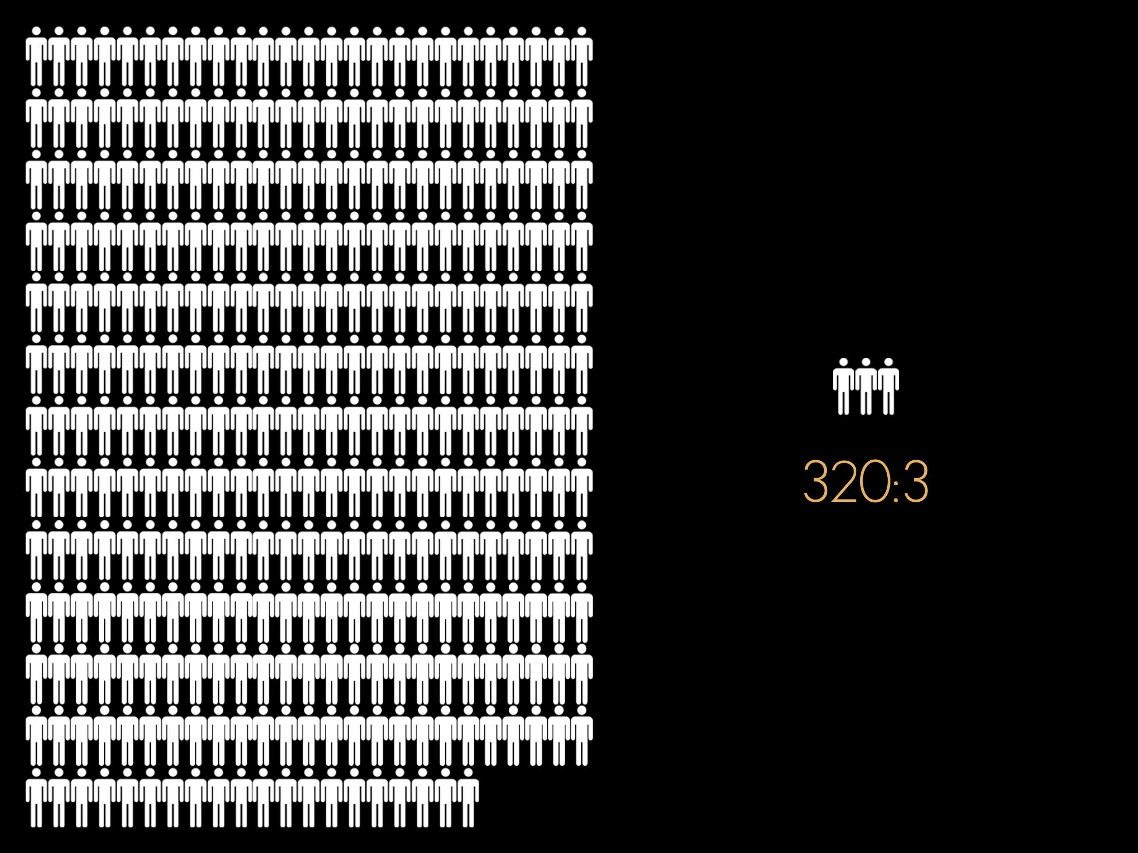

Slide 27
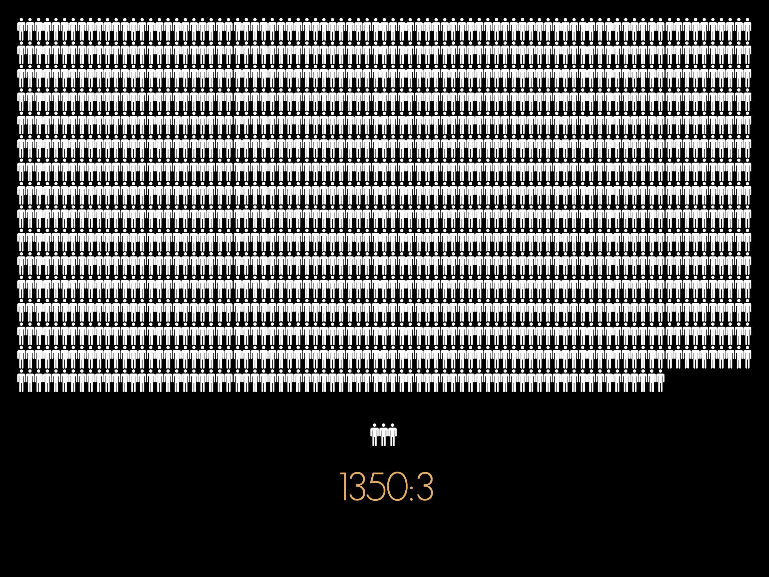

Slide 28
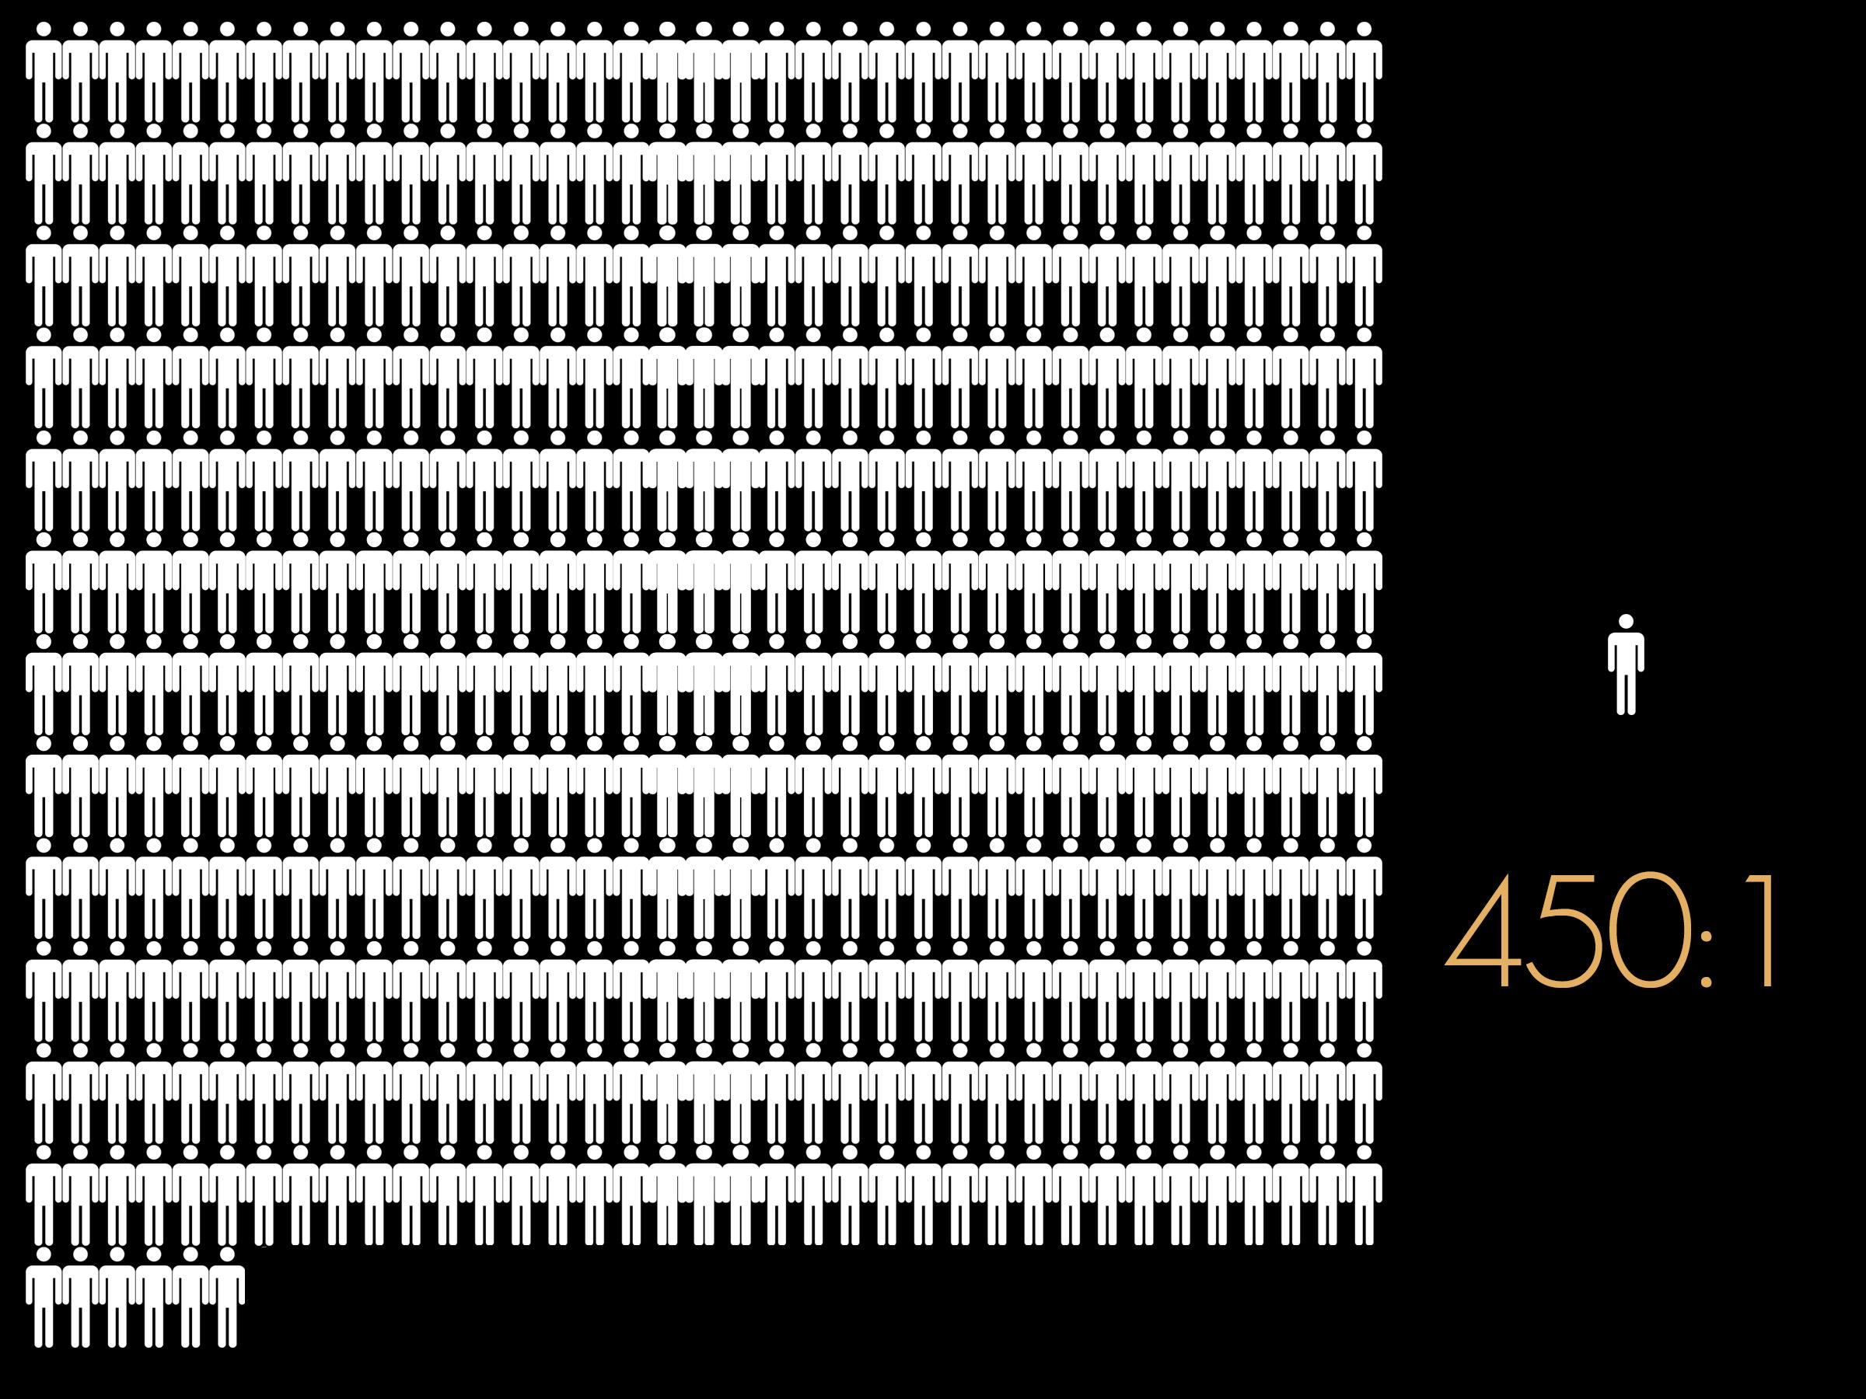

Slide 29
Judges 6:16
...you shall strike the Midianites as one man."

Slide 30
Jdg 7:15 As soon as Gideon heard the telling of the dream and its interpretation, he worshiped. And he returned to the camp of Israel and said, "Arise, for the LORD has given the host of Midian into your hand."

Slide 31
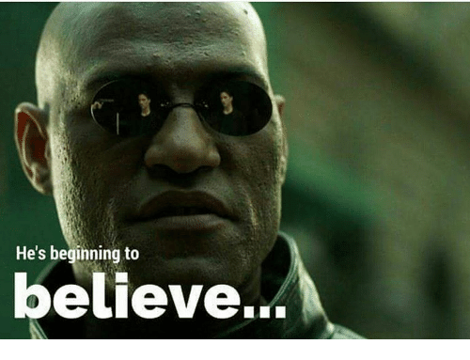

Slide 33
God’s Answer To Prayer
1 - Yes
2 - No
3 - Not yet
4 - I’ve got a better idea

Slide 34
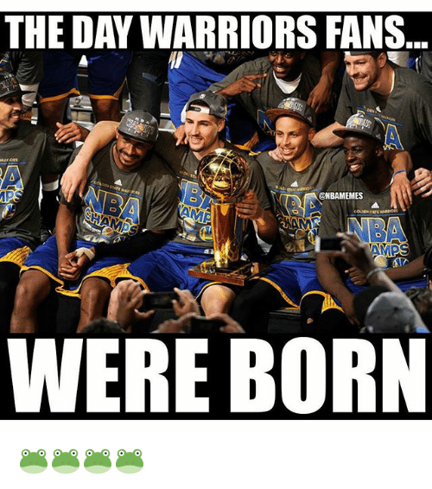

Slide 35
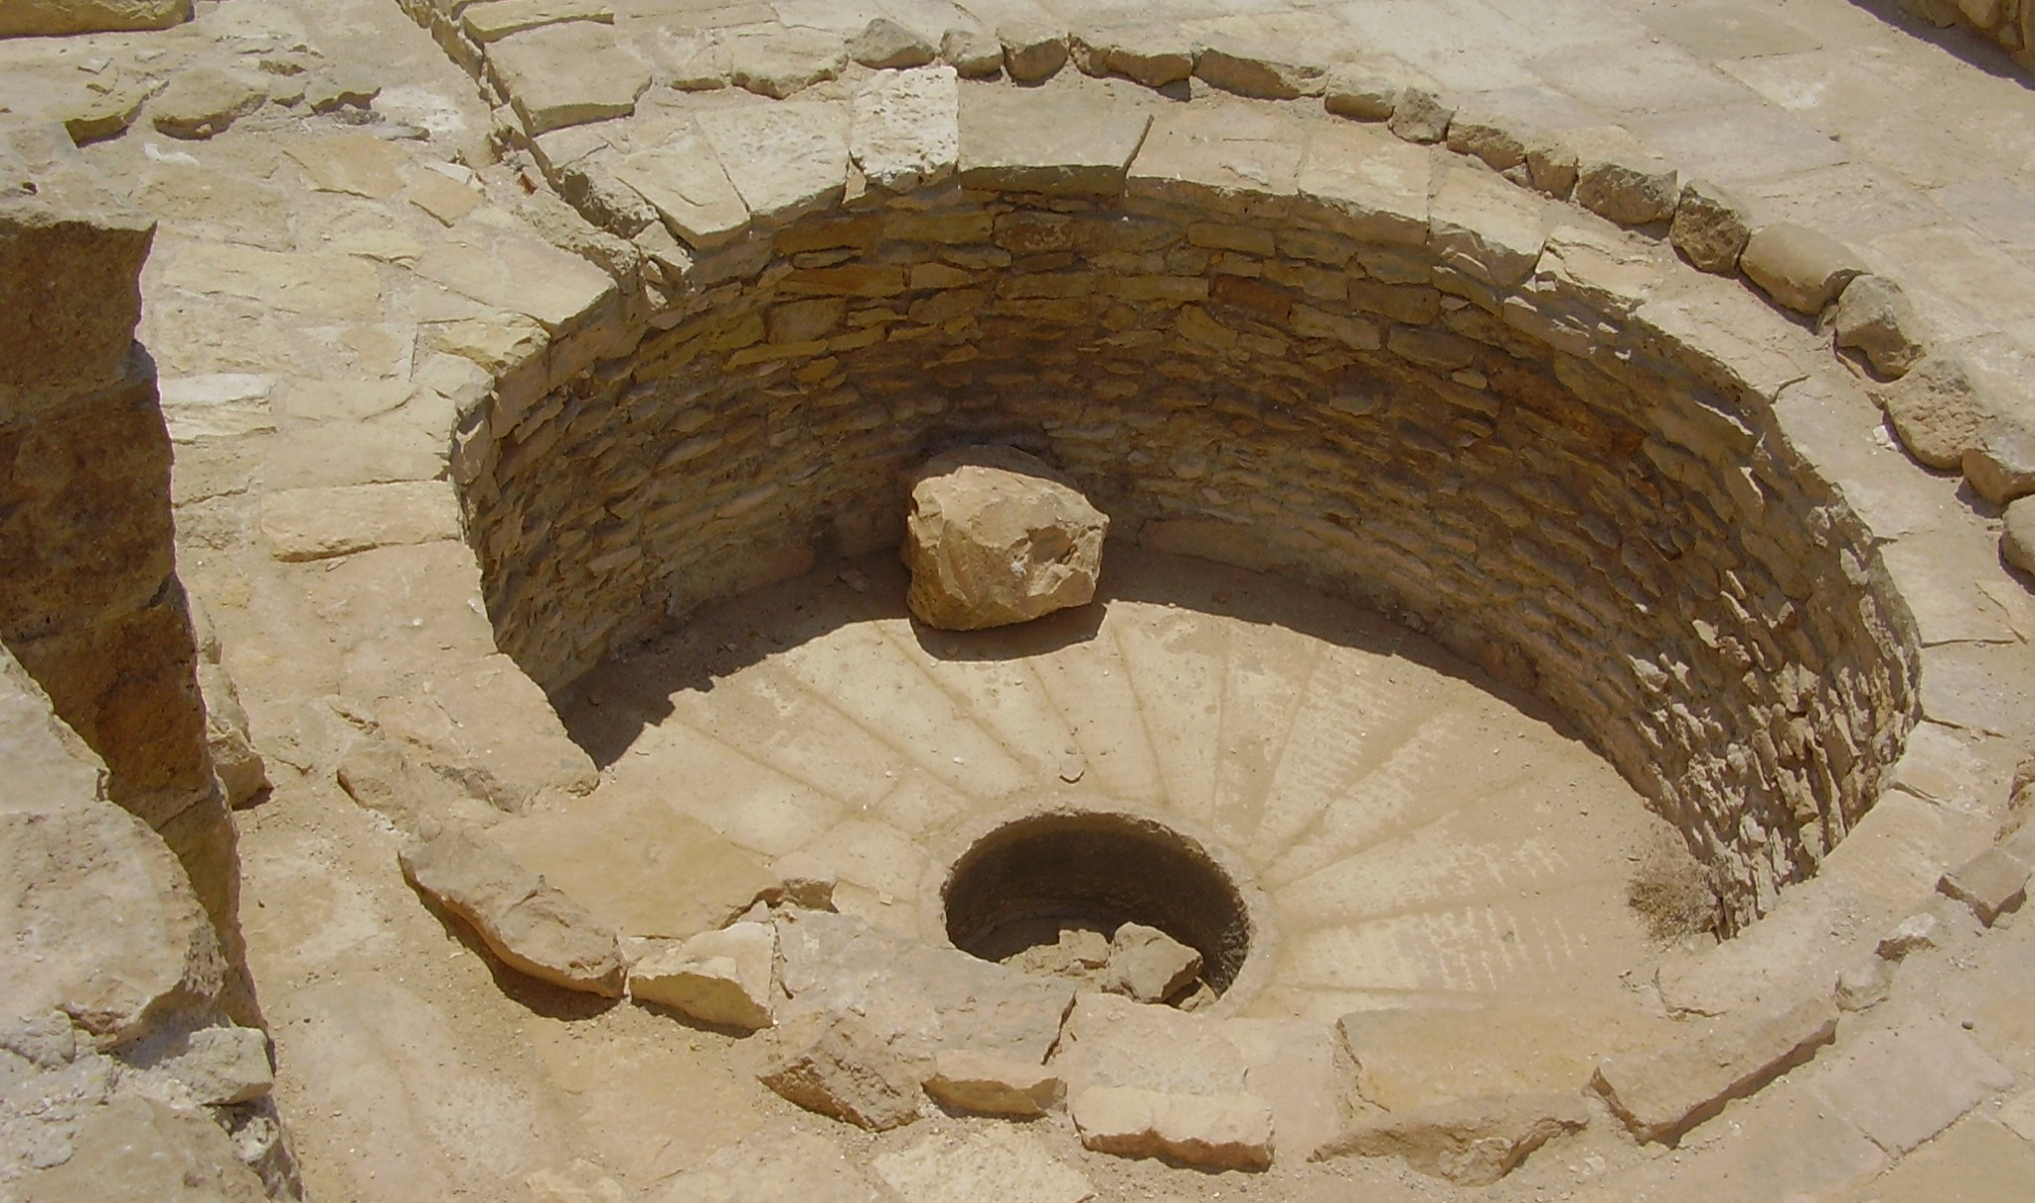
Winepress of Zeeb

Slide 36
Proverbs 15:1
A soft answer turns away wrath, But a harsh word stirs up anger.

