Slide 1
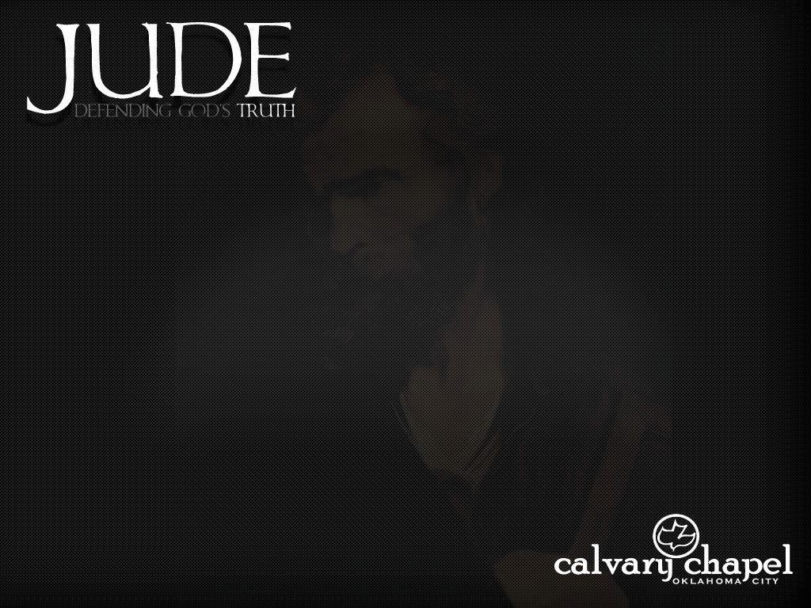
Jude = Judas ~ Gr. form of Judah
4 Judes in the New Testament
Judas Iscariot ~ Matt. 10.4
Judas, not Iscariot ~ John 14.22
Judas of Damascus ~ Acts 9.11
Judas, Jesus’ half=brother ~ Mark 6.3
“Is this not the carpenter, the Son of Mary, and brother of James, Joses, Judas, and Simon? And are not His sisters here with us?”

Slide 2
The theme of Jude is apostasy
apostasia ~ a standing away from or to remove from a position

Slide 3
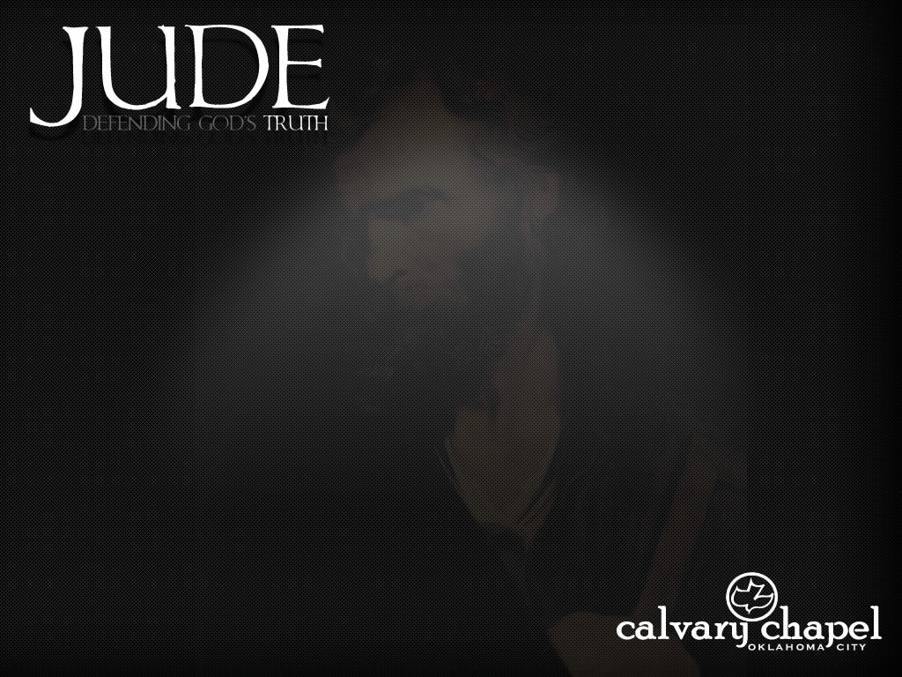

Slide 4

Psalm 23
Recreation is my shepherd, I shall not stay at home; It maketh me to lie down in a sleeping bag; It leadeth me down the interstate each weekend.
It restoreth my suntan;

Slide 5
Psalm 23
It leadeth me to state parks for comfort's sake. Even though I stray on the Lord's Day, I will fear no reprimand, for I am relaxed; My rod and my reel they comfort me.

Slide 6
Psalm 23
I anointed my skin with oil, My gas tank runneth dry; Surely my trailer shall follow me all the weekends of summer, And I shall return to the house of the Lord this fall.

Slide 7
Psalm 23
But by then, it will be hunting season and football season, And that's another psalm.

Slide 9
sanctified ~ NIV, loved; NASB, beloved

Slide 11

LOVE
MERCY
PEACE

Slide 12
Phil. 4.6-7 ~ ⁶ Be anxious for nothing, but in everything by prayer and supplication, with thanksgiving, let your requests be made known to God; ⁷ and the peace of God, which surpasses all understanding, will guard your hearts and minds through Christ Jesus.
D. L. Moody ~ “Worry about nothing, pray about everything and give thanks in anything.”

Slide 14
agony
contend ~ epagōnizomai – upon + to struggle, fight, strive, labor fervently
keep on contending (present tense)

Slide 16
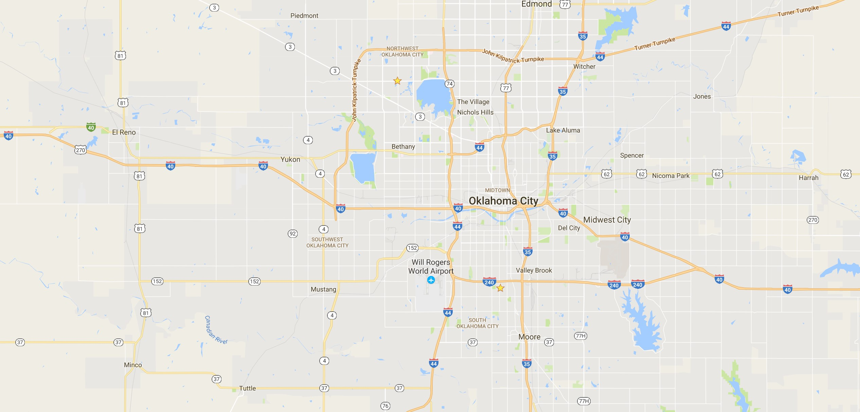
I-40
I-35
Amarillo

Slide 18
ungodly men ~ literally, irreverent
Titus 2.11-12 ~ ¹¹ For the grace of God that brings salvation has appeared to all men, ¹² teaching us that, denying ungodliness and worldly lusts, we should live soberly, righteously, and godly in the present age,

Slide 20
way of Cain ~ fleshly outbursts
error of Balaam ~ motivated by greed
rebellion of Korah ~ refusing authority

Slide 22
spots
~ literally, submerged reefs
clouds without water
~ promising, but empty
trees without fruit
~ useless
raging waves
~ mesmerizing, but dangerous
wandering (shooting) stars
~ exciting … then they are gone

Slide 24
Sensual ~ psuchikos ~ or soulish – usually translated, natural

Slide 26
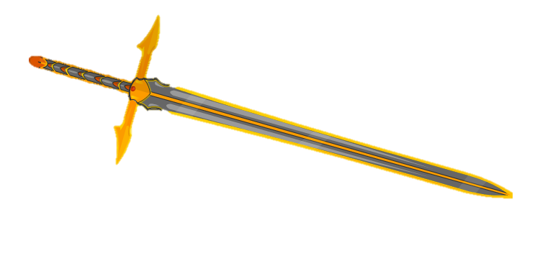
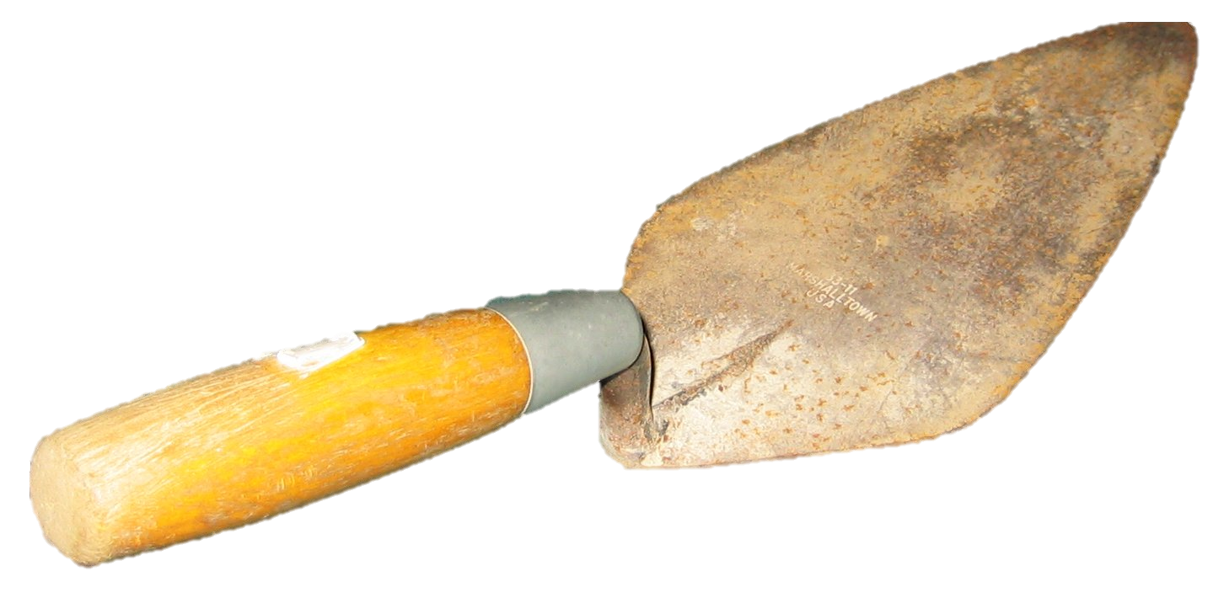
Neh. 4:15-17
contend earnestly (Jude 1.3)
building up (Jude 1.20)

Slide 28
Living Bible ~ Stay always within the boundaries where God's love can reach and bless you.

