Slide 1
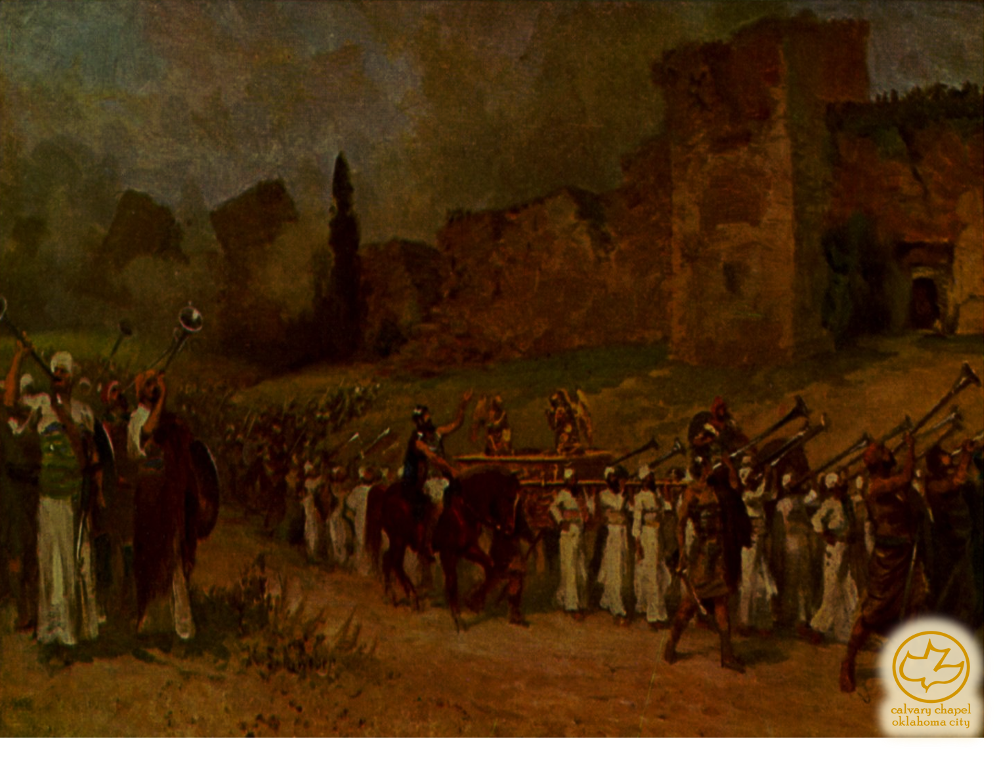

J
oshua 2o-24
A CD of this message will be available (free of charge) immediately following the service.
It will also be available for podcast later this week at calvaryokc.com

Slide 2
Joshua 20-24
Avenger (ga'al) of blood ~ also Kinsman Redeemer
To redeem from indentureship ~ Lev. 25:48-49
To redeem property sold due to poverty ~ Lev. 25:24-34
To marry the widow of a near-kinsman who is left without heir ~ Deut. 25:5-10
To receive restitution for injured relative ~ Num. 5:8; Deut. 19:5-10

Slide 3
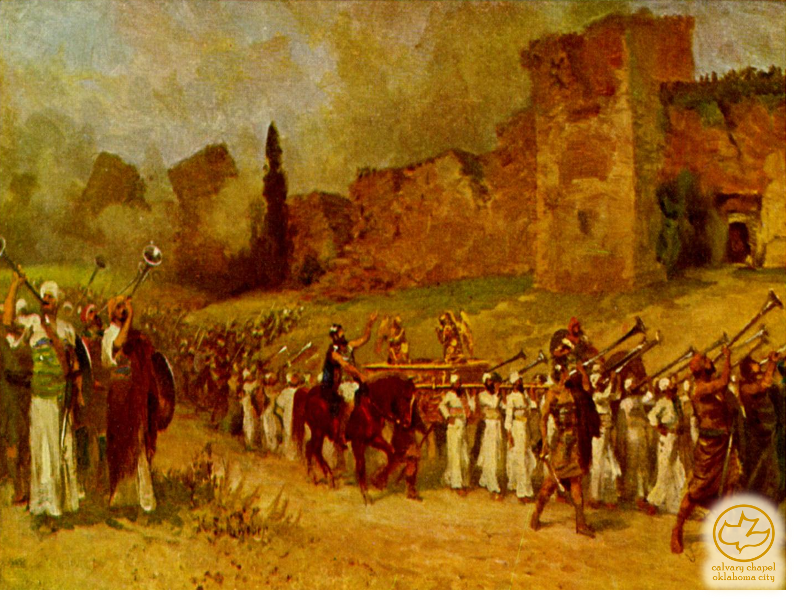
Joshua 20-24

Slide 4
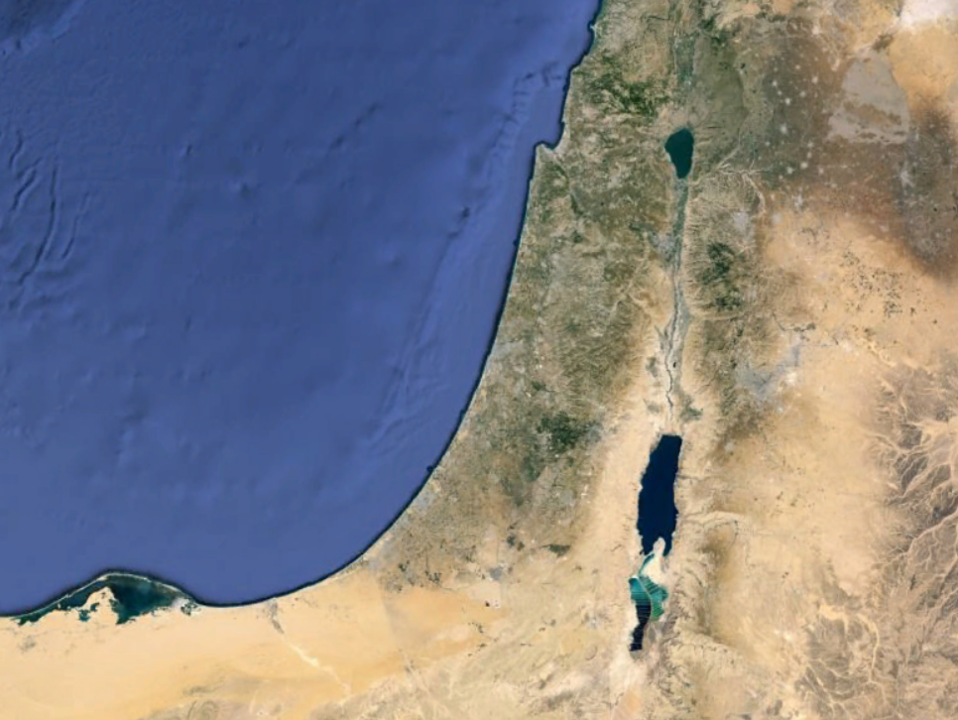
Joshua 20-24
Cities of Refuge
Kedesh
Cities of the Kohathites
Golan
Cities of the Gershonites
Ramath Gilead
Cities of the Merarites
Shechem
Cities of the Aaronites
Bezer
Hebron

Slide 5
Joshua 20-24

Slide 6
Joshua 20-24
Witness ~ KJV, Ed

Slide 7
Joshua 20-24

Slide 8
Joshua 20-24
Joshua 1:7 ~ Only be strong and very courageous, that you may observe to do according to all the law which Moses My servant commanded you; do not turn from it to the right hand or to the left, that you may prosper wherever you go.

Slide 9
Joshua 20-24

Slide 10
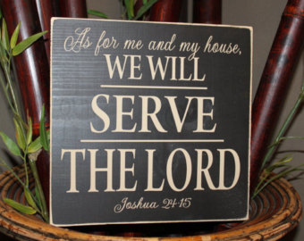
Joshua 20-24

Slide 11
Joshua 20-24

Slide 12
Joshua 20-24
Augustine ~ To myself, a heart of steel;
Gal. 5:24 ~ And those who are Christ's have crucified the flesh with its passions and desire.
To my fellow man, a heart of love;
Gal. 5:14 ~ For all the law is fulfilled in one word, even in this: "You shall love your neighbor as yourself."
To my God, a heart of fire.
Ps. 42:1 ~ As the deer pants for the water brooks,
So pants my soul for You, O God.

Slide 13
Joshua 20-24

