Slide 1
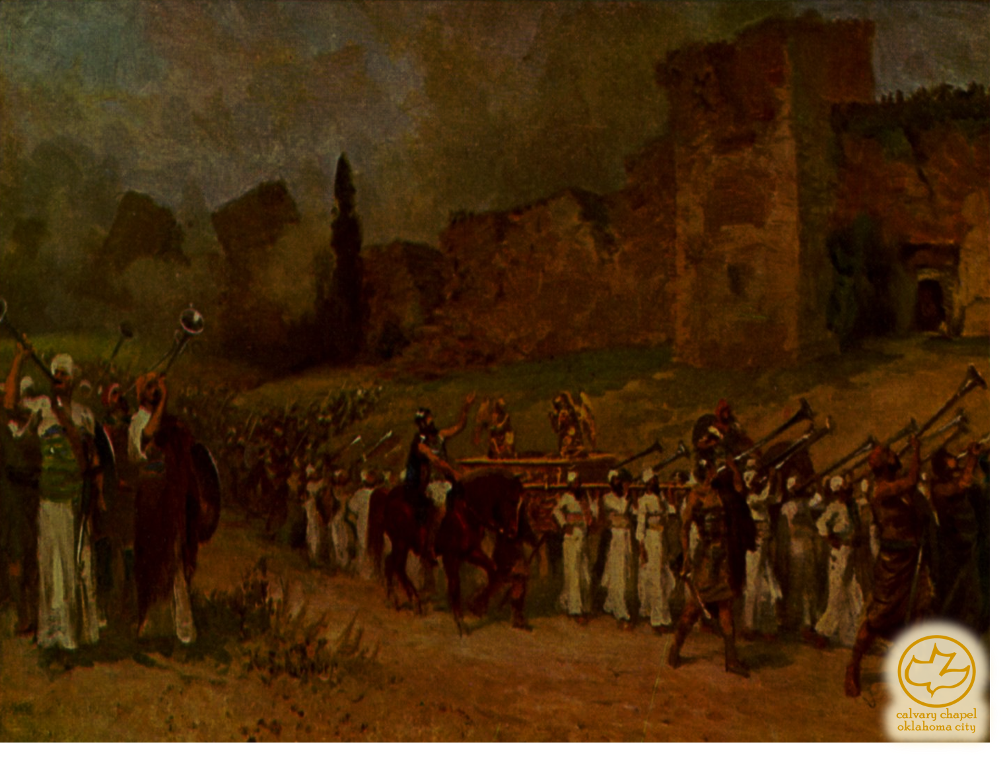

J
oshua 15-19
A CD of this message will be available (free of charge) immediately following the service.
It will also be available for podcast later this week at calvaryokc.com

Slide 2
Joshua 15-19
John 19:22 ~ And when He had said this, He breathed on them, and said to them, "Receive the Holy Spirit."

Slide 3
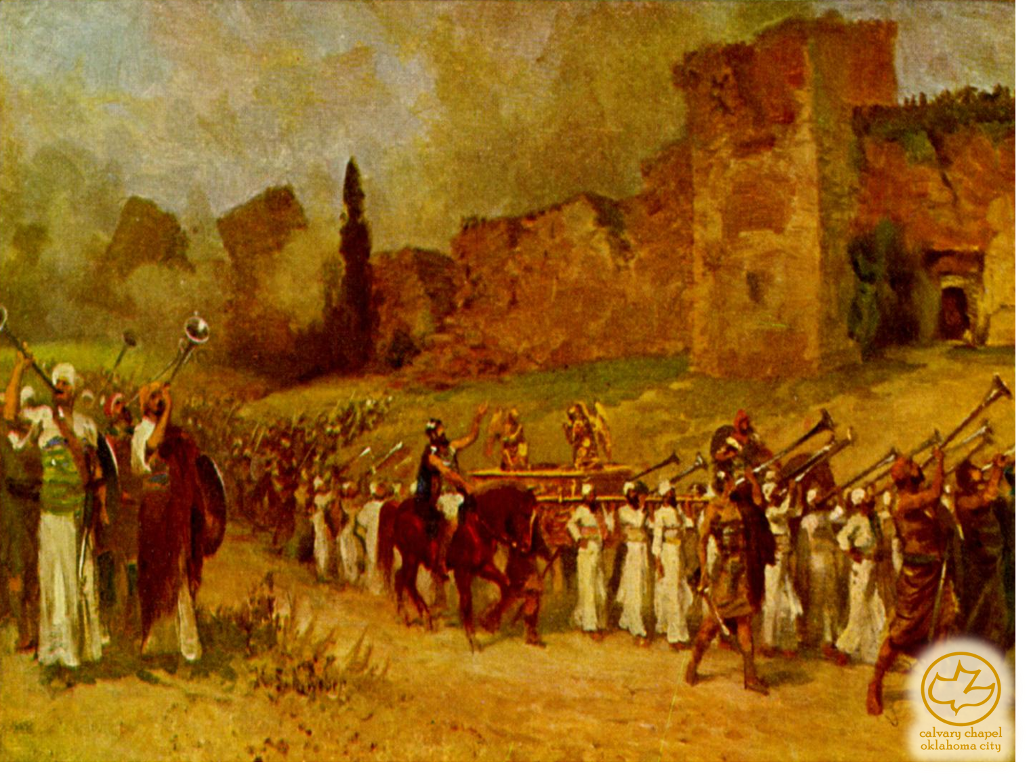
Joshua 15-19

Slide 4
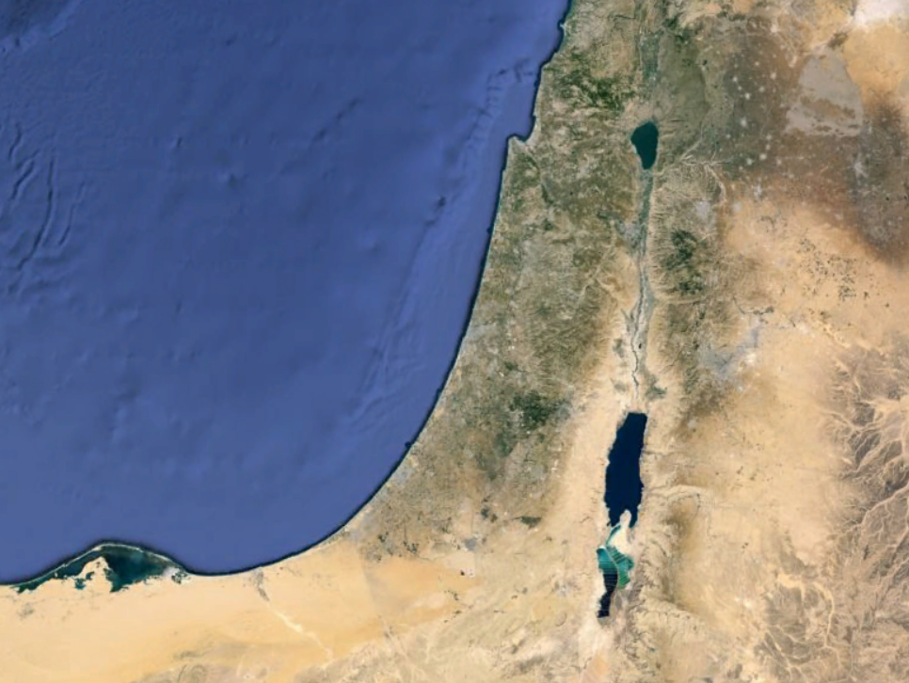
Joshua 15-19
NAPHTALI
ASHER
ZEBULON
MANASSEH
ISSACHAR
MANASSEH
EPHRAIM
DAN
GAD
BENJAMIN
JUDAH
REUBEN
SIMEON

Slide 5
Joshua 15-19

