Slide 1
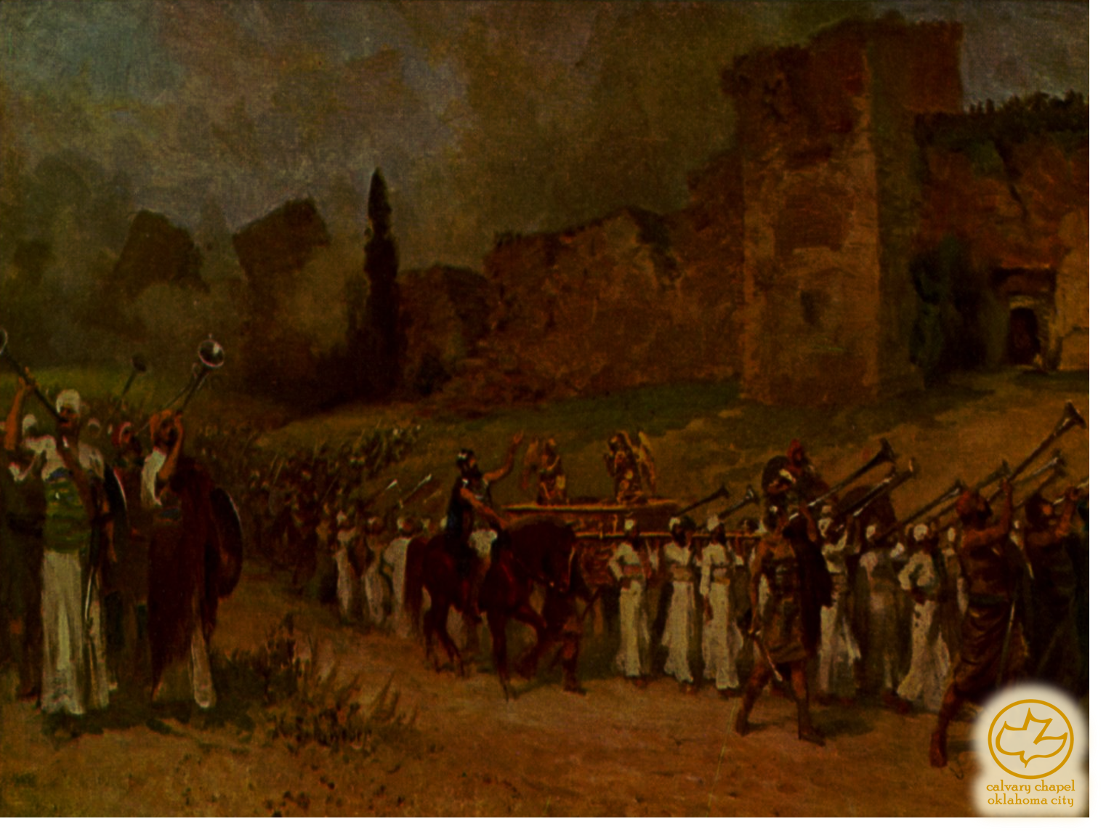

J
oshua 10-11
A CD of this message will be available (free of charge) immediately following the service.
It will also be available for podcast later this week at calvaryokc.com

Slide 2
Joshua 10-11
Adoni-Zedek ~ My lord is righteous
Melchizedek ~ King of Righteousness

Slide 3
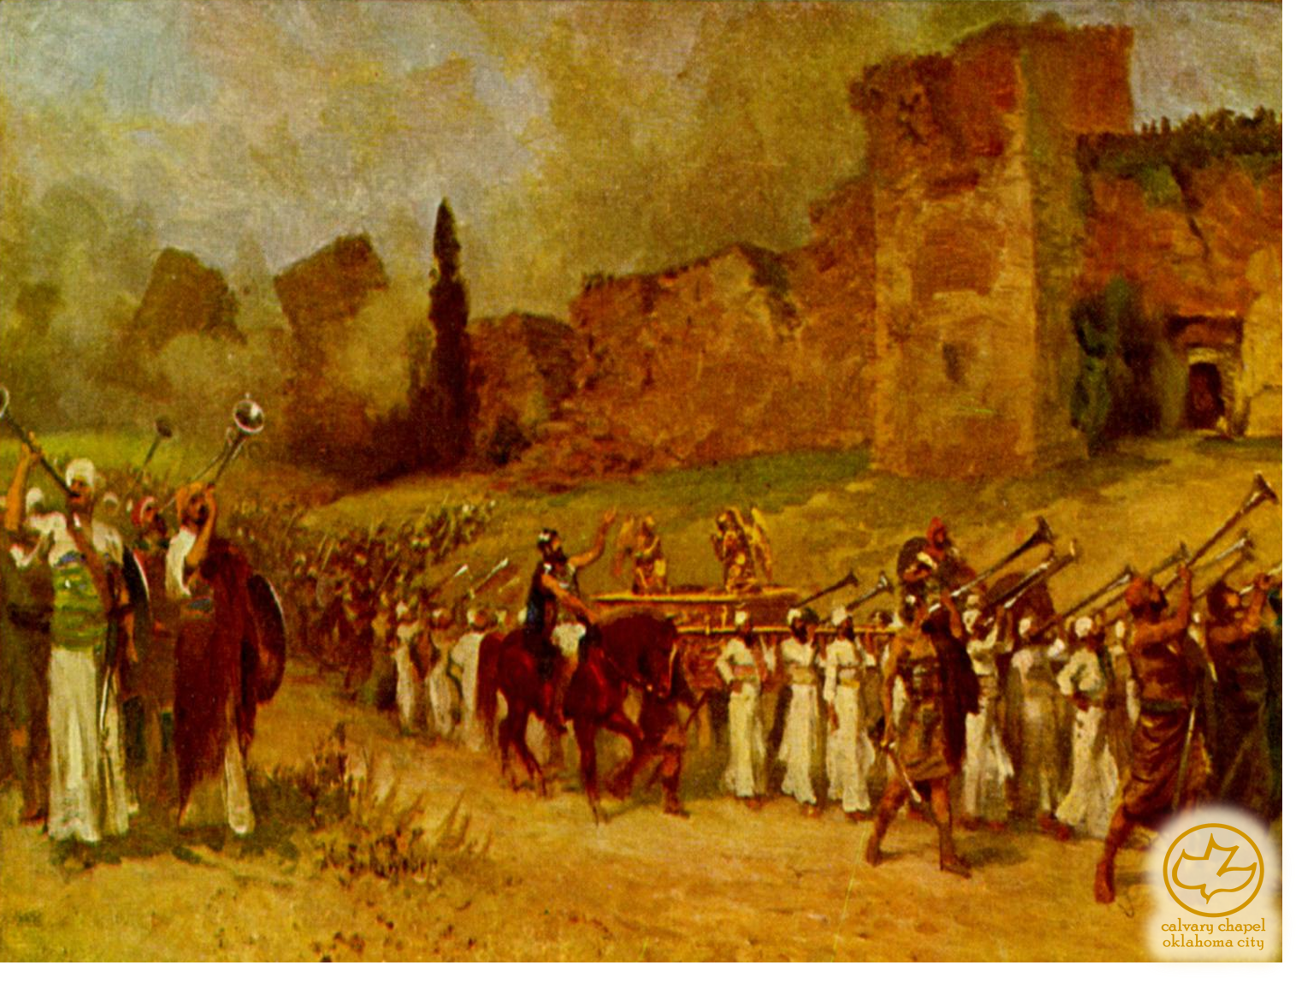
Joshua 10-11

Slide 4
Joshua 10-11
Matt. 11:12 ~ And from the days of John the Baptist until now the kingdom of heaven suffers violence (middle voice), and the violent take it by force.
NLT ~ And from the time John the Baptist began preaching and baptizing until now, the Kingdom of Heaven has been forcefully advancing, and violent people attack it.
James Denney ~ "The Kingdom of Heaven is not for the well-meaning but
for the desperate."

Slide 5
Joshua 10-11

Slide 6
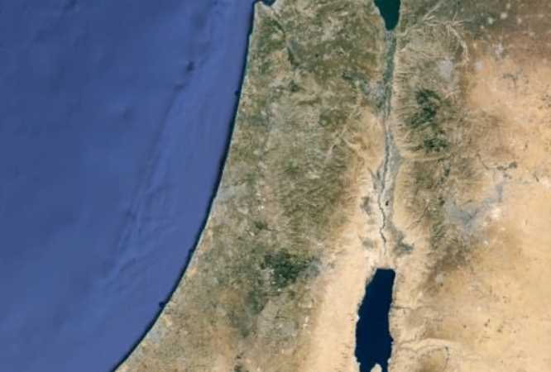
Joshua 10-11
Beth Horon
Gilgal?
Makkedah
Azekah

Slide 7
Joshua 10-11

Slide 8
Joshua 10-11
Num. 13:33 ~ There we saw the giants (nephilim) (the descendants of Anak came from the giants); and we were like grasshoppers in our own sight, and so we were in their sight.

Slide 9
Joshua 10-11

Slide 10
Joshua 10-11
Beth Horon
Gilgal?
Makkedah
Libnah
Lachish
Azekah
Hebron
Eglon
Debir

Slide 11
Joshua 10-11

Slide 12
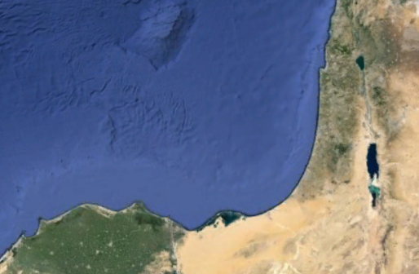
Joshua 10-11

Slide 13
Joshua 10-11

Slide 14
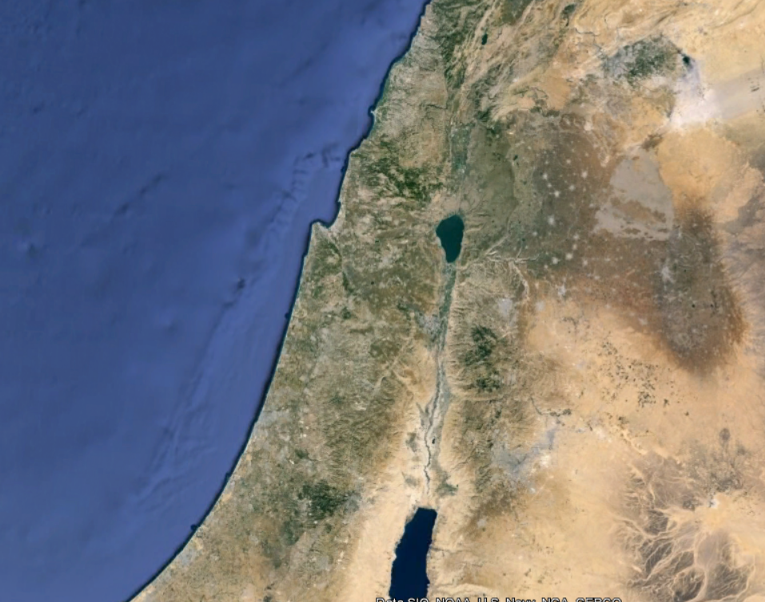
Joshua 10-11
Hazor
Merom

Slide 15
Joshua 10-11

Slide 16
Joshua 10-11
Hamstrung ~ KJV, hough (pronounced hock)
Ps. 20:7 ~ Some trust in chariots, and some in horses;
But we will remember the name of the Lord our God.

Slide 17
Joshua 10-11

Slide 18
Joshua 10-11
Harden ~ chazaq – to strengthen

Slide 19
Joshua 10-11

