Slide 1
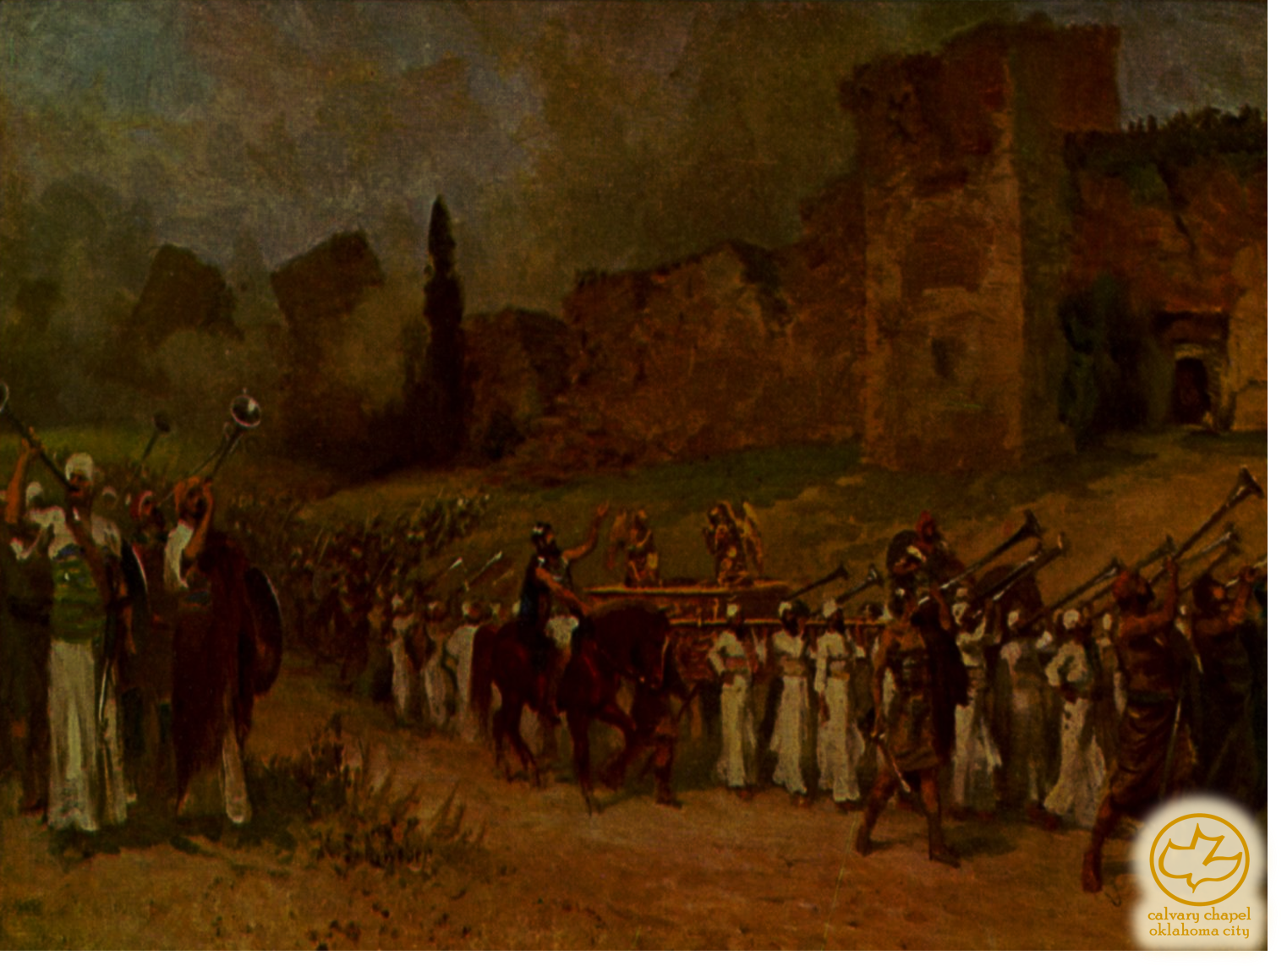
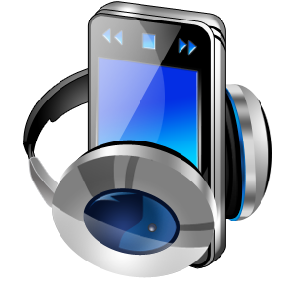
J
oshua 06-07
A CD of this message will be available (free of charge) immediately following the service.
It will also be available for podcast later this week at calvaryokc.com

Slide 2
Joshua 06-07
Some walls need to be built (Nehemiah)
Some walls need to be destroyed (Jericho)
Some of us can't tell the difference

Slide 3
Joshua 06-07
"O Shepherd. You said You would make my feet like hinds' feet and set me upon High Places."
"Well," He answered, "the only way to develop hinds' feet is to go by the paths which the hinds use." ― Hannah Hurnard, Hinds' Feet on High Places

Slide 4
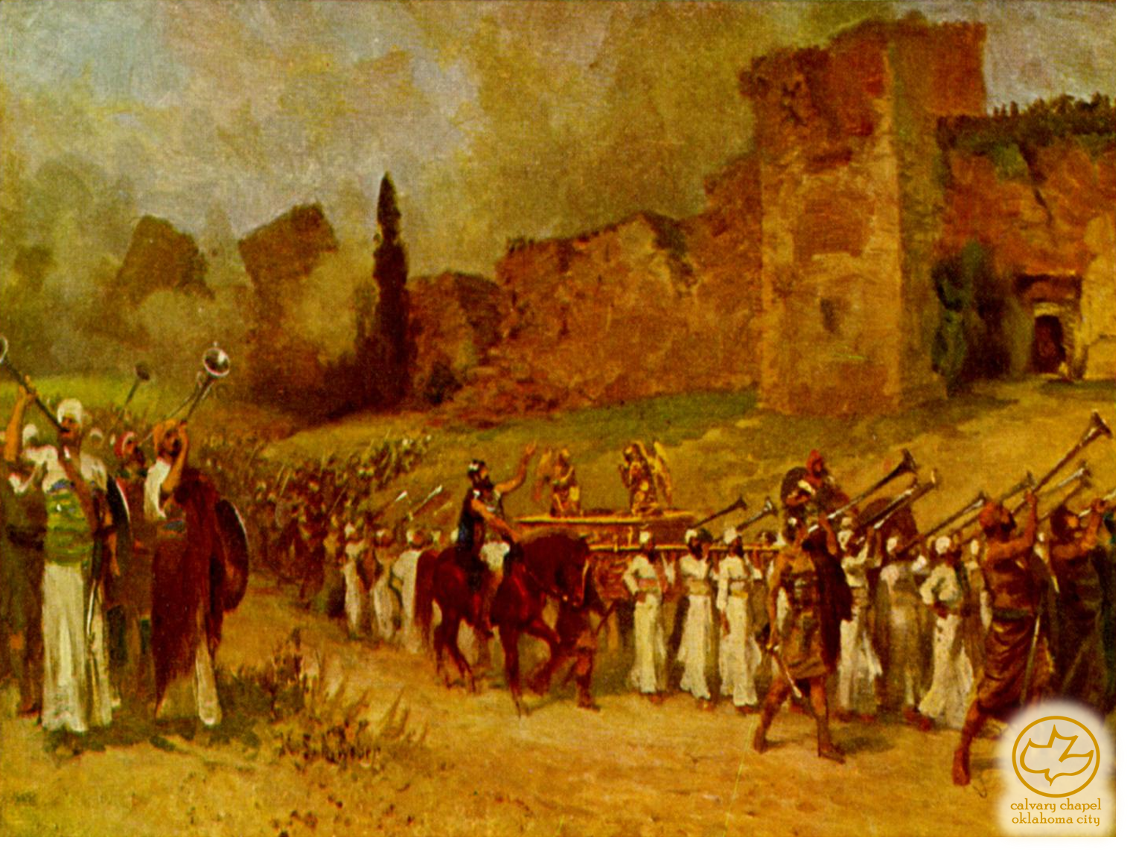
Joshua 06-07

Slide 5
Joshua 06-07
And Joshua rose early in the morning …
3:1; 6:12; 7:16; 8:10

Slide 6
Joshua 06-07

Slide 7
Joshua 06-07
Gen. 15:16 ~ But in the fourth generation they shall return here, for the iniquity of the Amorites is not yet complete.

Slide 8
Joshua 06-07

Slide 9
Joshua 06-07
1 Kings 16:34 ~ In his days Hiel of Bethel built Jericho. He laid its foundation with Abiram his firstborn, and with his youngest son Segub he set up its gates, according to the word of the LORD, which He had spoken through Joshua the son of Nun.

Slide 10
Joshua 06-07

Slide 11
Joshua 06-07
Accursed thing ~ cherem – from root meaning to destroy
NASB ~ things under the ban
NIV, devoted thing
NIV footnote ~ "The Hebrew term refers to the irrevocable giving over of things or persons to the LORD, often by totally destroying them."
Achan means troubler
Ai means heap or heap of ruins

Slide 12
Joshua 06-07

Slide 13
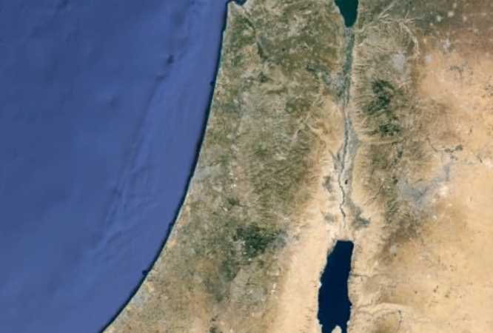
Joshua 06-07
Bethel
Gilgal?
Ai
Jericho

Slide 14
Joshua 06-07

Slide 15
Joshua 06-07
Struck them down on the descent ~ KJV, and smote them in the going down:
2 lessons from Achan:
We do not and never will sin in a vacuum
Our biggest strength is often the place of our greatest failures

Slide 16
Joshua 06-07

Slide 17
Joshua 06-07
Number 32:23 ~ But if you do not do so, then take note, you have sinned against the Lord; and be sure your sin will find you out.

Slide 18
Joshua 06-07

Slide 19
Joshua 06-07
Spoils ~ shalal – not, cherem

Slide 20
Joshua 06-07

Slide 21
Joshua 06-07
Deut. 24:16 ~ Fathers shall not be put to death for their children, nor shall children be put to death for their fathers; a person shall be put to death for his own sin.

Slide 22
Joshua 06-07

Slide 23
Joshua 06-07
Achor ~ trouble

Slide 24
Joshua 06-07

