Slide 1
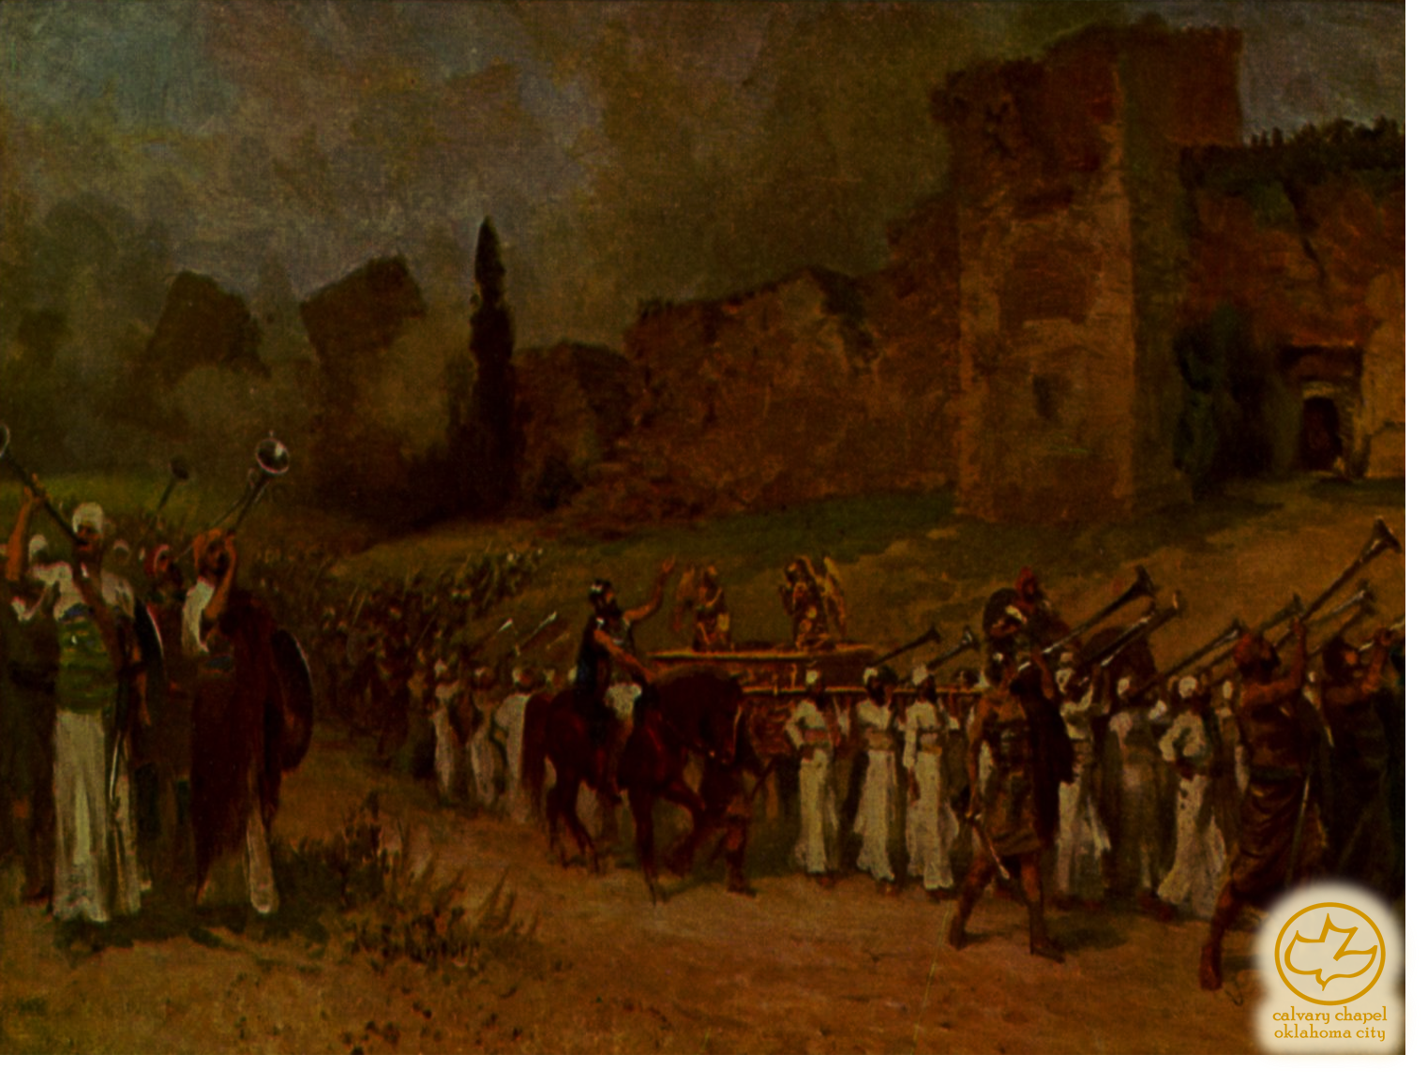

J
oshua 04-05
A CD of this message will be available (free of charge) immediately following the service.
It will also be available for podcast later this week at calvaryokc.com

Slide 2
Joshua 04-05
Jeffery Peters ~ "For … God to close off the Jordan is less trouble than for us to turn off a tap."

Slide 3
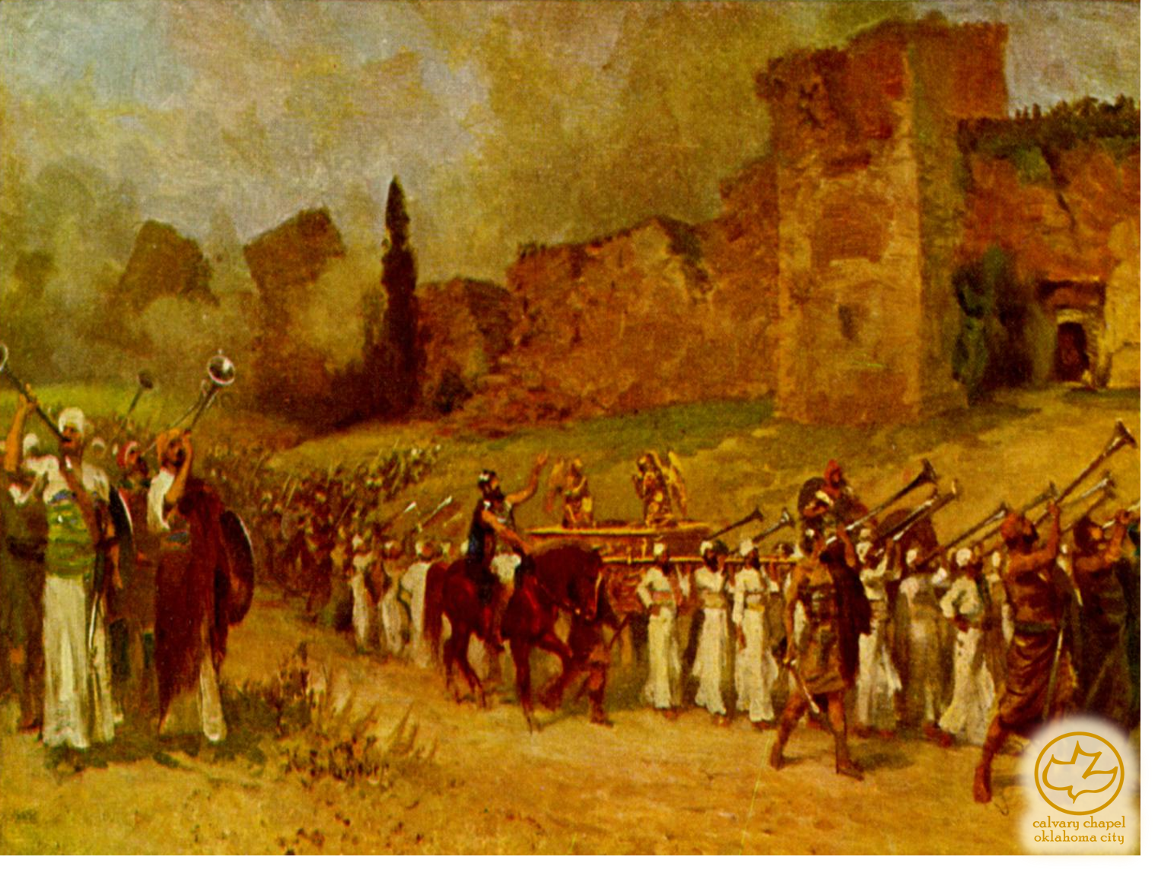
Joshua 04-05

Slide 4
Joshua 04-05
KJV, when all the people were clean passed over Jordan,

Slide 5
Joshua 04-05

Slide 6
Joshua 04-05
NIV, Joshua set up the twelve stones that had been in the middle of the Jordan at the spot where the priests who carried the ark of the covenant had stood.

Slide 7
Joshua 04-05

Slide 8
Joshua 04-05
Num. 26:2 ~ Take the sum of all the congregation of the children of Israel, from twenty years old and upward, throughout their fathers' house, all that are able to go to war in Israel.
v. 7 ~ Reuben 43,730
v. 18 ~ Gad 40,500
110,580
v. 34 ~ Manasseh 52,700
÷ 2 = 26,350

Slide 9
Joshua 04-05

Slide 10
Joshua 04-05
10th of Nisan
~ 1st day of Passover

Slide 11
Joshua 04-05

Slide 12
Joshua 04-05
Gal. 5:24 ~ And those who are Christ's have crucified the flesh with its passions and desires.
Deut. 10:16 ~ Therefore circumcise the foreskin of your heart, and be stiff-necked no longer.
Deut. 30:6 ~ And the Lord your God will circumcise your heart and the heart of your descendants, to love the Lord your God with all your heart and with all your soul, that you may live.

Slide 13
Joshua 04-05
Jer. 4:4a ~ Circumcise yourselves to the Lord,
And take away the foreskins of your heart …

Slide 14
Joshua 04-05

Slide 15
Joshua 04-05
Hill of the foreskins ~ NASB, NIV – Gibeath Haaraloth

Slide 16
Joshua 04-05

Slide 17
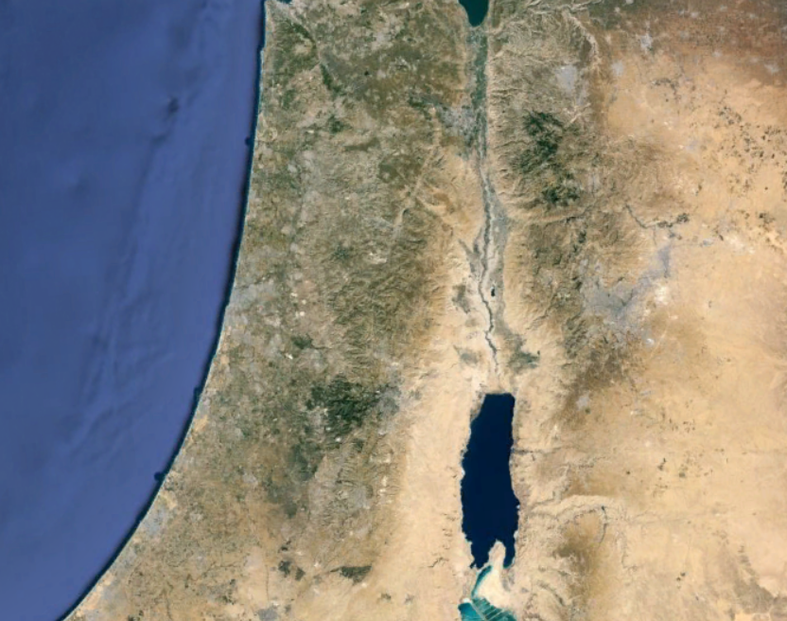
Joshua 04-05
Gilgal?
Jericho
Bethabara?

Slide 18
Joshua 04-05

Slide 19
Joshua 04-05
Theophany ~ preincarnate manifestation of Jesus

Slide 20
Joshua 04-05
The Angel of the LORD
Gen. 16
Hagar in wilderness
v. 13
Num. 22
Balaam and donkey
v. 28
Judges 2
Naming of "Bochin"
v. 1
Judges 6
Gideon
v. 14
Judges 13
Samson's parents
v. 22
Several places in the Kings, Psalms & Zechariah
Ex. 3
Burning bush
v. 4

Slide 21
Joshua 04-05

