Slide 1
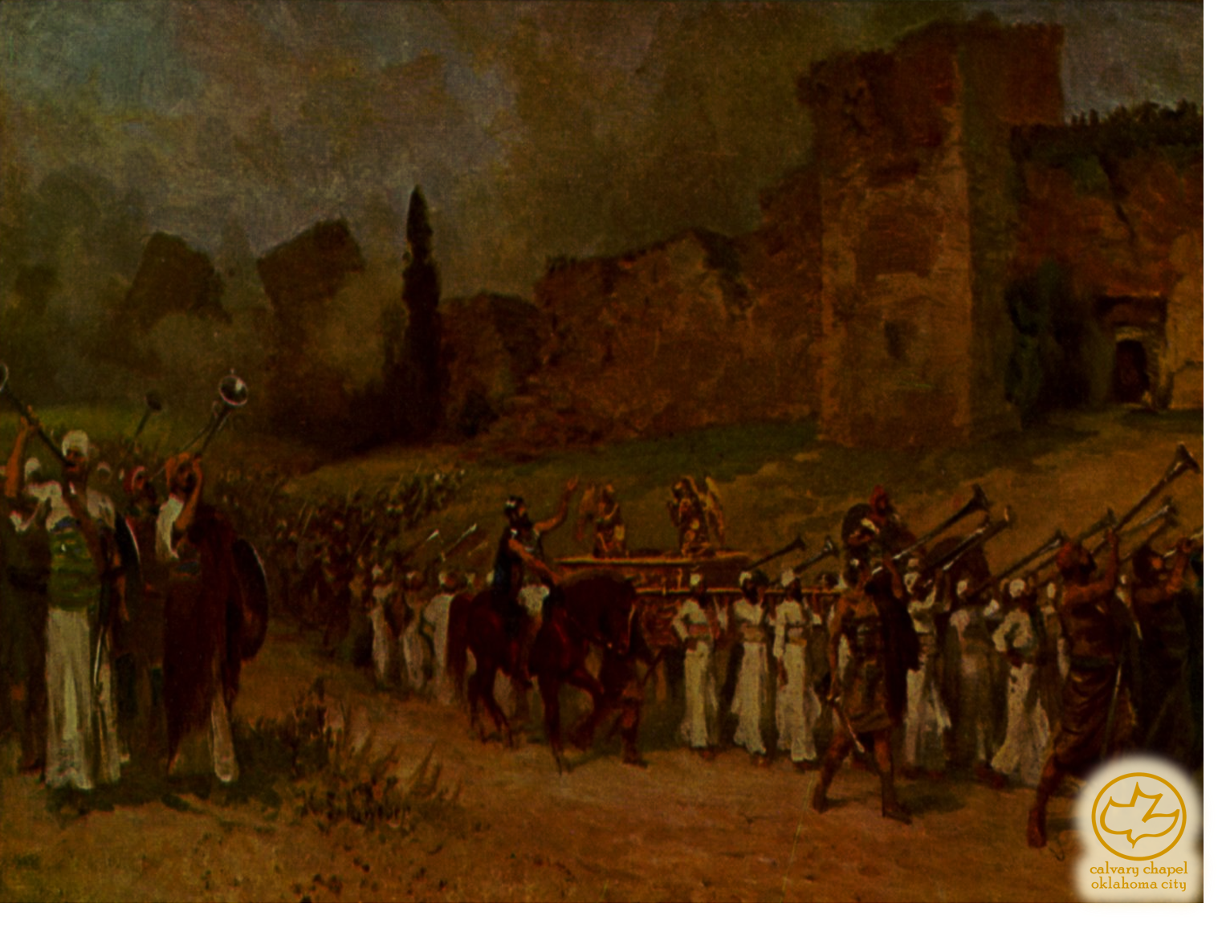
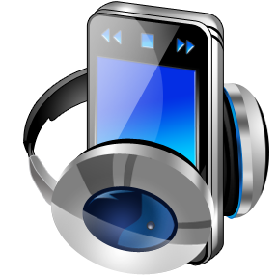
J
oshua 02-03
A CD of this message will be available (free of charge) immediately following the service.
It will also be available for podcast later this week at calvaryokc.com

Slide 2
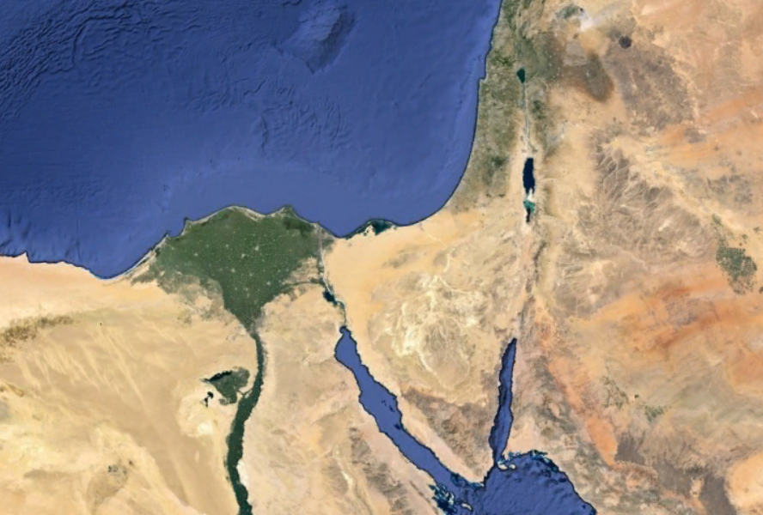
Joshua 02-03
Type of
Salvation
Water baptism
Learning to trust
Baptism with the Holy Spirit

Slide 3
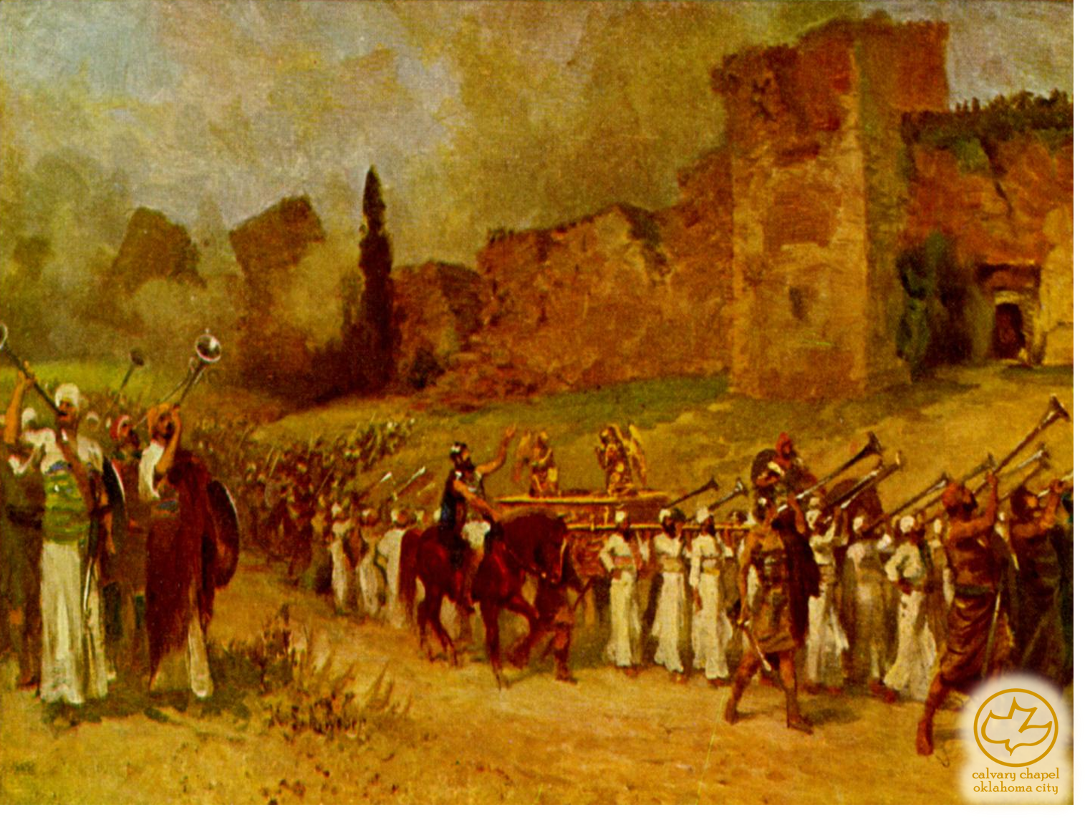
Joshua 02-03

Slide 4
Joshua 02-03
Harlot ~ LXX, pornē

Slide 5
Joshua 02-03

Slide 6
Joshua 02-03
KJV, but I wist not whence they were

Slide 7
Joshua 02-03

Slide 8
Joshua 02-03
KJV, whither the men went I wot not

Slide 9
Joshua 02-03

Slide 10
Joshua 02-03
Heb. 11.31 ~ By faith the harlot Rahab did not perish with those who did not believe, when she had received the spies with peace.
Did not believe ~ apeitheō – not persuaded

Slide 11
Joshua 02-03

Slide 12
Joshua 02-03
Rahab
Salmon
Boaz
Ruth
Obed
Jesse
David

Slide 13
Joshua 02-03

Slide 14
Joshua 02-03
John 7:38-39 ~ ³⁸ "He who believes in Me, as the Scripture has said, out of his heart will flow rivers of living water." ³⁹ But this He spoke concerning the Spirit, whom those believing in Him would receive; for the Holy Spirit was not yet given, because Jesus was not yet glorified.

Slide 15
Joshua 02-03

