Slide 1
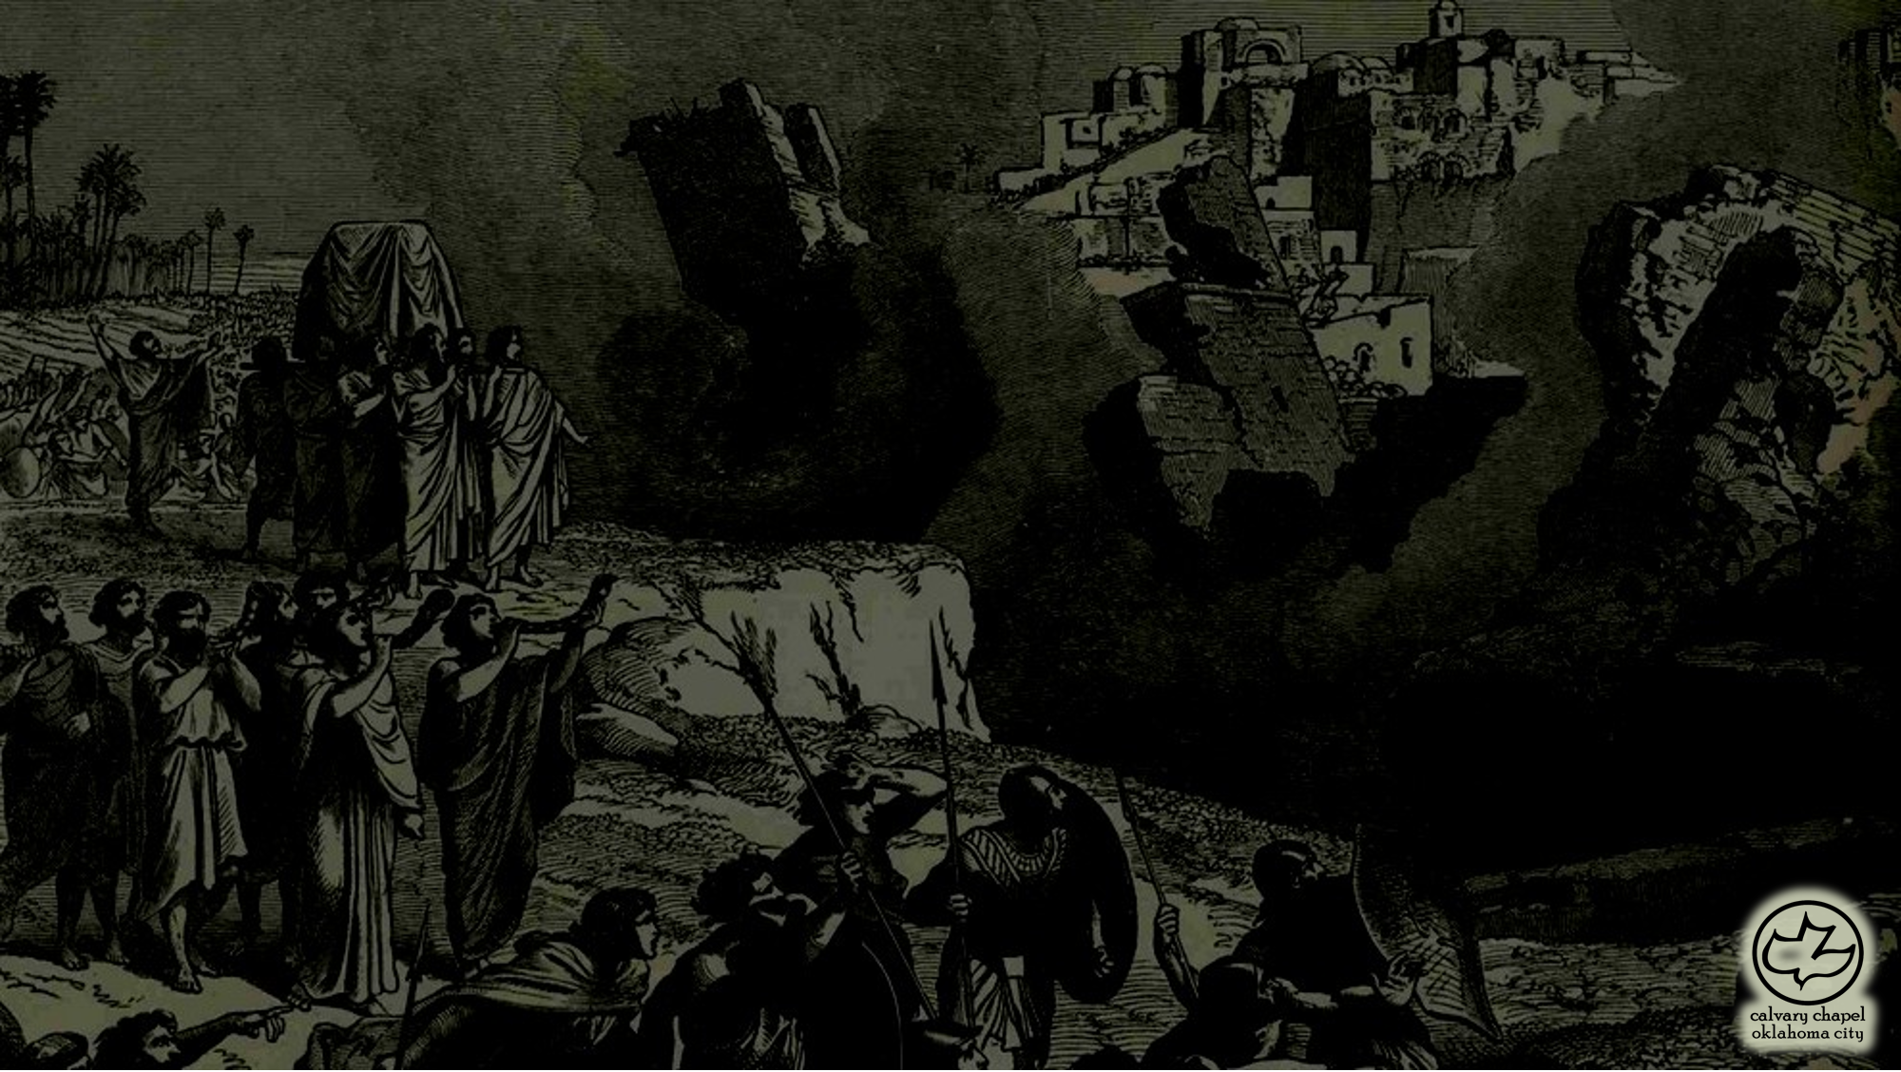

J
oshua 1
A CD of this message will be available (free of charge) immediately following the service.
It will also be available for podcast later this week at calvaryokc.com

Slide 2
Joshua 01
John 10.10 ~ The thief does not come except to steal, and to kill, and to destroy. I have come that they may have life, and that they may have it more abundantly.
Originally named Hoshea (salvation) – changed to Joshua (Yahweh is salvation) by Moses (Num. 13:16)
Joshua ~ Jeshua ~ Yeshua ~ Jesus
LXX ~ Joshua = Iēsous

Slide 3
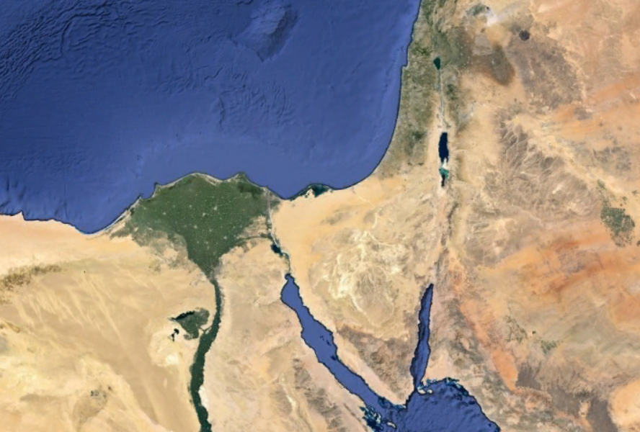
Joshua 01
Type of
Salvation
Water baptism
Learning to trust
Baptism with the Holy Spirit

Slide 4
Joshua 01
1 Cor. 10:6 ~ Now these things became our examples, to the intent that we should not lust after evil things as they also lusted.

Slide 5
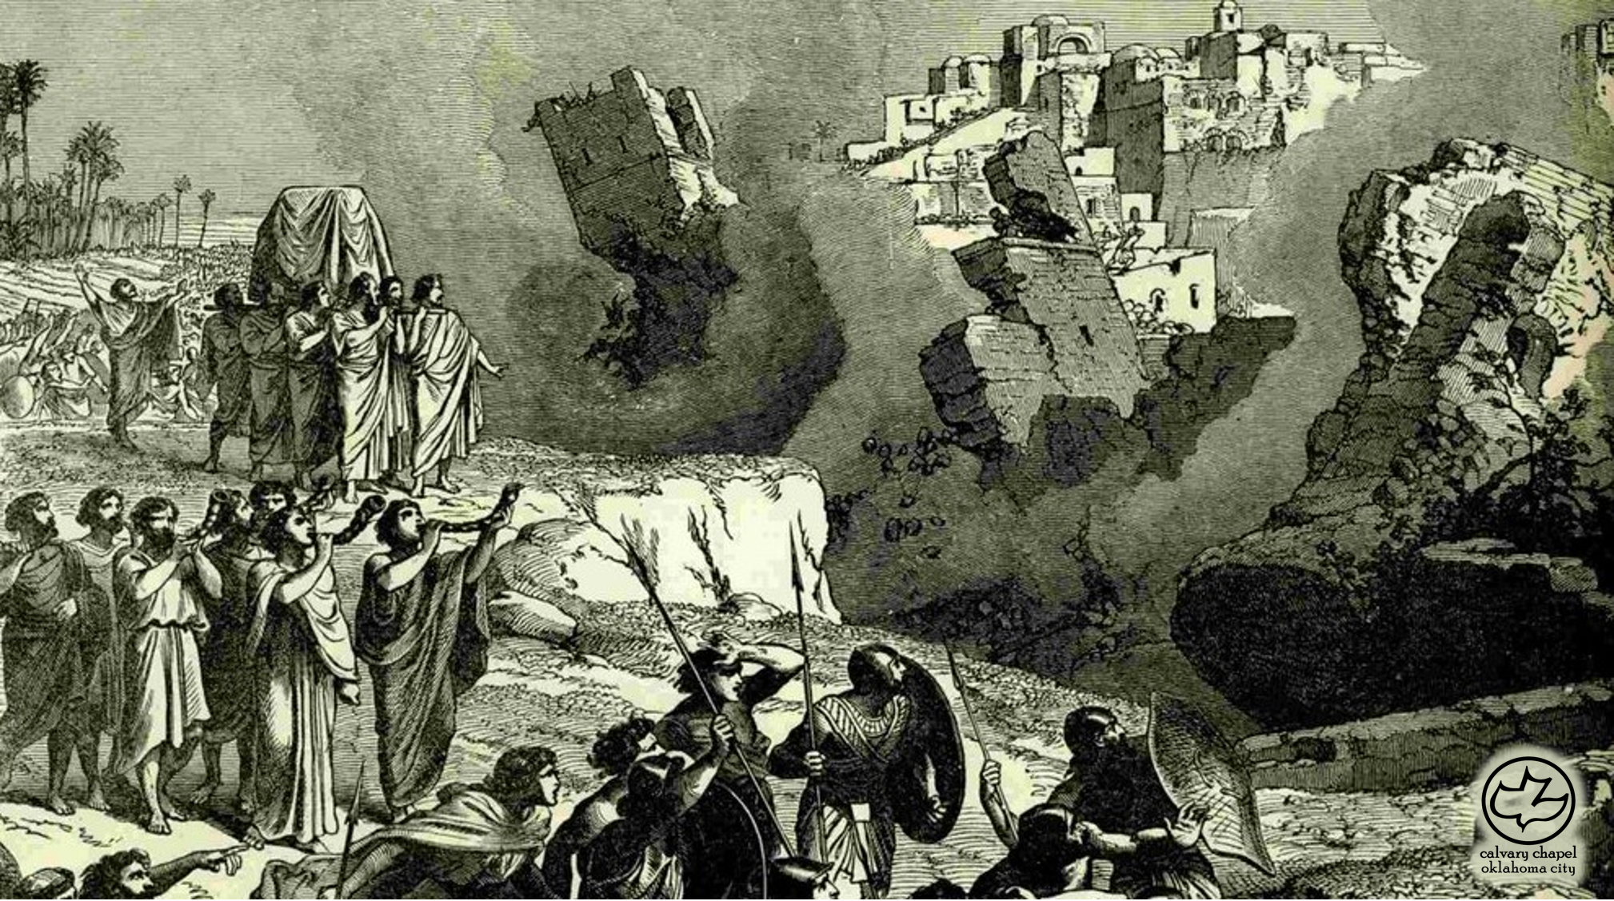
Joshua 01

Slide 6
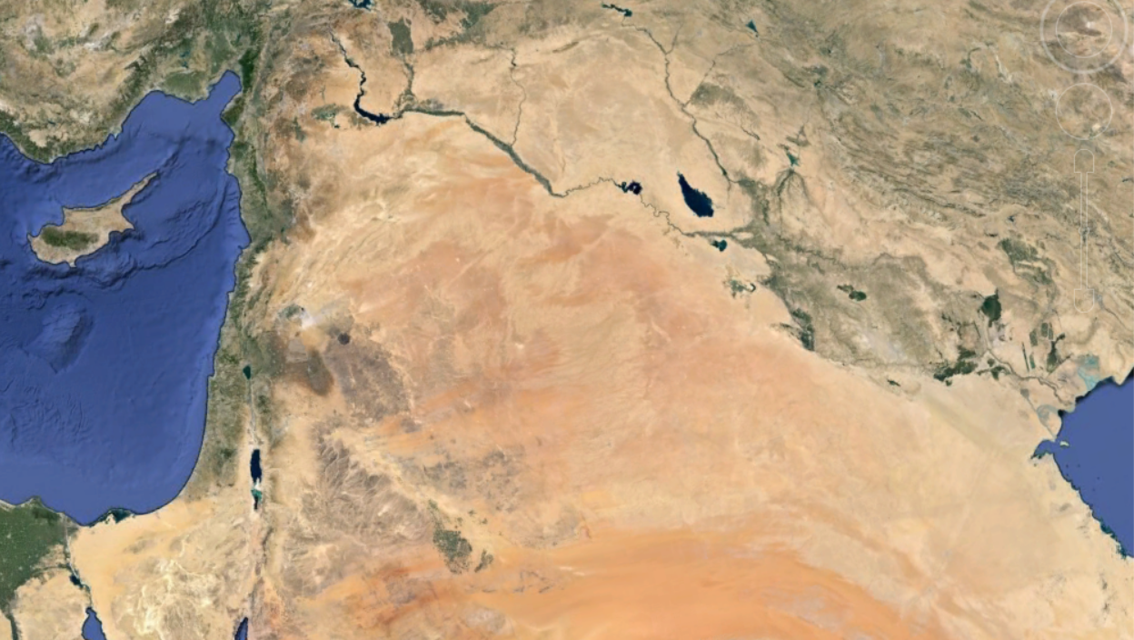
Joshua 01

Slide 7
Joshua 01
Eph. 1:3 ~ Blessed be the God and Father of our Lord Jesus Christ, who has blessed us with every spiritual blessing in the heavenly places in Christ,

Slide 8
Joshua 01

Slide 9
Joshua 01
3-part sermon ~ Be Strong and of Good Courage
v. 6 ~ God's Promise
C. H. Spurgeon ~ "(Joshua) was not to use the promise as a couch upon which his indolence might luxuriate, but as a girdle wherewith to gird up his loins for future activity."
vv. 7-8 ~ God's Power
Meditate ~ from a word meaning to moan or to mutter
v. 9 ~ God's Presence

Slide 10
Joshua 01

Slide 11
Joshua 01
Ps. 138:2 ~ … For You have magnified Your word above all Your name
NASB, For You have magnified Your word according to all Your name.

Slide 12
Joshua 01

Slide 13
Joshua 01
Provisions ~ KJV, victuals (some editions, vittles)

Slide 14
Joshua 01

Slide 15
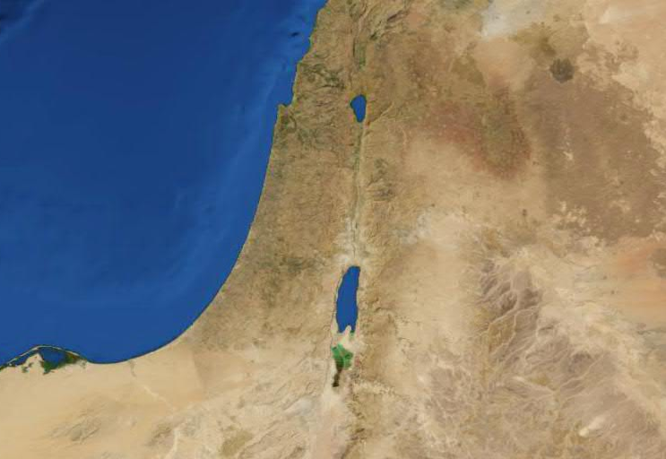
Joshua 01
Manasseh
Manasseh
Gad
Reuben

Slide 16
Joshua 01

Slide 17
Joshua 01
George McDonald ~ "In whatever man does without God, he must fail miserably, or succeed more miserably."

Slide 18
Joshua 01

Slide 19
Joshua 01
2 Pet. 1:3 ~ seeing that His divine power has granted to us everything pertaining to life and godliness, through the true knowledge of Him who called us by His own glory and excellence.

Slide 20
Joshua 01

