Slide 1
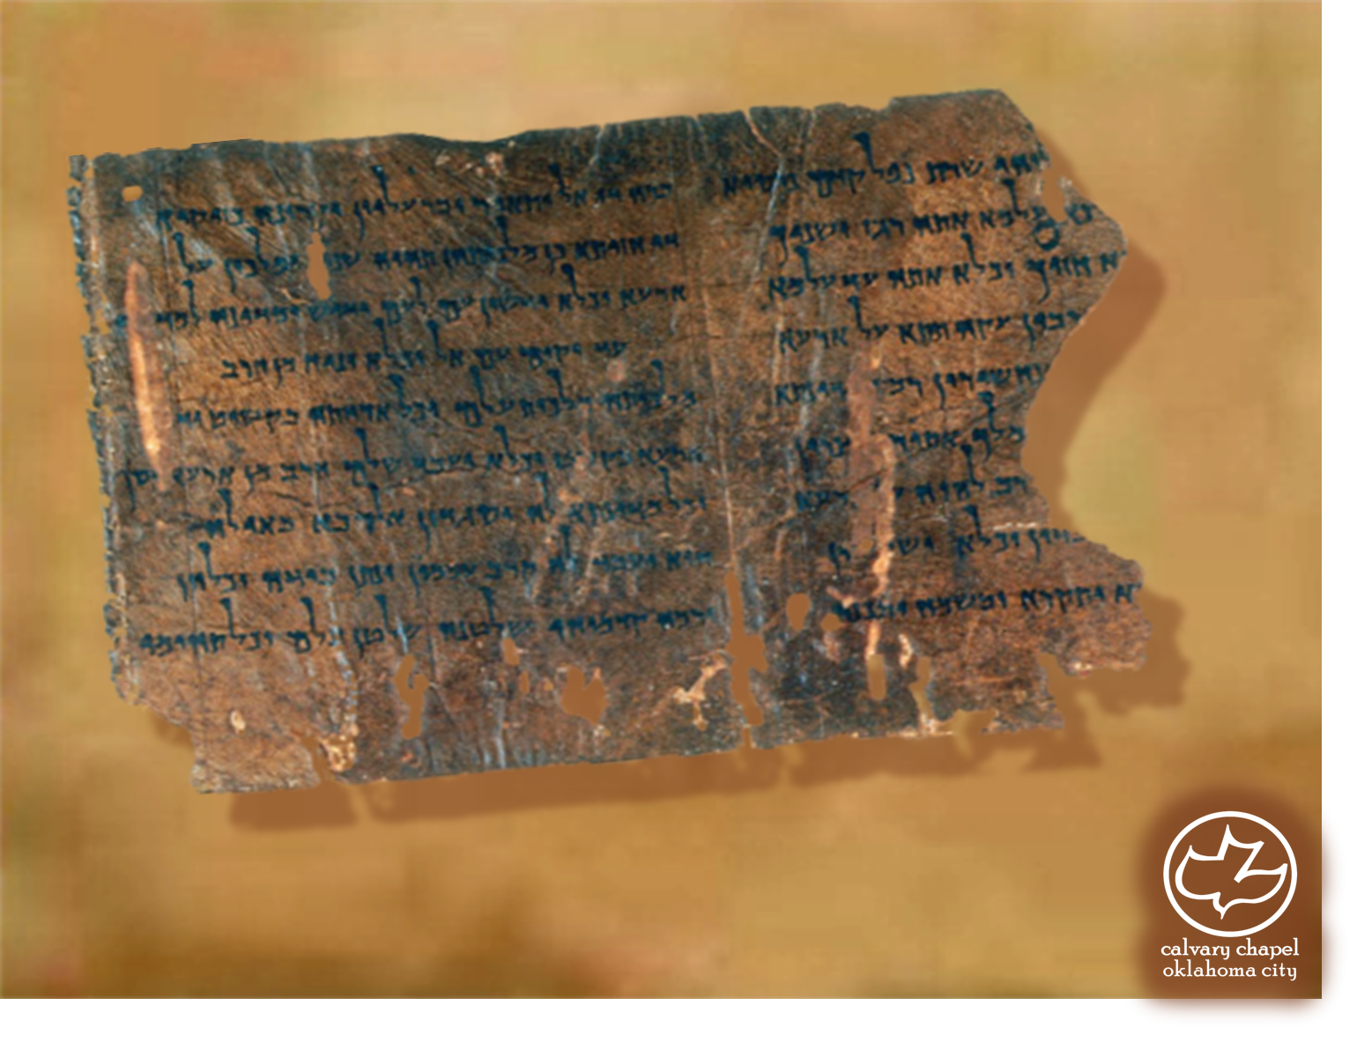

Minor Prophets … Major Message:
Jonah 3:1-4:11
A CD of this message will be available (free of charge) immediately following today's message
This message will be available via podcast later this week at calvaryokc.com

Slide 2
Jonah 3:1-4:11
Heb. 4:13 ~ there is no creature hidden from His sight, but all things are naked and open to the eyes of Him to whom we must give account

Slide 3
Jonah 3:1-4:11
Inner wall ~ 100’ high, 50’ wide, 8 mile circumference
Outer wall ~ including suburbs, 55 mile circumference

Slide 4
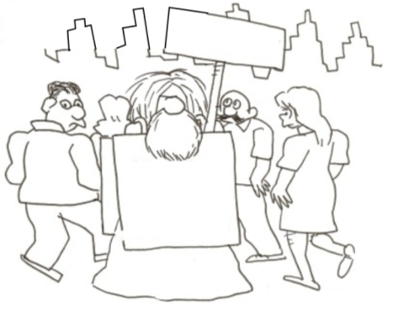
Jonah 3:1-4:11
40 days
And then
Nineveh will be toast

Slide 5
Jonah 3:1-4:11
Reign of Ashur-dan III (773-755 BC)
774
772
770
768
766
764
762
760
758
756
Major plague
765 BC
Solar eclipse
763 BC
Major plague
759 BC
Several military losses
Major earthquake
Major revolt 763-759 BC

Slide 6
Jonah 3:1-4:11
Deut. 12:41 ~ The men of Nineveh will rise up in the judgment with this generation and condemn it, because they repented at the preaching of Jonah; and indeed a greater than Jonah is here.

Slide 7
Jonah 3:1-4:11
Jer. 18: 7-8 ~ ⁷ The instant I speak concerning a nation and concerning a kingdom, to pluck up, to pull down, and to destroy it, ⁸ if that nation against whom I have spoken turns from its evil, I will relent of the disaster that I thought to bring upon it.

Slide 8
Jonah 3:1-4:11
KJV ~ And God saw their works, that they turned from their evil way; and God repented of the evil …

Slide 9
Jonah 3:1-4:11
Angry ~ literally, hot

Slide 10
Jonah 3:1-4:11
200,000 years’ wages
3 months’ wages
60,000:1

