Slide 1
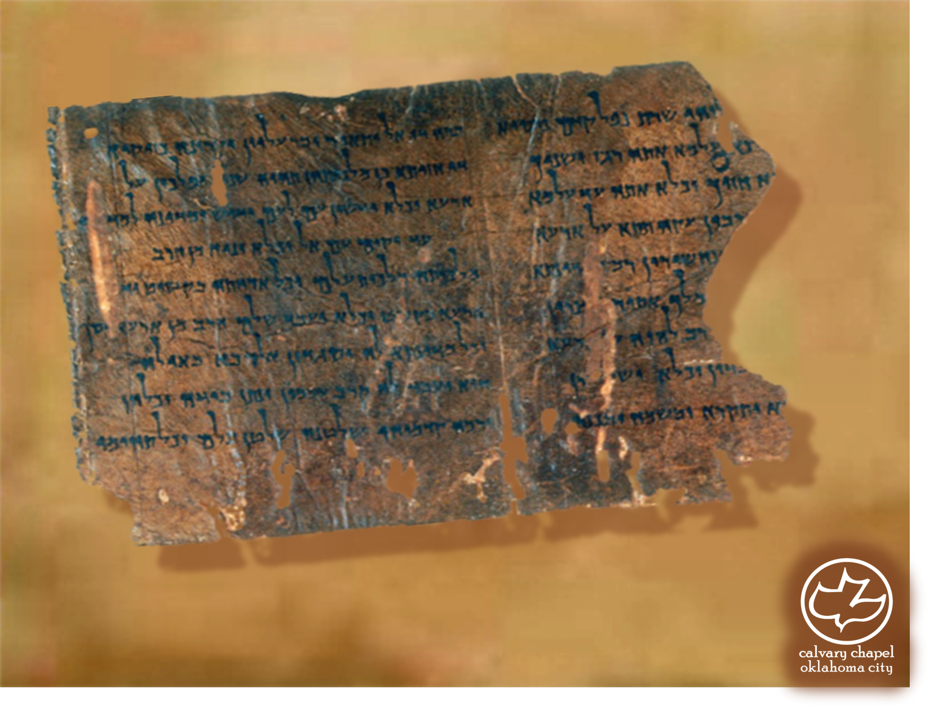

Minor Prophets … Major Message:
Jonah 1:1-2:10
A CD of this message will be available (free of charge) immediately following today's message
This message will be available via podcast later this week at calvaryokc.com

Slide 2
Johah 1:1-2:10
Jesus mentioned 4 prophets by name: Elijah, Elisha, Isaiah and Jonah

Slide 3
Johah 1:1-2:10
1 Kings 14:25 ~ He (Jeroboam II – 793-752 BC ) restored the territory of Israel from the entrance of Hamath to the Sea of the Arabah, according to the word of the Lord God of Israel, which He had spoken through His servant Jonah the son of Amittai, the prophet who was from Gath Hepher.

Slide 4
Johah 1:1-2:10
840BC
820BC
800BC
780BC
760BC
740BC
Jonah
Micah
Jeroboam II
Amos
Hosea
Isaiah

Slide 5
Jonah 1:1-2:10
Jonah and His Critics
Distance around city less than 8 miles
3:3 ~ So Jonah arose and went to Nineveh, according to the word of the LORD. Now Nineveh was an exceedingly great city, a three-day journey in extent.

Slide 6
Jonah 1:1-2:10
Jonah and His Critics
Plagues in 765 and 759 BC
Solar eclipse, June 15, 763 BC
Ashur-dan III, 772-754 BC – weak and ineffectual

Slide 7
Jonah 1:1-2:10
enclosed alive in the bricks of the wall, some of them were crucified on stakes along the wall; I caused a great multitude of them to be flayed in my presence, and I covered the wall with their skins. I gathered together the heads in the form of crowns, and their pierced bodies in the form of garlands.”
(From an Assyrian general’s war journal) “I slew two hundred and sixty fighting men; I cut off their heads and made pyramids thereof. I slew one of every two. I built a wall before the great gates of the city; I flayed the chief men of the rebels, and I covered the wall with their skins. Some of them were

Slide 8
Jonah 1:1-2:10
Jonah ~ Dove
Amittai ~ My truth

Slide 9
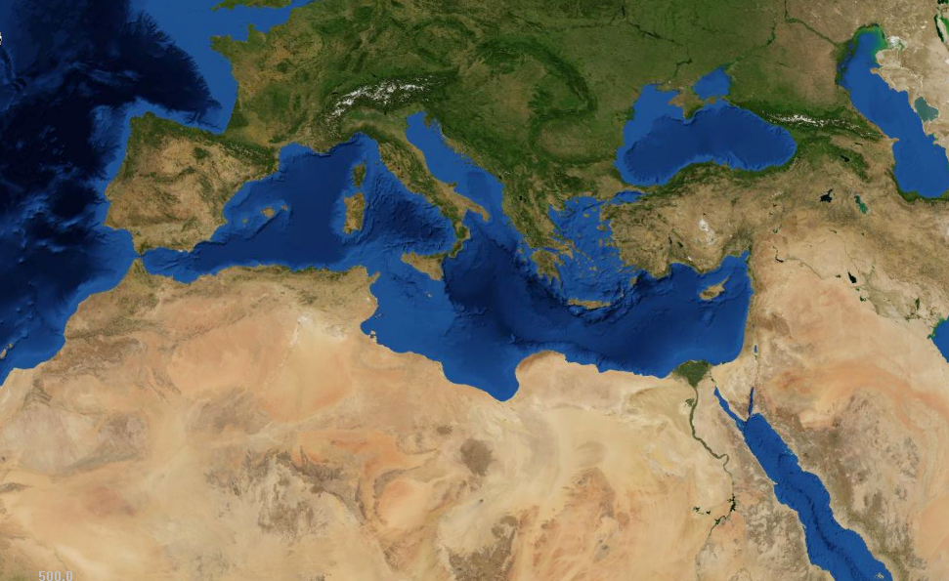
Jonah 1:1-2:10
Tarshish
Nineveh
2500 mi.
500 mi.
Joppa

Slide 10
Jonah 1:1-2:10
Sent out ~ literally hurled (NASB)

Slide 11
Jonah 1:1-2:10
Fear ~ yare’ (KJV – worship)

Slide 12
Jonah 1:1-2:10
Fish ~ dag
Whale ~ tannim
Matt. 12:40 (KJV) ~ whale – kētos, literally, sea monster (NASB)

Slide 13
Jonah 1:1-2:10
Matt. 12:38–40 ~ ³⁸ Then some of the scribes and Pharisees answered, saying, “Teacher, we want to see a sign from You.”
³⁹ But He answered and said to them, “An evil and adulterous generation seeks after a sign, and no sign will be given to it except the sign of the prophet Jonah.
⁴⁰ For as Jonah was three days and three nights in the belly of the great fish, so will the Son of Man be three days and three nights in the heart of the earth.

Slide 14
Jonah 1:1-2:10
Rabbi Eleazar ben Azariah ~ “A day and a night make a whole day, and a portion of a whole day is reckoned as a whole day.”
Thursday
Friday
Saturday
Sunday
6pm
6am
6pm
6am
6pm
6am
6pm
6am
Day 1
Day 1
Day 2
Day 1
Day 2
Day 3
Day 2
Day 3
Day 3

Slide 15
Jonah 1:1-2:10
D. A. Carson ~ “Three days and three nights is a special phrase used in the ancient world with the meaning ‘long enough to be definitely dead’. It derives originally from the ancient pagan notion that the soul’s trip to the after-world took three days and nights. Jesus’ use of the same
phrase for the duration of his death before his resurrection carries a similar force: it is a way of saying that he would really die, not that he would be literally dead for exactly seventy-two hours.”

Slide 16
Jonah 1:1-2:10
Ps. 18:6 ~ In my distress I called upon the LORD, And cried out to my God; He heard my voice from His temple, And my cry came before Him, even to His ears.

Slide 17
Jonah 1:1-2:10
C. H. Spurgeon ~ “I do not know of a more gloomy sentence that human lips can speak than this, — ‘I am cast out of thy sight …’”
“I do not know of a more hopeful resolution that the human heart can determine upon than this, — ‘Yet I will look again toward thy holy temple.’”

Slide 18
Jonah 1:1-2:10
Worthless idols ~ literally, empty nothings

