Slide 1
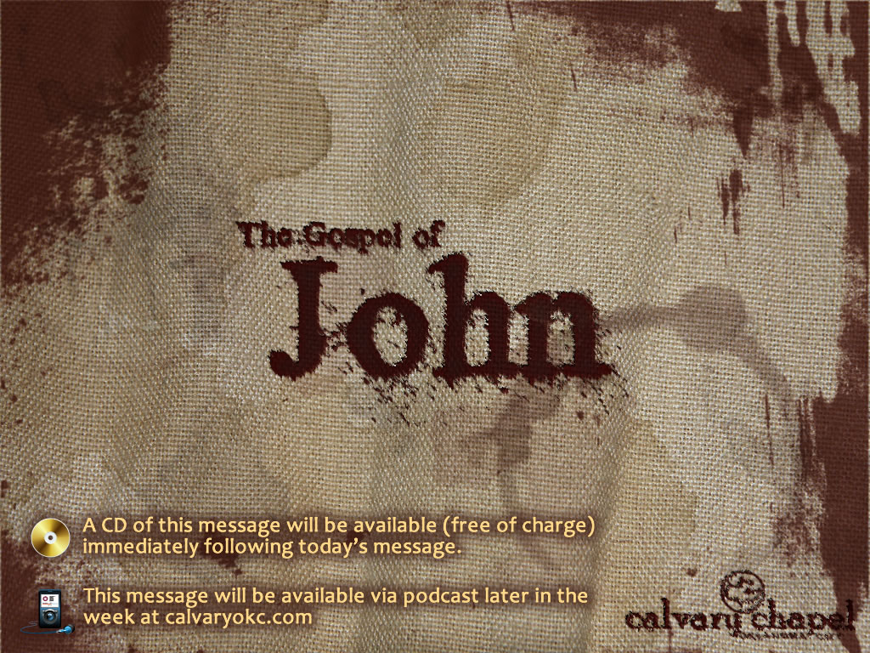
21:1-25

Slide 2
21:1-25
I fled Him, down the nights and down the days,
I fled Him, down the arches of the years,
I fled Him, down the labyrinthine ways
Of my mind; and in the midst of tears
I hid from Him, and under running laughter.
Up vistaed hopes I sped;
And shot, precipitated,
Adown Titanic glooms of chasmed fears,
From those strong Feet that followed, followed after … – excerpted from The Hound of Heaven, by Francis Thompson

Slide 3
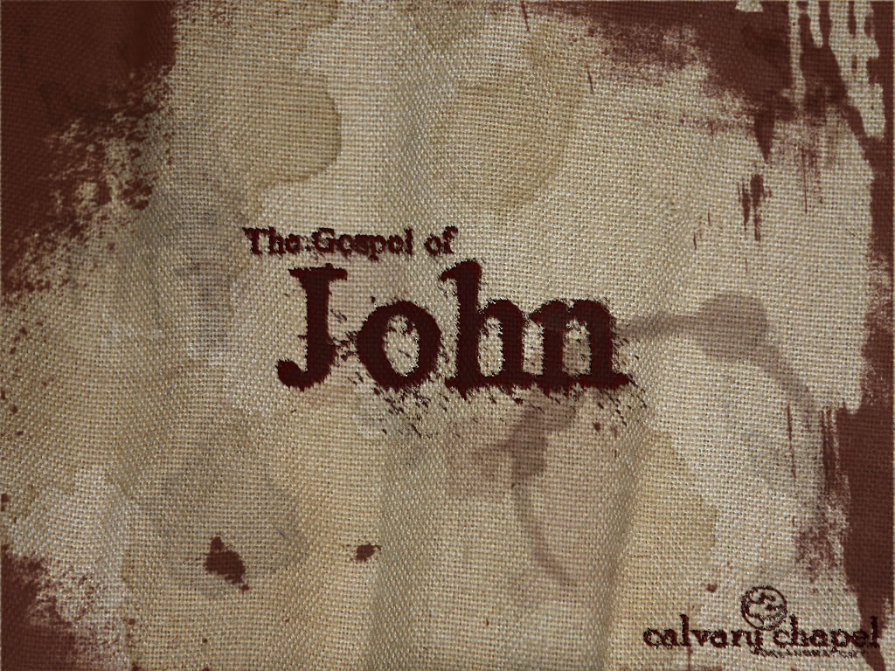
21:1-25

Slide 4
21:1-25
Children ~ paidion – infant, small child

Slide 5
21:1-25

Slide 6
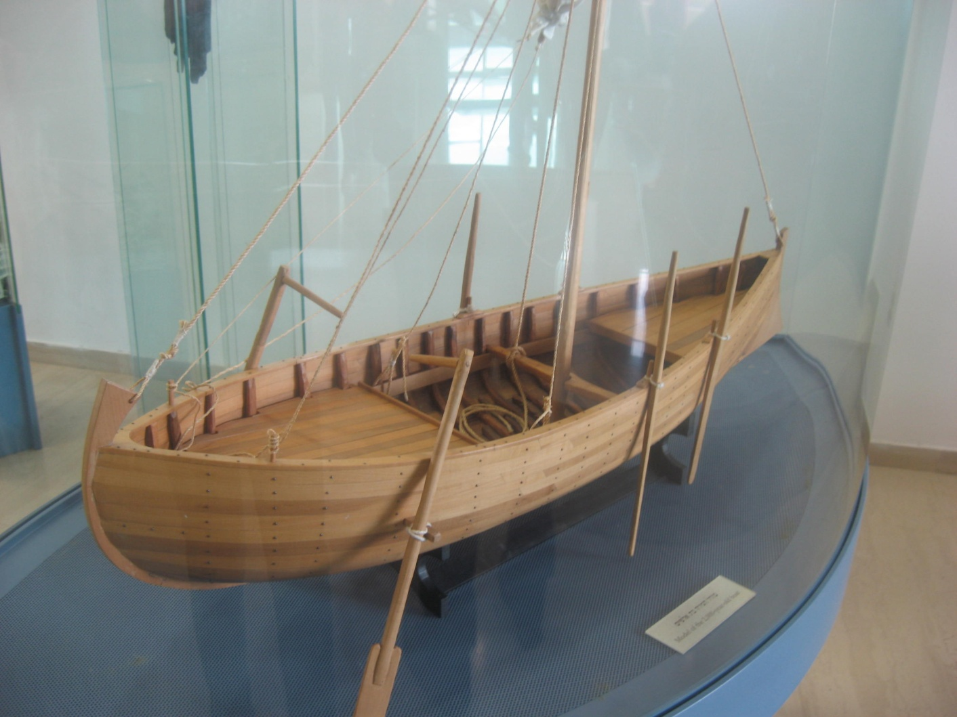
21:1-25
Luke 5:8 ~ "Depart from me, for I am a sinful man, O Lord!"
26.5'
7.5'

Slide 7
21:1-25

Slide 8
21:1-25
200 cu.

Slide 9
21:1-25

Slide 10
21:1-25
Cyril of Alexandria ~ 100 = fullness of the Gentiles, 50 = remnant of Israel, 3 = Trinity
Augustine ~ 10 = Law, 7 = Grace (10 + 7 = 17)
1 + 2 + 3 + 4 + 5 + 6 + 7 + 8 + 9 + 10 + 11 + 12 + 13 + 14 + 15 + 16 + 17 =
153
Jerome ~ 153 different kinds of fish (sea = world)
Not broken ~ ou + schizō

Slide 11
21:1-25

Slide 12
21:1-25
These?
Disciples?
Jesus?
Fish?

Slide 13
21:1-25

Slide 14
21:1-25
v. 16 ~ He said to him again a second time, “Simon, son of Jonah, do you agapaō Me?”
He said to Him, “Yes, Lord; You know that I love phileō You.”
He said to him, “poimainō My probaton.”
v. 17 ~ He said to him the third time, “Simon, son of Jonah, do you phileō Me?” Peter was grieved because He said to him the third time, “Do you phileō Me?”
And he said to Him, “Lord, You eidō all things; You ginōskō that I phileō You.”
v. 15 ~ "Simon, son of Jonah, do you agapaō Me more than these?" He said to Him, "Yes, Lord; You know that I phileō You." He said to him, "Boskō My arnion."
agapaō ~ unconditional love
eidō ~ to know, to perceive
phileō ~ strong affection
ginōskō ~ to know completely
boskō ~ feed
arnion ~ little lambs
poimainō ~ to shepherd
probaton~ sheep

Slide 15
21:1-25

Slide 16
21:1-25
Restoration involves three things:
Humility
Honesty
Love

Slide 17
21:1-25

Slide 18
21:1-25
1. Water to wine
Hebrew Chiasm
1a. Followed by cleansing of Temple
An ancient literary technique in which concepts or ideas are placed in a special symmetric order or pattern in a chiastic structure to emphasize them.
I. e. ABC … CBA, etc.
2. Raising the nobleman's son
2a. Followed by commendation of faith
3. Lame man at Bethesda
3a. Followed by Sabbath debate
* Miracles #4 & 5 both culminated in the teaching that Jesus is sufficient to every need
4. Feeding the 5000 *
5. Walking on the water *
6. Healing of the man born blind
6a. Followed by Sabbath debate
7. Raising Lazarus
7a. Followed by admonition for lack of faith
8. 153 fish
8a. Followed by restoration of Peter

Slide 19
21:1-25

