Slide 1
20:1-31

Slide 2
20:1-31
Classical-historical method
1) Impact of His life
2) Fulfilled prophecy
3) Resurrection
J. Gresham Mechen ~ "Christianity is not built upon a complex of ideas, but upon a historical fact – the resurrection."
Simon Greenleaf, Laws of Legal Evidence (3 vol.)

Slide 3
20:1-31

Slide 4
20:1-31
First day of the week ~ 1st day after the 1st Sabbath after the Passover
: Feast of Firstfruits

Slide 5
20:1-31
Taken away ~ aireō - to lift up
Synoptics ~ rolled back ~ apokuliō (kuliō, wallow)

Slide 6
20:1-31

Slide 7
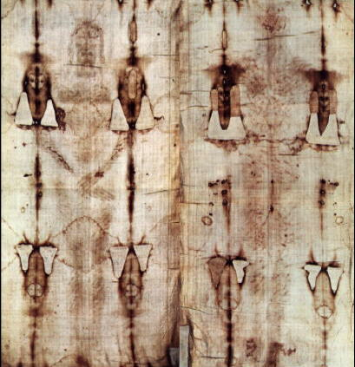
20:1-31
The Shroud of Turin

Slide 8
20:1-31

Slide 9
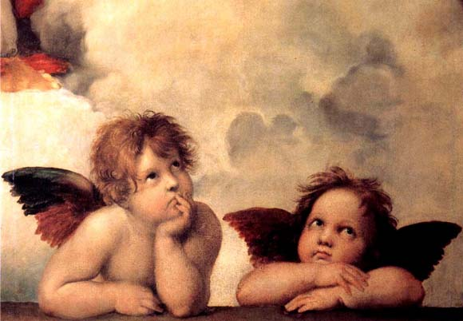
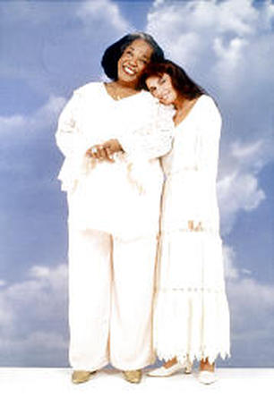
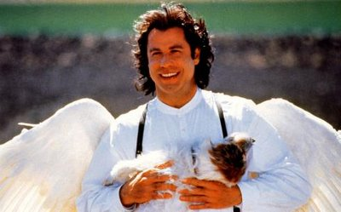
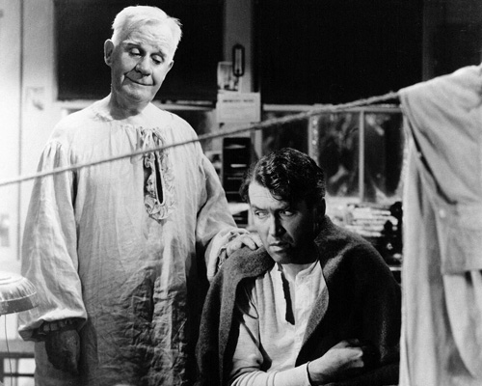
20:1-31

Slide 10
20:1-31

Slide 11
20:1-31
Literally, "Stop clinging to me"

Slide 12
20:1-31

Slide 13
20:1-31
Luke 24:11 ~ And their words seemed to them like idle tales, and they did not believe them.

Slide 14
20:1-31

Slide 15
20:1-31
Glad ~ NASB, rejoiced; NIV, overjoyed

Slide 16
20:1-31

Slide 17
20:1-31
Breathed ~ emphusaō – in LXX only in Gen. 2:7

Slide 18
20:1-31

Slide 19
20:1-31
Moody ~ "If everyone in world understood the love of God, I could make everyone in the world a convert."

Slide 20
20:1-31

