Slide 1
19:19-42

Slide 2
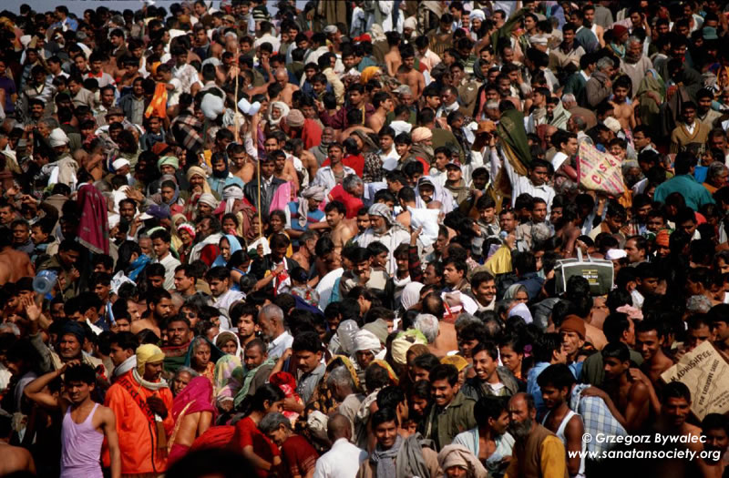
19:19-42
Kumbh Mela

Slide 3
19:19-42

Slide 4
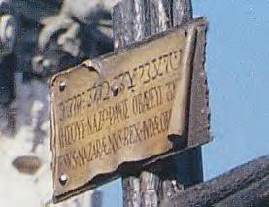
19:19-42
I
N
R
I
ESVS
azarenvs
EX
udaeorvm

Slide 5
19:19-42

Slide 6
19:19-42
Caiaphas called Him "Savior"
John 11:50b-51 ~ ^{50b} " … it is expedient for us that one man should die for the people, and not that the whole nation should perish." ⁵¹ Now this he did not say on his own authority; but being high priest that year he prophesied that Jesus would die for the nation,
Pilate called Him "King"

Slide 7
19:19-42

Slide 8
19:19-42
Ps. 22:14-18 ~ NLT ¹⁴ My life is poured out like water, and all my bones are out of joint.
My heart is like wax, melting within me.
¹⁵ My strength has dried up like sunbaked clay.
My tongue sticks to the roof of my mouth.
You have laid me in the dust and left me for dead.
¹⁶ My enemies surround me like a pack of dogs;
an evil gang closes in on me.
They have pierced my hands and feet.
¹⁷ I can count every bone in my body.
My enemies stare at me and gloat.
¹⁸ They divide my clothes among themselves
and throw dice for my garments.

Slide 9
19:19-42

Slide 10
19:19-42
David Guzik ~ "Jesus came all the way down the ladder to accomplish our salvation. He let go of absolutely everything – even His clothes – becoming completely poor for us, so we could become completely rich in Him."

Slide 11
19:19-42

Slide 12
19:19-42
Matthew 27:56 | Mark 15:40 | John 19:25
-- | -- | His mother, Mary
Mary Magdalene | Mary Magdalene | Mary Magdalene
Mary, mother of James and Joses | Mary, mother of James the Less and Joses | Mary, wife of Clopas
Mother of Zebedee's sons | Salome | His mother's sister

Slide 13
19:19-42
Matthew 27:56 | Mark 15:40 | John 19:25
Matt. 20: 22 ~ But Jesus answered and said, "You do not know what you ask. Are you able to drink the cup that I am about to drink, and be baptized with the baptism that I am baptized with?" They said to Him, "We are able."

Slide 14
19:19-42

Slide 15
19:19-42
Ps. 69:21 ~ They also gave me gall for my food, And for my thirst they gave me vinegar to drink.

Slide 16
19:19-42

Slide 17
19:19-42
"It is finished!" ~ tetelestai
"Describes an action which is viewed as having been completed in the past, once and for all, not needing to be repeated.
"Jesus’ last cry from the cross, TETELESTAI ('It is finished!') is a good example of the perfect tense used in this sense, namely 'It [the atonement] has been accomplished, completely, once and for all time.'"
Wuest ~ It has been finished and stands complete.

Slide 18
19:19-42
Do
ne

Slide 19
19:19-42

Slide 20
19:19-42
Luke 23:46 ~ And when Jesus had cried out with a loud voice, He said, "Father, ‘into Your hands I commit My spirit.’"
Ps. 31:5

Slide 21
19:19-42

Slide 22
19:19-42
On Him ~ eis

Slide 23
19:19-42

Slide 24
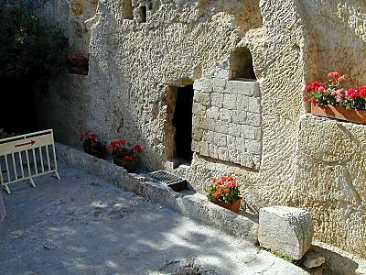
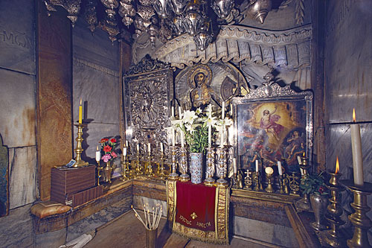
19:19-42
Church of the Holy Sepulchre
The Garden Tomb

Slide 25
19:19-42

Slide 26
19:19-42
Ps. 103:12 ~ As far as the east is from the west, So far has He removed our transgressions from us.

Slide 27
19:19-42

