Slide 1
19:1-18

Slide 2
19:1-18
"Ohhhhh, That's Bad."
"Ohhhhh, That's Good."
"Ohhhhh, That's Bad."
"No, that's Awful!"
"Ohhhhh, That's Good."
"Ohhhhh, That's Bad."
"Ohhhhh, That's Good."
"Ohhhhh, That's Bad."

Slide 3
19:1-18

Slide 4
19:1-18
Scourged ~ mastigoō (from a root meaning to chew or gnaw )
Cat o' nine tails
Latin flagellum
NLT ~ lead-tipped whip

Slide 5
19:1-18

Slide 6
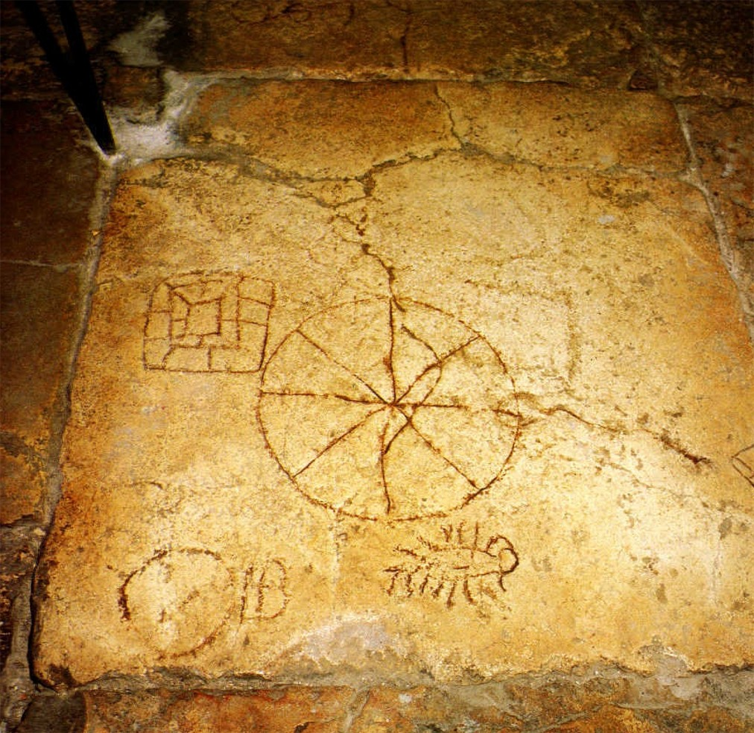
19:1-18
The "King's Game"

Slide 7
19:1-18

Slide 8
19:1-18
Is. 50:6 (NLT) ~ I give my back to those who beat me and my cheeks to those who pull out my beard. I do not hide from shame, for they mock me and spit in my face.
Is. 52:14 (NLT) ~ Many were amazed when they saw him—beaten and bloodied, so disfigured one would scarcely know he was a person.

Slide 9
19:1-18

Slide 10
19:1-18
Lev. 24:16 ~ And whoever blasphemes the name of the LORD shall surely be put to death. All the congregation shall certainly stone him, the stranger as well as him who is born in the land. When he blasphemes the name of the LORD, he shall be put to death.

Slide 11
19:1-18
Deut. 21:22–23 ~ ²² “If a man has committed a sin deserving of death, and he is put to death, and you hang him on a tree, ²³ his body shall not remain overnight on the tree, but you shall surely bury him that day, so that you do not defile the land which the Lord your God is giving you as an inheritance; for he who is hanged is accursed of God.

Slide 12
19:1-18

Slide 13
19:1-18
Latin ~ patibulum (between 75-125 lb)

Slide 14
19:1-18

