Slide 1
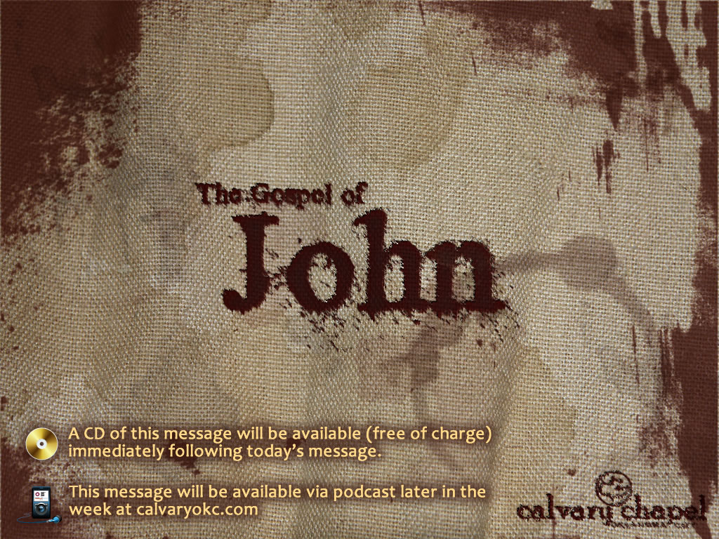
18:15-40

Slide 2
18:15-40
Strike ~ derō – to flay, to scourge, to thrash

Slide 3
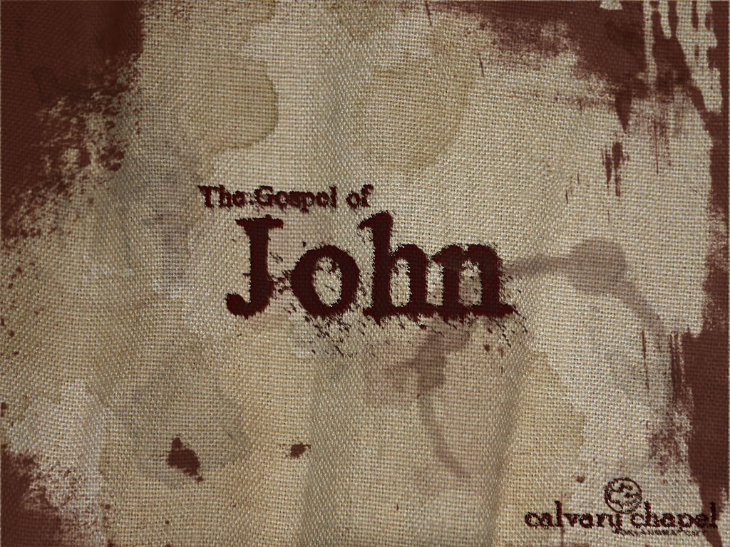
18:15-40

Slide 4
18:15-40
Luke 22:61-62 ~ ⁶¹ And the Lord turned and looked at Peter. And Peter remembered the word of the Lord, how He had said to him, "Before the rooster crows, you will deny Me three times." ⁶² So Peter went out and wept bitterly.

Slide 5
18:15-40

Slide 6
18:15-40
Praetorium ~ KJV, hall of judgment

Slide 7
18:15-40

Slide 8
18:15-40
Gen. 49:10 ~ The scepter shall not depart from Judah, nor a lawgiver from between his feet, until Shiloh comes.

Slide 9
18:15-40

Slide 10
18:15-40
Deut. 21:22–23 ~ ²² “If a man has committed a sin deserving of death, and he is put to death, and you hang him on a tree, ²³ his body shall not remain overnight on the tree, but you shall surely bury him that day, so that you do not defile the land which the Lord your God is giving you as an inheritance; for he who is hanged is accursed of God.

Slide 11
18:15-40

Slide 12
18:15-40
John 3:14-16 ~ ¹⁴ And as Moses lifted up the serpent in the wilderness, even so must the Son of Man be lifted up, ¹⁵ that whoever believes in Him should not perish but have eternal life. ¹⁶ For God so loved the world that He gave His only begotten Son, that whoever believes in Him should not perish but have everlasting life.

Slide 13
18:15-40

Slide 14
18:15-40
Of this world ~ ek, literally "out of"

Slide 15
18:15-40

Slide 16
18:15-40
Robber ~ lestēs (openly) not, kleptēs (hidden)
Barabbas ~ son of the father

Slide 17
18:15-40

