Slide 1

18:1-14

Slide 2
18:1-14
Kidron ~ turbid, murky
Josephus: 250,000 lambs each Passover
Gethsemane ~ olive press

Slide 3

18:1-14

Slide 4
18:1-14
Luke 22:41-44 ~ ⁴¹ And He was withdrawn from them about a stone’s throw, and He knelt down and prayed, ⁴² saying, "Father, if it is Your will, take this cup away from Me; nevertheless not My will, but Yours, be done." ⁴³ Then an angel appeared to Him from heaven, strengthening Him. ⁴⁴ And being in agony, He prayed more earnestly. Then His sweat became like great drops of blood falling down to the ground.

Slide 5
18:1-14

Slide 6
18:1-14
Matt. 26:48 ~ ⁴⁸ Now His betrayer had given them a sign, saying, "Whomever I kiss, He is the One; seize Him." ⁴⁹ Immediately he went up to Jesus and said, "Greetings, Rabbi!" and kissed Him.

Slide 7
18:1-14

Slide 8

18:1-14
Detachment ~ speira – 600 troops

Slide 9
18:1-14

Slide 10
18:1-14
I Am ~ egō eimi
John 8:58 ~ Jesus said to them, "Most assuredly, I say to you, before Abraham was, I AM."

Slide 11
18:1-14

Slide 12
18:1-14
Lu. 22:36-38 ~ ³⁶ Then He said to them, "But now, he who has a money bag, let him take it, and likewise a knapsack; and he who has no sword, let him sell his garment and buy one. ³⁷ "For I say to you that this which is written must still be accomplished in Me: ‘And He was numbered with the transgressors.’ For the things concerning Me have an end." ³⁸ So they said, "Lord, look, here are two swords." And He said to them, "It is enough."

Slide 13
18:1-14

Slide 14
18:1-14
Dietrich Bonhoeffer, Letters and Papers From Prison ~ "The fanatic thinks that his single-minded principles qualify him to do battle with the powers of evil; but like a bull he rushes at the red cloak instead of at the person who is holding it; he exhausts himself and is beaten. He gets entangled in non-essentials and falls into the trap set by cleverer people."

Slide 15
18:1-14
Eph. 6:12 ~ For we do not wrestle against flesh and blood, but against principalities, against powers, against the rulers of the darkness of this age, against spiritual hosts of wickedness in the heavenly places.

Slide 16
18:1-14

Slide 17
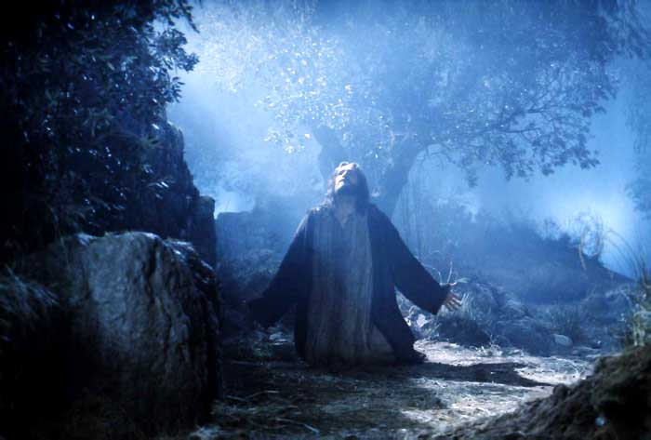
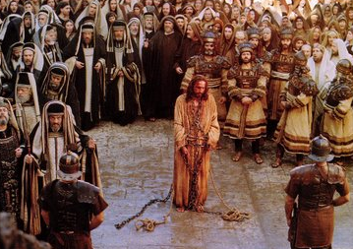
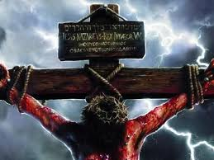
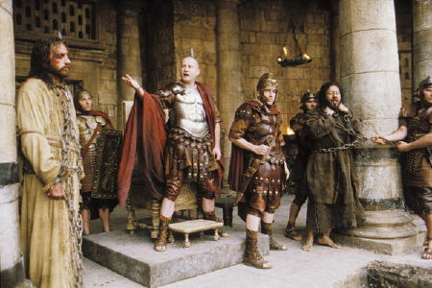
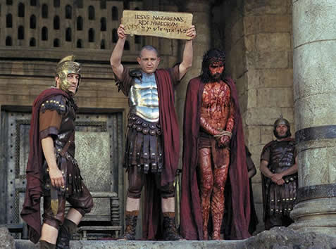
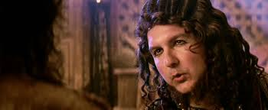
18:1-14
Pilate’s Quarters
Calvary
Gethsemane
Council Chambers
Herod’s Palace
Last Supper
From the “Upper Room” to “The Place of the Skull”
Annas (Jn. 18:18-24)
Caiaphas (Matt. 26:57-68)
The next morning (Matt. 27:1)
Pilate (Mark 15:2-5)
Herod (Lu. 23:6-12)
Pilate (Matt. 27:15-30)

Slide 18
18:1-14

