Slide 1
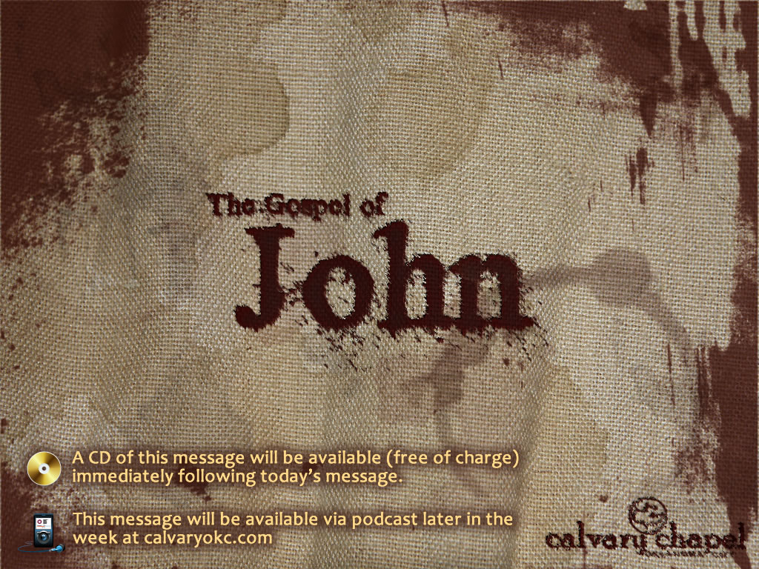
17:14-26

Slide 2
17:14-26
2 Cor. 5:17 ~ If anyone be in Christ,
he is a new creation;
he is a white-washed Adam
old things have passed away; behold, all things have become new.

Slide 3

17:14-26

Slide 4
17:14-26
“The Church is in the world as it ought to be …
unfortunately the world is in the Church as it ought not to be.”

Slide 5
17:14-26
Submarine in water … good thing
Water in submarine … bad thing

Slide 6
17:14-26
D. L. Moody ~ "If I walk with the world, I cannot walk with God."

Slide 7
17:14-26

Slide 8
17:14-26
"What the fathers did in moderation, the children will do in excess."

Slide 9
17:14-26

Slide 10
17:14-26
2 ways we can divide the Body
1) Exclusivism
2) False doctrine

Slide 11
17:14-26
Rom. 16:17 ~ Now I urge you, brethren, note those who cause divisions and offenses, contrary to the doctrine which you learned, and avoid them.
2 Thess. 3:14 ~ And if anyone does not obey our word in this epistle, note that person and do not keep company with him, that he may be ashamed.
Walter Martin – "Controversy for the sake of controversy is sin; Controversy for the sake of truth is a divine command."

Slide 12
17:14-26

Slide 13


17:14-26
Apostles'
Doctrine

Slide 14
17:14-26

Slide 15
17:14-26
1 Cor. 13:12 ~ For now we see in a mirror, dimly, but then face to face. Now I know in part, but then I shall know just as I also am known.

Slide 16
17:14-26

Slide 17
17:14-26
Declared ~ gōrizō – to make known or recognized

Slide 18
17:14-26

