Slide 1
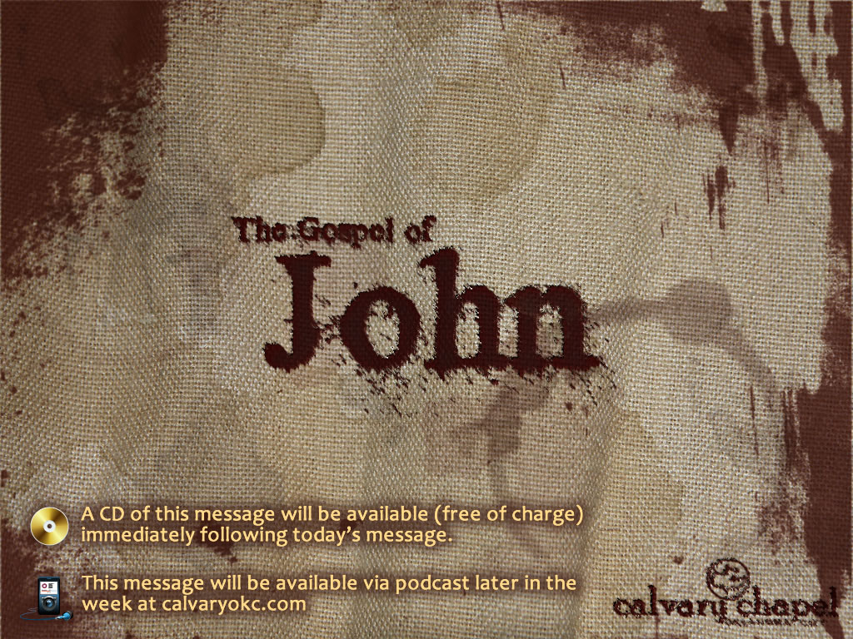
17:1-13

Slide 2
17:1-13
Rom. 8:26 ~ Likewise the Spirit also helps in our weaknesses. For we do not know what we should pray for as we ought, but the Spirit Himself makes intercession for us with groanings which cannot be uttered.

Slide 3

17:1-13

Slide 4
17:1-13
Spurgeon ~ "Prayer is not so much about length as it is about weight."

Slide 5
17:1-13

Slide 6
17:1-13
Glorify ~ doxa (opinion)

Slide 7
17:1-13

Slide 8
17:1-13
Three Persons
Father
One Being
IS
GOD
IS
IS
Son
Spirit

Slide 9
17:1-13

Slide 10
17:1-13
Know ~ not oida (intuitive), but ginōskō (experiential)
Present tense (knowing)

Slide 11
17:1-13

Slide 12
17:1-13
Manifested ~ phaneroō – to make visible
Ps. 9:10 ~ And those who know Your name will put their trust in You; For You, Lord, have not forsaken those who seek You.
Ps. 20:7 ~ Some trust in chariots, and some in horses;
But we will remember the name of the Lord our God.
Prov. 3:5-6 ~ ⁵ Trust in the Lord with all your heart,
And lean not on your own understanding;
⁶ In all your ways acknowledge Him,
And He shall direct your paths.

Slide 13
17:1-13

Slide 14
17:1-13
World ~ kosmos – a society organizing itself without God
3rd of 19x in chapter

Slide 15
17:1-13

Slide 16
17:1-13
"No creature could ever pray this." ~ Martin Luther

Slide 17
17:1-13

Slide 18
17:1-13
John 15:11 ~ "These things I have spoken to you, that My joy may remain in you, and that your joy may be full."
John 16:24 ~ "Until now you have asked nothing in My name. Ask, and you will receive, that your joy may be full."
1 John 1:3, 4 ~ ³ that which we have seen and heard we declare to you, that you also may have fellowship with us; and truly our fellowship is with the Father and with His Son Jesus Christ. ⁴ And these things we write to you that your joy may be full.

Slide 19
17:1-13

