Slide 1
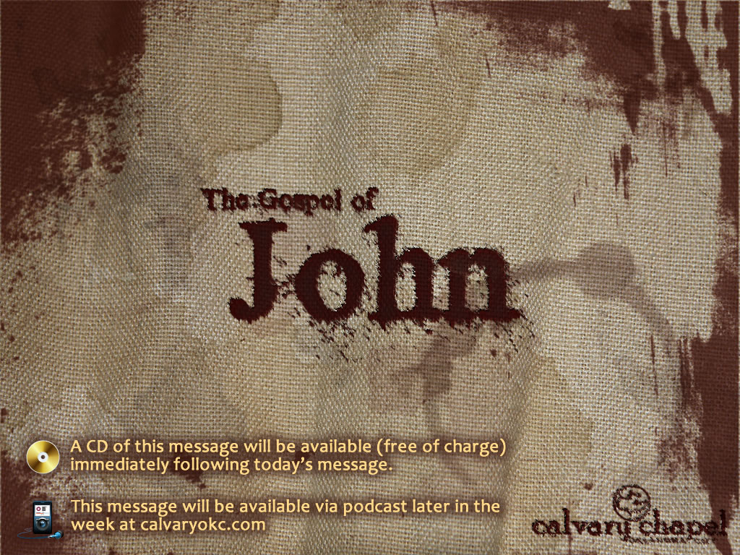
15:18-16:4

Slide 3
15:18-16:4
Hates ~ miseō – to detest

Slide 4
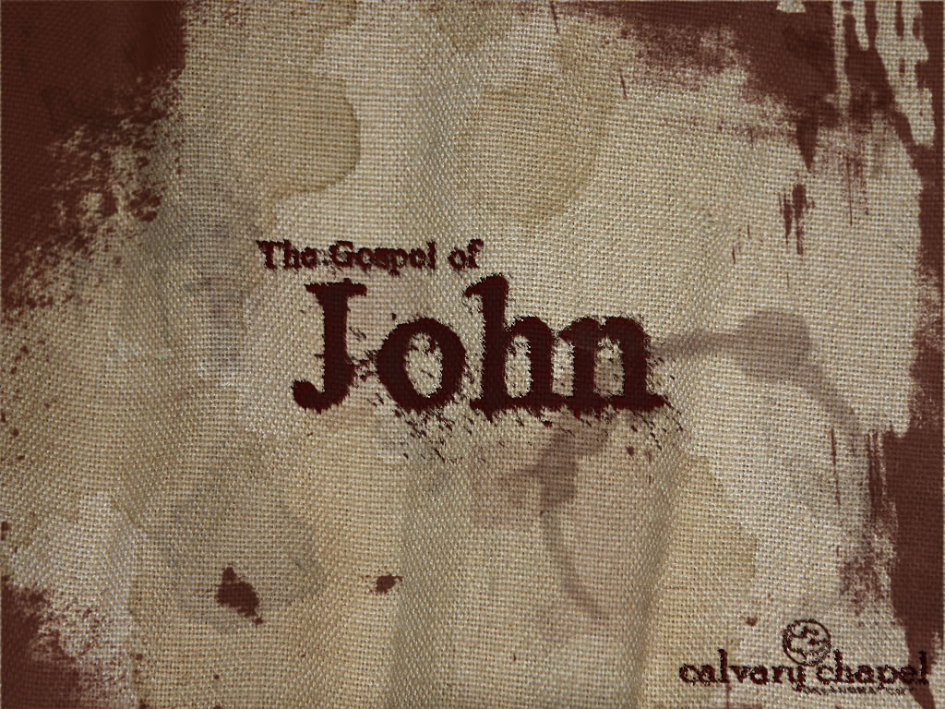
15:18-16:4

Slide 5
15:18-16:4
1 Thess. 4:10b-12 ~ ^{10b} But we urge you, brethren, that you increase more and more; ¹¹ that you also aspire to lead a quiet life, to mind your own business, and to work with your own hands, as we commanded you, ¹² that you may walk properly toward those who are outside, and that you may lack nothing.

Slide 6
15:18-6:4

Slide 7
15:18-16:14
World ~ kosmos – an orderly arrangement (cosmetics)
The world's system as set in opposition to God

Slide 8
15:18-16:4

Slide 9
15:18-16:4
Service ~ latreia
Rom. 12:1 ~ I beseech you therefore, brethren, by the mercies of God, that you present your bodies a living sacrifice, holy, acceptable to God, which is your reasonable
service.
act of worship.
Former U. S. A/G John Ashcroft ~ "Islam is a religion in which God requires you to send your son to die for him. Christianity is a faith in which God sent his Son to die for you."

Slide 10
15:18-16:4

