Slide 1
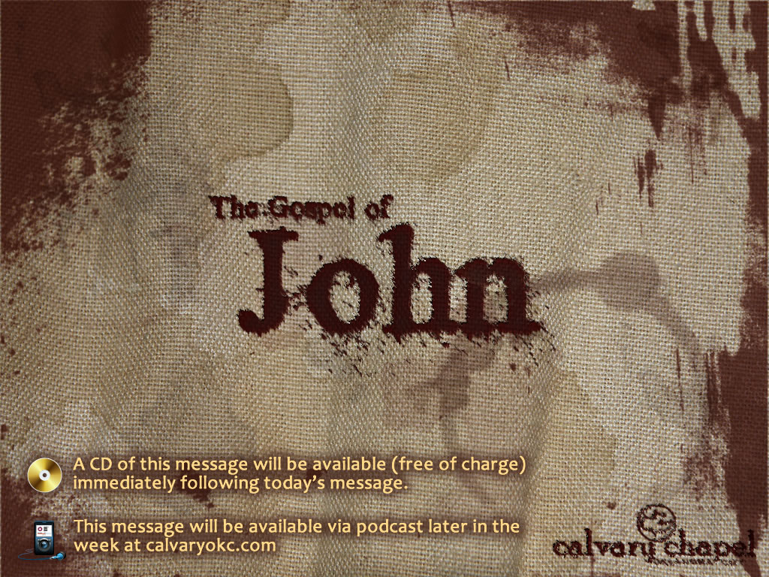
15:1-17

Slide 2
15:1-17

Slide 3
15:1-17
True ~ alēthinos – from a root meaning unhidden or to reveal
Vinedresser ~ geōrgos – gē (earth) + ergon (work) literally earth-worker

Slide 4

15:1-17

Slide 5
15:1-17
Takes away ~ airō – literally lifts up
Prunes ~ kathairō – literally to cleanse

Slide 6
15:1-17

Slide 7
15:1-17
Abide ~ menō – 34x in John; 13x in chapter

Slide 8
15:1-17

Slide 9
15:1-17
Fruit-bearing is not produced by human effort
Fruit-bearing is not produced by inactivity

Slide 10
15:1-17

Slide 11

15:1-17
"If I covet any place on earth but the dust at the foot of the cross, then I know nothing of Calvary love." – Amy Carmichael

Slide 12
15:1-17

Slide 13
15:1-17
"If I have not the patience of my Savior with souls who grow slowly; if I know little of travail (a sharp and painful thing) till Christ be fully formed in them, then I know nothing of Calvary love." – Amy Carmichael

Slide 14
15:1-17

Slide 15
15:1-17
10:10b ~ … I have come that they may have life, and that they may have it more abundantly.
12:24b ~ … unless a grain of wheat falls into the ground and dies, it remains alone; but if it dies, it produces much grain.
13:17 ~ If you know these things, blessed are you if you do them.
Abiding

Slide 16
15:1-17

Slide 17
15:1-17
"If my interest in the work of others is cool; if I think in terms of my own special work; if the burdens of others are not my burdens too, and their joys mine, then I know nothing of Calvary love." – Amy Carmichael

Slide 18
15:1-17

Slide 19
15:1-17
"If I avoid being 'plowed under,' with all that such plowing entails of rough handling, isolation, uncongenial situations, strange tests, then I know nothing of Calvary love." – Amy Carmichael

Slide 20
15:1-17

Slide 21
15:1-17
Servants ~ douloi (pl. of doulos)
NASB, slaves

Slide 22
15:1-17

Slide 23
15:1-17
Gal 5:22-23a ~ ²² But the fruit of the Spirit is love, joy, peace, longsuffering, kindness, goodness, faithfulness, ^{23a} gentleness, self-control.
"Love is the key. Joy is love singing. Peace is love resting. Longsuffering is love enduring. Kindness is love's touch. Goodness is love's character. Faithfulness is love's habit. Gentleness is love's self-forgetfulness. Self-control is love holding the reins." – Donald Grey Barnhouse

Slide 24
15:1-17

Slide 25
15:1-17
"God loved the world. Go thou and do likewise." Erwin W. Lutzer

Slide 26
15:1-17

