Slide 1
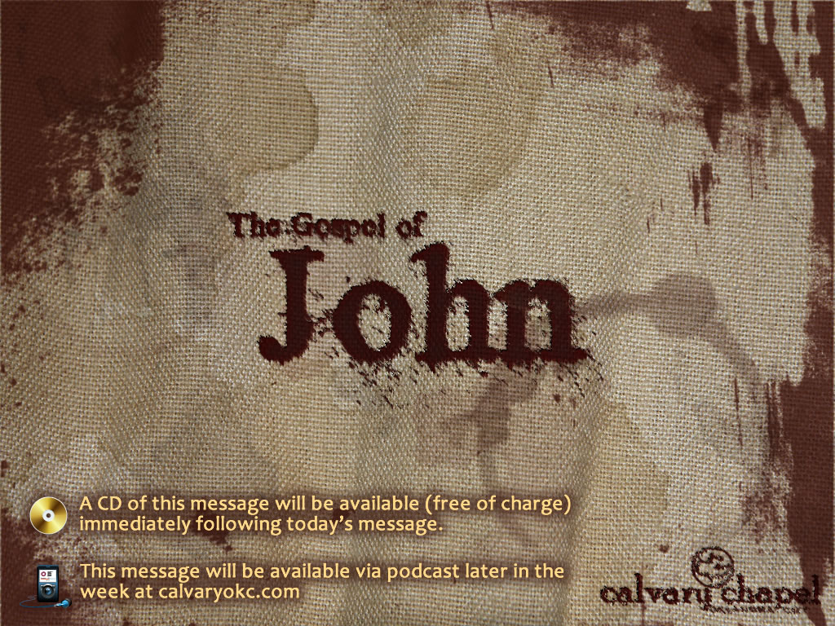
14:15-31

Slide 2
14:15-31

Slide 3

14:15-31

Slide 4
14:15-31
Helper ~ KJV – Comforter
Paraklētos – para (with) + kaleō– to call
Comfort ~ con (L.) (with) + fortis (L.) (to fortify)

Slide 5
14:15-31

Slide 6
14:15-31
Spirit of Jesus ~ Phil. 1:19
Spirit of God ~ 26x
Holy Spirit ~ almost 100x
Another ~ allos - not heteros

Slide 7
14:15-31

Slide 8
14:15-31
"Tolerance is the virtue of the man without convictions." – G. K. Chesterton

Slide 9
14:15-31

Slide 10
14:15-31
Ps. 51:1 ~ Do not cast me away from Your presence, And do not take Your Holy Spirit from me.

Slide 11
14:15-31

Slide 12
14:15-31
Orphans ~ KJV, comfortless – orphanos
Destitute, friendless, bereft of parents

Slide 13
14:15-31

Slide 14
14:15-31
Home ~ monē (noun form of menō ~ to stay, to remain)

Slide 15
14:15-31

