Slide 1
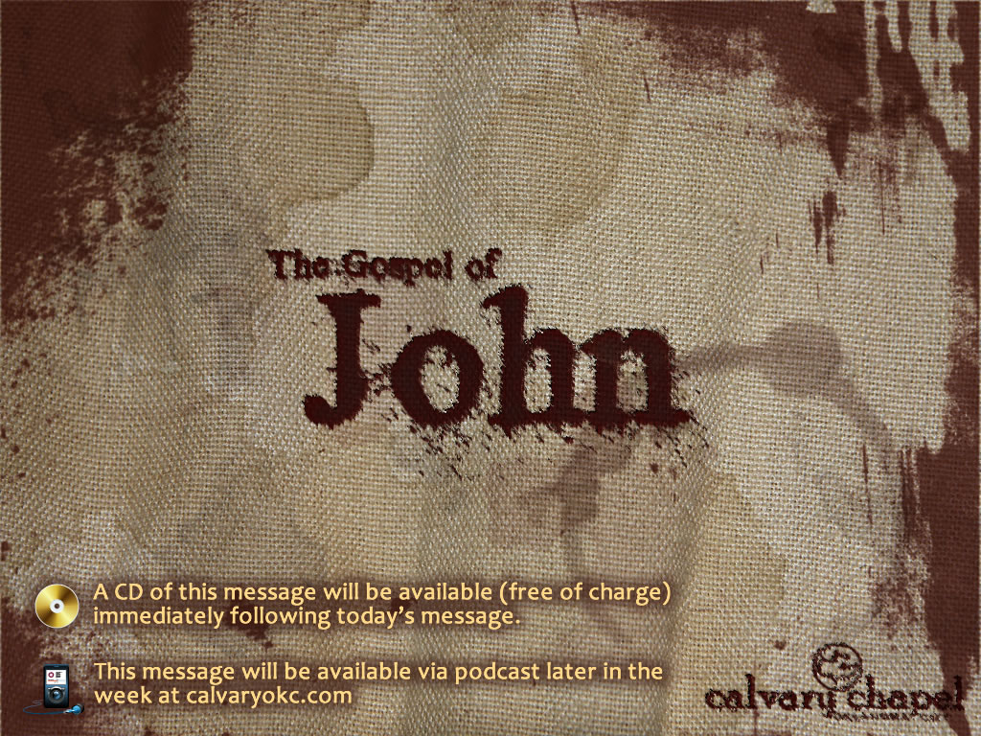
14:1-14

Slide 2
14:1-14
Troubled ~ tarassō – same as 13:21
Believe ~ pisteuō , to have faith in, to place trust with

Slide 3
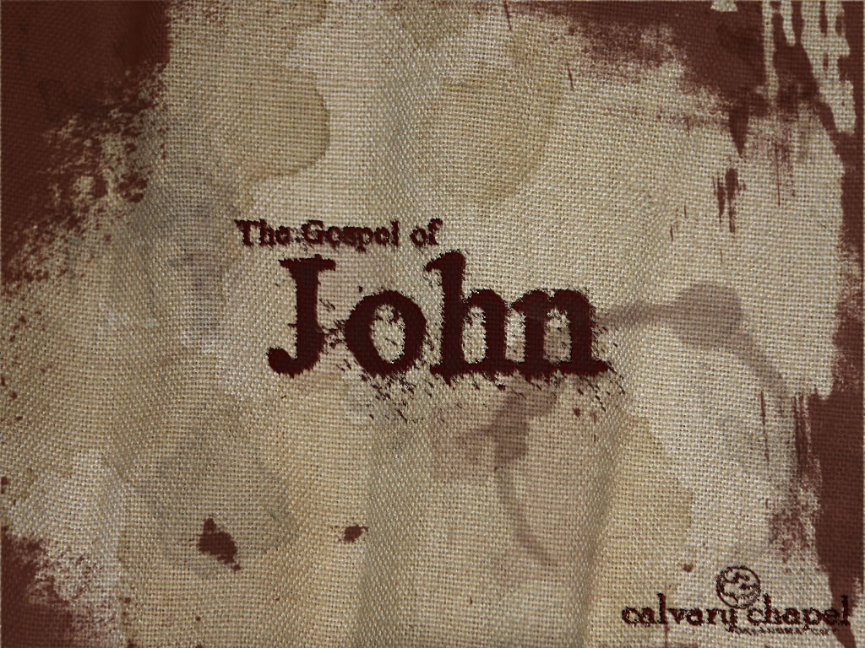
14:1-14

Slide 4
14:1-14
Mansions ~ monē – only here and v. 23 (noun form of menō)

Slide 5
14:1-14

Slide 6
14:1-14
6th of seven "I am" statements in John
6:35; 8:12; 10:7, 10:14; 11:25; ; 15:1
14:6

Slide 7
14:1-14

Slide 8
14:1-14
Karl Barth ~ "No religion reveals God …
His Son does."

Slide 9
14:1-14

Slide 10
14:1-14
Not sēmeion (signs) but ergon (works)

Slide 11
14:1-14

