Slide 1
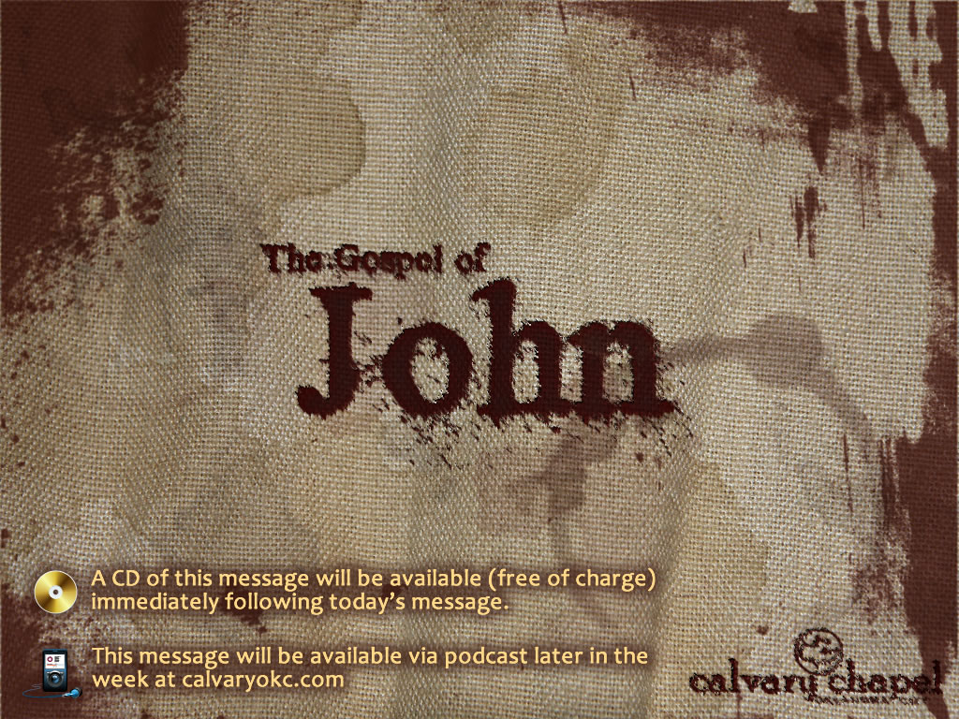
13:18-38

Slide 2
13:18-38
Know ~ eidō – to know, to perceive, to come to understand

Slide 3

13:18-38

Slide 4
13:18-38
Ps. 41:9 ~ Even my own familiar friend in whom I trusted, Who ate my bread, Has lifted up his heel against me.

Slide 5
13:18-38

Slide 6
13:18-38
2 Cor. 4:8 ~ We are hard pressed on every side, yet not crushed; we are perplexed, but not in despair;

Slide 7
13:18-38

Slide 8
13:18-38
Other disciples
Judas
Jesus
Triclinium
Peter
John

Slide 9
13:18-38

Slide 10
13:18-38
F. F. Bruce ~ "Satan could not have entered into him had he not granted him admission. Had he been willing to say "No" to the adversary, all of his Master's intercessory power was available to him there and then to strengthen him. But when a disciple's will turns traitor, when the spiritual aid of Christ is refused, that person's condition is desperate indeed."

Slide 11
13:18-38

Slide 12
13:18-38
Little children ~ teknion – only here by Jesus
7x in 1 John

Slide 13
13:18-38

Slide 14
13:18-38
Matt. 7:20 ~ Therefore by their fruits you will know them.
Gal. 5:22-23a ~ ²² But the fruit of the Spirit is love, joy, peace, longsuffering, kindness, goodness, faithfulness, ^{23a} gentleness, self-control.
Fruit is singular, not plural
1 Cor. 13:4-8 ~ Love is patient; is kind; is not jealous, boastful or proud; does not demand its own way; not irritable or keeps a record of wrong; does not rejoice in injustice but the truth; never gives up, never loses faith; is always hopeful and endures through every circumstance
(NLT)

Slide 15
13:18-38

Slide 16
13:18-38
The Four Loves:
Storgos
~ Family love
Philos
~ Brotherly love
Eros
~ Romantic, sexual love
Agape
~ Unconditional love

Slide 17
13:18-38

Slide 18
13:18-38
C. S. Lewis, The Four Loves ~ "To love at all is to be vulnerable. Love anything, and your heart will certainly be wrung and possibly be broken. If you want to make sure of keeping it intact, you must give your heart to no one, not even to an animal. Wrap it up carefully around your hobbies and little luxuries; avoid all entanglements; lock it up safe in the casket or coffin of your selfishness.
But in that casket – safe, dark, motionless airless – it will change.
, It will not be broken; it will become unbreakable,
impenetrable, irredeemable."

Slide 19
13:18-38

Slide 20
13:18-38
Titus 2:10 ~ …show all good fidelity, that we may adorn the doctrine of God our Savior in all things.
D. G. Barnhouse: "Too often we alienate men by our inconsistency. Instead of adorning the doctrine, as we read in Titus 2:10, we detract from it. The gospel goes out into the world with two strikes against it. God Himself speaks of the offense of the cross, and it is bad enough to have the offense of the cross without having the offense of the disciple. Be sure when someone is offended by Christianity, they are offended,
not by you, but by your doctrine. I can take it, I can stand it, if someone hates Christianity because of what Jesus Christ did and because of what we preach. That, we're to expect. What makes me tremble is that someone anyone should dislike Christianity because of me. Everyone should keep this in mind as we remember that the world looks at the disciple before it looks at the doctrines."

Slide 21
13:18-38

