Slide 1
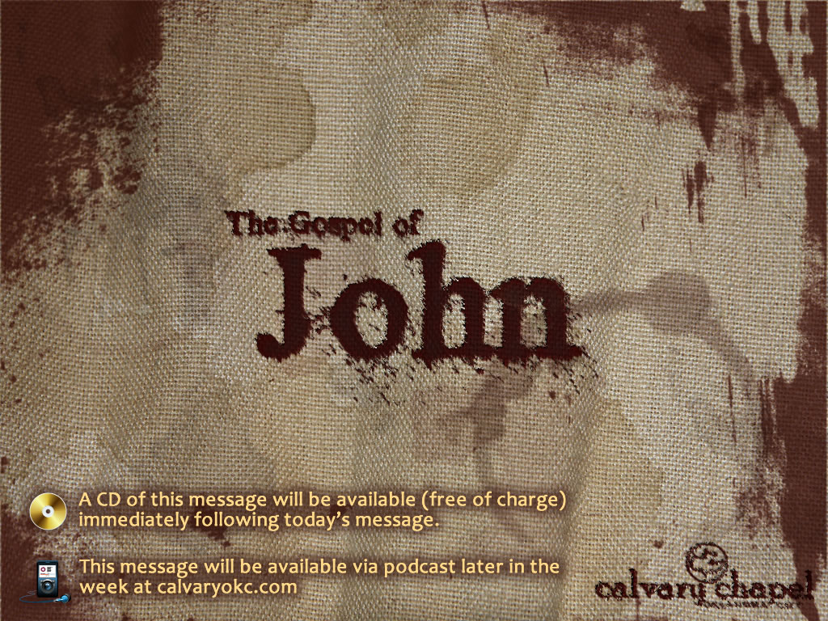
13:1-17

Slide 2
13:1-17
There is a mute who wants to buy a toothbrush. By imitating the action of brushing one's teeth, he successfully expresses himself to the shopkeeper and the purchase is done.
Now if there is a blind man who wishes to buy a pair of sunglasses, how should he express himself?
(scroll down)
He opens his mouth and says. "I would like to buy a pair of sunglasses."

Slide 3

13:1-17

Slide 4
13:1-17
End ~ telos – completely

Slide 5
13:1-17

Slide 6
13:1-17
Being ended ~ NASB better, During supper
Put it into ~ literally thrown into

Slide 7
13:1-17

Slide 8
13:1-17
Towel ~ lention – a linen slave's apron

Slide 9
13:1-17

Slide 10
13:1-17
Literally, "Lord, You, my feet are washing?"

Slide 11
13:1-17

Slide 12
13:1-17
Other disciples
Judas
Jesus
John
Triclinium
Peter

Slide 13
13:1-17

Slide 14
13:1-17
Matthew 16:22 - "Far be it from You, Lord; this shall never happen to You!"
Acts 10:14 - "Not so, Lord! For I have never eaten anything common or unclean."

Slide 15
13:1-17

Slide 16
13:1-17
KJV ~ He that is washed needeth not save to wash his feet, but is clean every whit:
Bathed (NKJV) ~ louō
Wash (NKJV) ~ niptō
Clean (NKJV) ~ katharos

Slide 17
13:1-17

Slide 18
13:1-17
Ps. 119:9 ~ How can a young man cleanse his way? By taking heed according to Your word.
Phil. 4:9 ~ The things which you learned and received and heard and saw in me, these do, and the God of peace will be with you.

Slide 19
13:1-17

Slide 20
13:1-17
Altar of Incense
Table of Showbread
Laver
Altar
Ark of the Covenant
Menorah
I John 5:9 ~ If we confess our sins, He is faithful and just to forgive us our sins and to cleanse us from all unrighteousness.
Ps. 51:17 ~ The sacrifices of God are a broken spirit, A broken and a contrite heart-- These, O God, You will not despise

Slide 21
13:1-17

