Slide 1
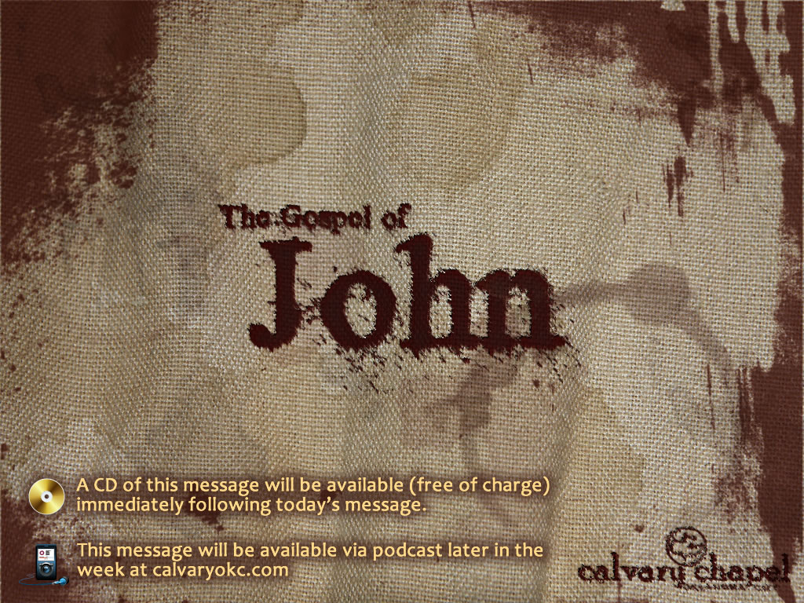
12:27-50

Slide 2
12:27-50
Things you don't want to hear in surgery:
"Don't worry; I think it's sharp enough."
"Everybody stand back! I lost my contact lens!"
"FIRE! FIRE! Everyone get out of here!"
"Better save that. We'll need it for the autopsy."
"What do you mean 'You want a divorce'!?"
"Someone call the janitor - we're going to need a mop."
"Could you stop that thing from beating; it's throwing my concentration off?"
"Oh no! I just lost my Rolex."
"Oops! Hey, has anyone ever survived 500ml of this stuff before?"
"You know, there's big money in kidneys. Heck, the guy's got two of them."

Slide 3
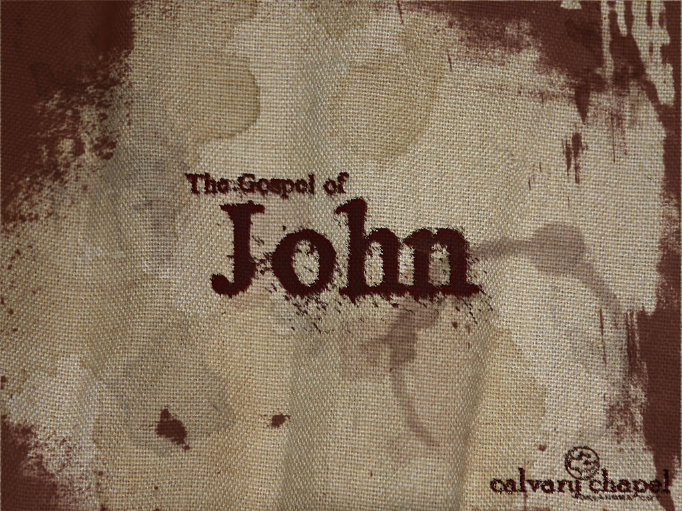
12:27-50

Slide 4
12:27-50
Luke 2:34-35 ~ ³⁴ Then Simeon blessed them, and said to Mary His mother, "Behold, this Child is destined for the fall and rising of many in Israel, and for a sign which will be spoken against ³⁵ "(yes, a sword will pierce through your own soul also), that the thoughts of many hearts may be revealed."
Luke 2:52 ~ And Jesus increased in wisdom and stature, and in favor with God and men.

Slide 5
12:27-50

Slide 6
12:27-50
Matt. 3:16-17 ~ ¹⁶ When He had been baptized, Jesus came up immediately from the water; and behold, the heavens were opened to Him, and He saw the Spirit of God descending like a dove and alighting upon Him. ¹⁷ And suddenly a voice came from heaven, saying, "This is My beloved Son, in whom I am well pleased."

Slide 7
12:27-50
Luke 9:34-35 ~ ³⁴ While he was saying this, a cloud came and overshadowed them; and they were fearful as they entered the cloud. ³⁵ And a voice came out of the cloud, saying, "This is My beloved Son. Hear Him!"

Slide 8
12:27-50

Slide 9
12:27-50
Was hidden ~ passive voice
NASB, NIV ~ hid Himself (not preferred)

Slide 10
12:27-50

Slide 11
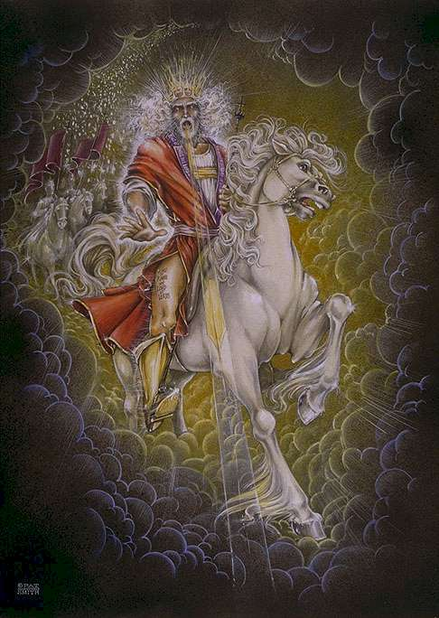
12:27-50
epiphaneia ~ manifestation, appearing
Rev. 19:11-16 ~ ¹¹ Now I saw heaven opened, and behold, a white horse. And He who sat on him was called Faithful and True, and in righteousness He judges and makes war. ¹² His eyes were like a flame of fire, and on His head were many crowns. He had a name written that no one knew except Himself. ¹³ He was clothed with a robe dipped in blood, and His name is called The Word of God. ¹⁴ And the armies in heaven, clothed in fine linen, white and clean, followed Him on white horses. ¹⁵ Now out of His mouth goes a sharp sword, that with it He should strike the nations. And He Himself will rule them with a rod of iron. He Himself treads the winepress of the fierceness and wrath of Almighty God. ¹⁶ And He has on His robe and on His thigh a name written: KING OF KINGS AND LORD OF LORDS.
Phil. 2:4-8 ~ ⁴ Let each of you look out not only for his own interests, but also for the interests of others. ⁵ Let this mind be in you which was also in Christ Jesus, ⁶ who, being in the form of God, did not consider it robbery to be equal with God, ⁷ but made Himself of no reputation, taking the form of a bondservant, and coming in the likeness of men. ⁸ And being found in appearance as a man, He humbled Himself and became obedient to the point of death, even the death of the cross.

Slide 12
12:27-50

Slide 13
12:27-50
John 12:38 ~ Isaiah 53:1
John 12:40 ~ Isaiah 6:10

Slide 14
12:27-50

Slide 15
12:27-50
David Guzik ~ "Is it possible to be a secret follower of Jesus? Only temporarily; either the secrecy will cancel out the belief, or the belief will cancel out the secrecy."

Slide 16
12:27-50

