Slide 1
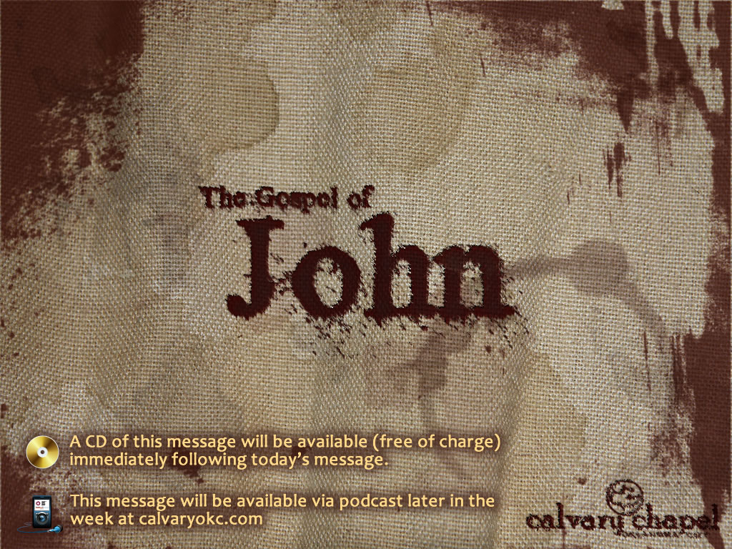
12:9-26

Slide 2
12:9-26
Matt. 21:9-11 ~ ⁹ Then the multitudes who went before and those who followed cried out, saying: "Hosanna to the Son of David! ‘Blessed is He who comes in the name of the LORD!’ Hosanna in the highest!" ¹⁰ And when He had come into Jerusalem, all the city was moved, saying, "Who is this?" ¹¹ So the multitudes said, "This is Jesus, the prophet from Nazareth of Galilee."
Moved ~ noun form of seismos

Slide 3

12:9-26

Slide 4
12:9-26
The end of it shall be with a flood,
And till the end of the war desolations are determined.
²⁷ Then he shall confirm a covenant with many for one week;
But in the middle of the week
He shall bring an end to sacrifice and offering.
And on the wing of abominations shall be one who makes desolate,
Even until the consummation, which is determined,
Is poured out on the desolate.”
Daniel 9:25–27 ~ ²⁵ Know therefore and understand,
That from the going forth of the command
To restore and build Jerusalem
Until Messiah the Prince,
There shall be seven weeks and sixty-two weeks;
The street shall be built again, and the wall,
Even in troublesome times.
²⁶ And after the sixty-two weeks
Messiah shall be cut off, but not for Himself;
And the people of the prince who is to come
Shall destroy the city and the sanctuary.

Slide 5
12:9-26

Slide 6
12:9-26
7 weeks = 49 years
62 weeks = 424 years
49
+ 424
483
Hebrew lunar year = 360 days
Mar. 5, 444 BC (Artaxerxes' decree)
– Apr. 30, AD 33 (Triumphal Entry) = 173,880 days
years
483
x 360
173,880
… from the going forth of the command
To restore and build Jerusalem
Until Messiah the Prince,
There shall be seven weeks and sixty-two weeks (total of 69 weeks)
days

Slide 7
12:9-26

Slide 8
12:9-26
Luke 19:41-44 ~ ⁴¹ Now as He drew near, He saw the city and wept over it, ⁴² saying, “If you had known, even you, especially in this your day, the things that make for your peace! But now they are hidden from your eyes. ⁴³ For days will come upon you when your enemies will build an embankment around you, surround you and close you in on every side, ⁴⁴ and level you, and your children within you, to the ground; and they will not leave in you one stone upon another, because you did not know the time of your visitation.”

Slide 9
12:9-26

Slide 10
12:9-26
10 Nisan

Slide 11
12:9-26

Slide 12
12:9-26
John 12:32 ~ And I, if I am lifted up from the earth, will draw all peoples to Myself.

Slide 13
12:9-26

Slide 14
12:9-26
A. W. Tozer ~ "I can safely say, on the authority of all that is revealed in the Word of God, that any man or woman on this earth who is bored and turned off by worship is not ready for heaven."

Slide 15
12:9-26
A. W. Tozer (Man, The Dwelling Place of God): "The old cross is a symbol of death. It stands for the abrupt, violent end of a human being. The man in Roman times who took up his cross and started down the road had already said good-by to his friends. He was not coming back. He was going out to have it ended. The cross made no compromise, modified nothing, spared nothing. It slew all of the man, completely and for good. It did not try to keep on good terms with its victim. It struck cruel and hard, and when it had finished its work, the man was no more.
The race of Adam is under a death sentence. There is no
commutation and no escape. God cannot approve any of the fruits of sin, however innocent they may appear to the eyes of men. God salvages the individual by liquidating him and then raising him again to newness of life.
That evangelism which draws friendly parallels between the ways of God and the ways of men is false to the Bible and cruel to the souls of its hearers. The faith of Christ does not parallel the world, it intersects it. In coming to Christ we do not bring our old life up onto a higher plane–we leave it at the cross. The corn of wheat must fall into the ground and die."

Slide 16
12:9-26

Slide 17
12:9-26
George Muller : "There was day when I died.
Died to George Muller, his opinions, preferences, tastes, and will; died to the world, its approval or censure; died to the approval or blame even of my brethren or friends; and since then I have studied only to show myself approved unto God."

Slide 18
12:9-26

Slide 19
12:9-26
Serves …
not hupēretēs
Service to superiors,
1 Cor. 4:1 ~ Let a man so consider us, as servants of Christ and stewards of the mysteries of God.
not doulos
Col. 4:12 ~ Epaphras, who is one of you, a bondservant of Christ, greets you …
Service to the Lord,
but diakonos
Service to brothers,
Matt. 20:26 ~ Yet it shall not be so among you; but whoever desires to become great among you, let him be your servant.

Slide 20
12:9-26

