Slide 1
11:46-12:8

Slide 2
11:46-12:8

Slide 3
11:46-12:8
2 Cor. 2:15-16a ~ ¹⁵ For we are to God the fragrance of Christ among those who are being saved and among those who are perishing. ^{16a} To the one we are the aroma of death leading to death, and to the other the aroma of life leading to life.

Slide 4
11:46-12:8

Slide 5
11:46-12:8
Council ~ sunedrion – sun, with + hedraios, immovable, settled, steadfast
Sanhedrin

Slide 6
11:46-12:8

Slide 7
11:46-12:8
Blaise Pascal ~ "Men never delight in doing evil as much as if they can do it for religious reasons"

Slide 8
11:46-12:8

Slide 9
11:46-12:8
For ~ huper – usually translated over, but when used in this kind of context, it means in the place of or instead of

Slide 10
11:46-12:8

Slide 11
11:46-12:8
"Are we predetermined to be Arminians, or do we have a choice as to whether we are Calvinists or not?" – Ray Stedman

Slide 12
11:46-12:8

Slide 13
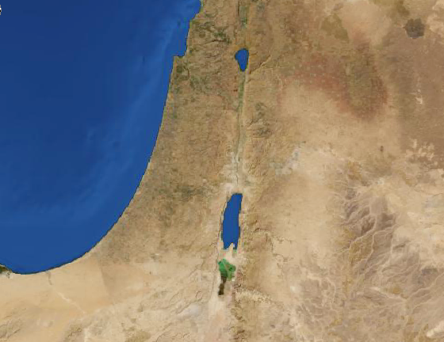
11:46-12:8
Ephraim
Jerusalem

Slide 14
11:46-12:8

Slide 15
11:46-12:8
In Luke chapter 10, she served and complained
In John chapter 11, she met the Resurrection and the Life
In John chapter 12, she served without complaining

Slide 16
11:46-12:8

Slide 17
11:46-12:8
Pound ~ litra – a Roman lb. (12 oz.) (liter)
Literally, a pound of genuine perfumed nard

Slide 18
11:46-12:8

Slide 19
11:46-12:8
Three hundred denarii was between $12,000-12,500 based upon current minimum wage

Slide 20
11:46-12:8

Slide 21
11:46-12:8
Thief ~ kleptēs

Slide 22
11:46-12:8

Slide 23
11:46-12:8
Matt. 6:19-21 ~ ¹⁹ Do not lay up for yourselves treasures on earth, where moth and rust destroy and where thieves break in and steal; ²⁰ but lay up for yourselves treasures in heaven, where neither moth nor rust destroys and where thieves do not break in and steal.
²¹ For where your treasure is, there your heart will be also.

Slide 24
11:46-12:8

Slide 25
11:46-12:8
A. W. Tozer ~ "I can safely say, on the authority of all that is revealed in the Word of God, that any man or woman on this earth who is bored and turned off by worship is not ready for heaven."

Slide 26
11:46-12:8

