Slide 1
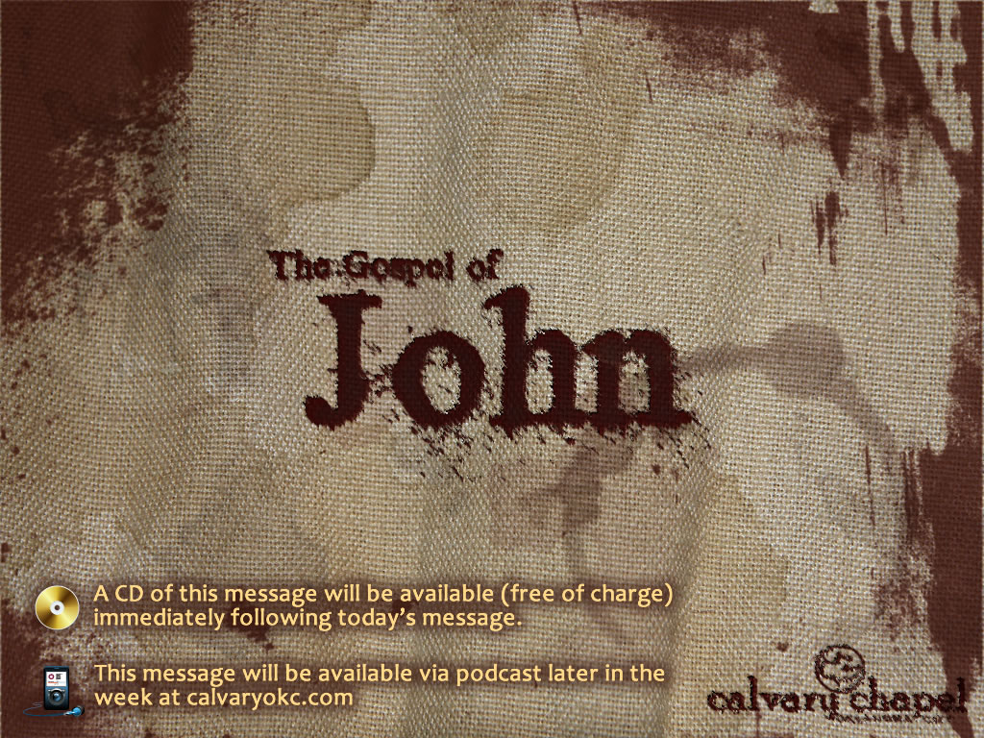
11:1-45

Slide 2
11:1-45
Groucho Marx ~ “I’m not scared of dying, I just don’t want to be there when it happens.
Epicurus 341 BC - 270 BC ~ "While I am, death is not; and when death is, I am not. Therefore, I am not concerned with death."

Slide 3

11:1-45

Slide 4
11:1-45
Love ~ phileō

Slide 5
11:1-45

Slide 6
11:1-45
Loved ~ agapaō – phileō plus volition, determination and commitment

Slide 7
11:1-45

Slide 8
11:1-45
So – oun, NIV, yet

Slide 9
11:1-45

Slide 10
11:1-45
5th (and greatest) of seven "I am" statements in John
6:35; 8:12; 10:7, 11; 11:25; 14:6; 15:1
11:25

Slide 11
11:1-45

Slide 12
11:1-45
Never ~ ou mē – "no way, Jose`"

Slide 13
11:1-45

Slide 14
11:1-45
Gandhi (15 yr. before his death): "I must tell you in all humility that Hinduism, as I know it, entirely satisfies my soul. It fills my whole being, and I find a solace in the Bhagavad and Upanishads that I miss even in the Sermon on the Mount,"
"My days are numbered, I am not likely to live very long - perhaps a year or a little more. For the first time in fifty years I find my-self in the slough of despond. All about me is darkness; I am praying for light."

Slide 15
11:1-45

Slide 16
11:1-45
Loved ~ phileō

Slide 17
11:1-45

Slide 18
11:1-45
Lazarus ~ a form of Eliezer – God is my help or comfort

Slide 19
11:1-45

