Slide 1
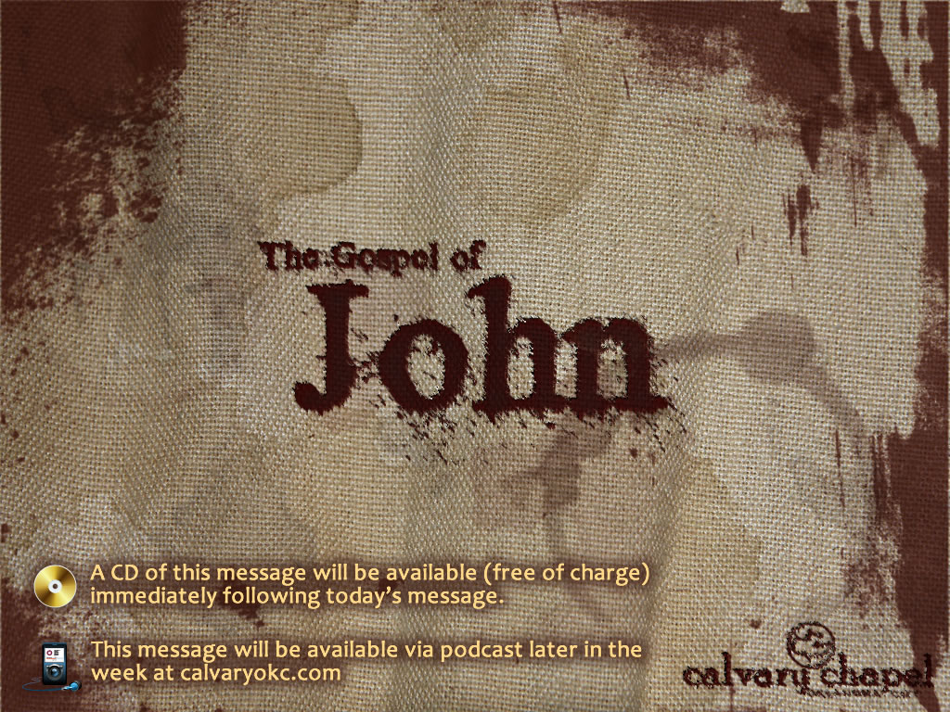
10:19-42

Slide 2
10:19-42
PSYCHIATRIC HOTLINE
1
2
3
ABC
DEF
4
GHI
5
6
JKL
MNO
7
PQRS
8
9
TUV
WXYZ
*
0
#
+

Slide 3

10:19-42

Slide 4
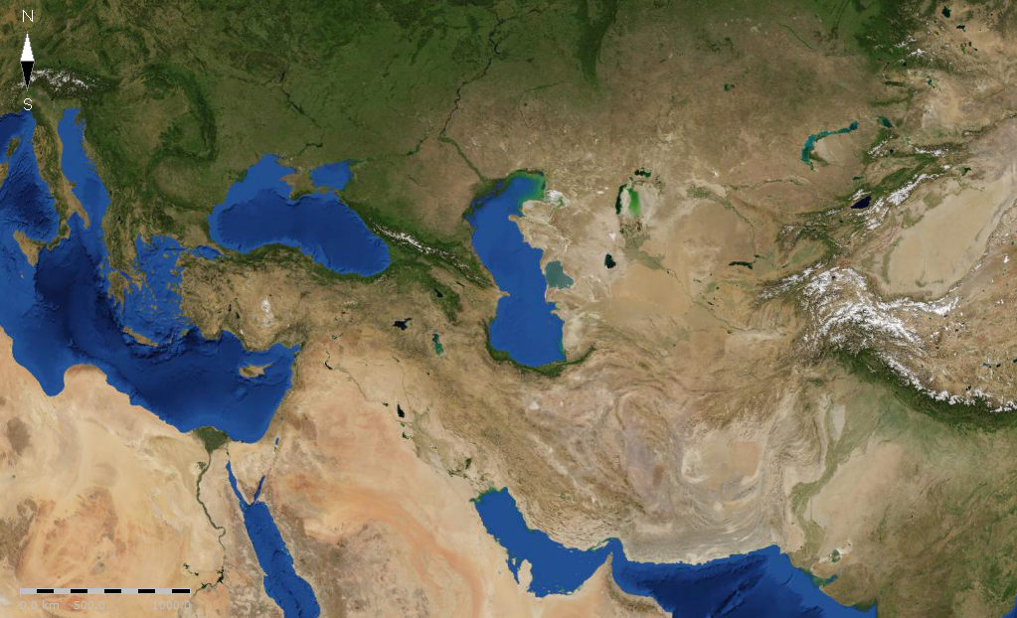
10:19-42
Lysimachus
Cassander
Ptolemy
Selucid

Slide 5
10:19-42
Antiochus IV (Epiphanes) in 175 BC
Took Canaan (Coelē Syria) from Egypt in 170 BC
Launched 2nd attack on Egypt in 168 BC
Intercepted by Roman ambassador Gaius Pompillis Laenas)
Turned anger toward Judah

Slide 6
10:19-42

Slide 7
10:19-42
Jer. 8:20 – The harvest is past,
The summer is ended,
And we are not saved

Slide 8
10:19-42

Slide 9
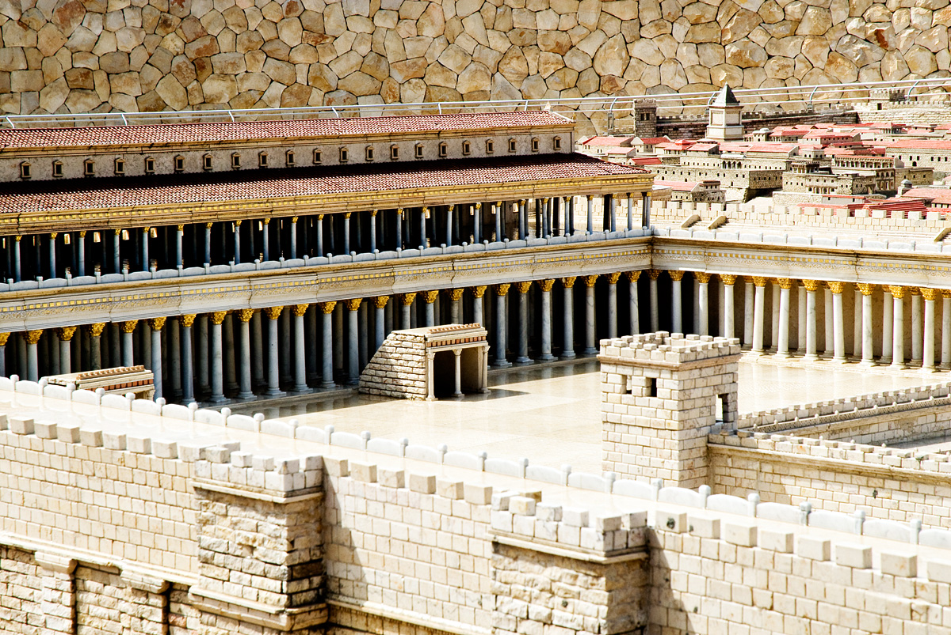
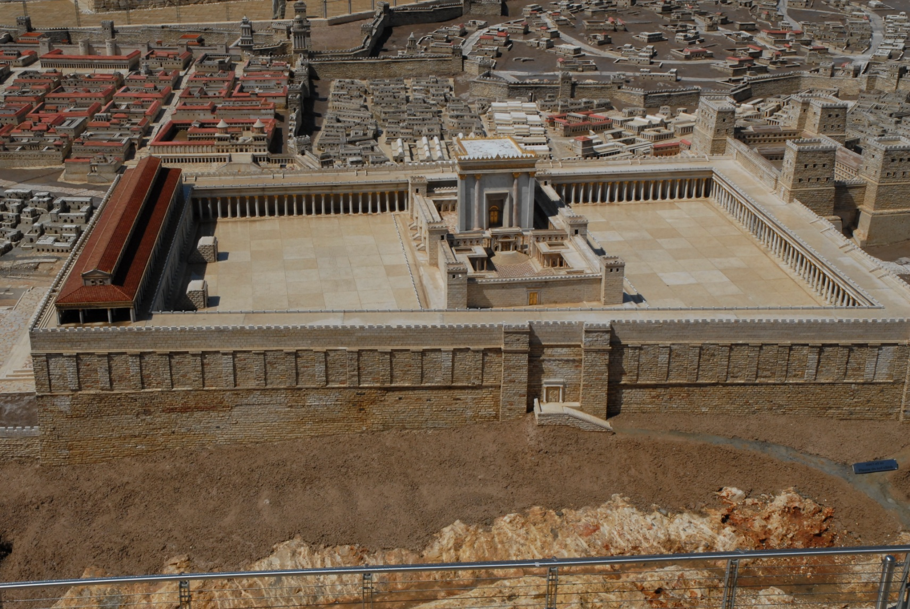
10:19-42
Solomon's Porch

Slide 10
10:19-42

Slide 11
10:19-42
2 Tim. 3:16 ~ All Scripture is given by inspiration of God, and is profitable for doctrine, for reproof, for correction, for instruction in righteousness

Slide 12
10:19-42

Slide 13
10:19-42
Soteriology
sōtēria (salvation) + legō (to study)

Slide 14
10:19-42

Slide 15
10:19-42
"The temptation to make our relation to God judicial instead of personal is very strong. Believing for salvation has been reduced to a once-done act that requires no further attention." – A. W. Tozer

Slide 16
10:19-42
"He who created us without our help will not save us without our consent." – St. Augustine

Slide 17
10:19-42

Slide 18
10:19-42
Never ~ ou mē – never, ever

Slide 19
10:19-42

Slide 20
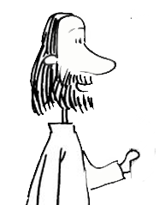
10:19-42
You are riding in the back of a pickup truck. You hit a bump, but the tailgate is up and it protects you.
Once saved always saved

Slide 21
10:19-42
You are riding in the back of a pickup truck. You hit a bump, but the tailgate is down and you are thrown out or jump out.
Fallen from grace

Slide 22
10:19-42
You are riding along in a pickup truck. You hit a bump, but you stay in the cab with Jesus so you don't have to worry about it.
Calvary Chapel

Slide 23
10:19-42

Slide 24
10:19-42
was God who become a Man
He
wasn't a man who become God

Slide 25
10:19-42

