Slide 1
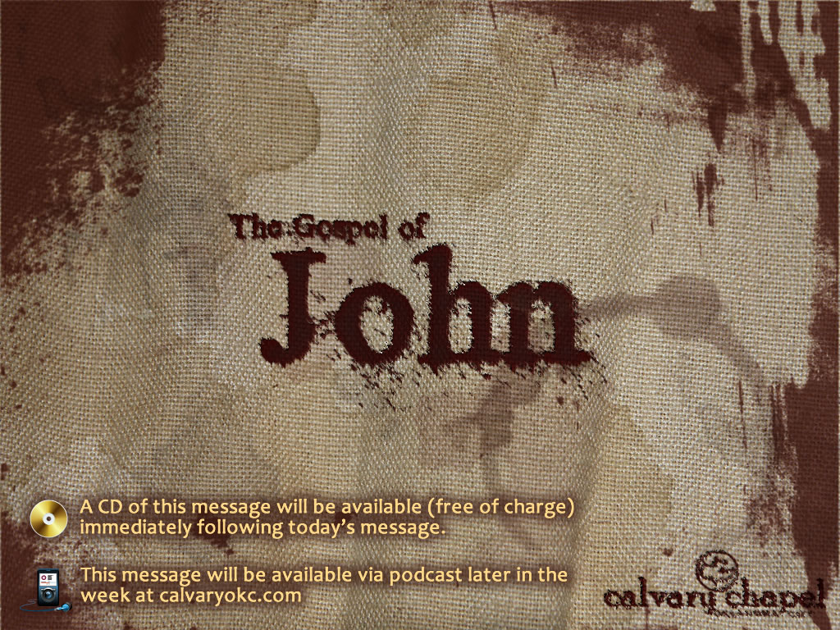
10:1-18

Slide 2
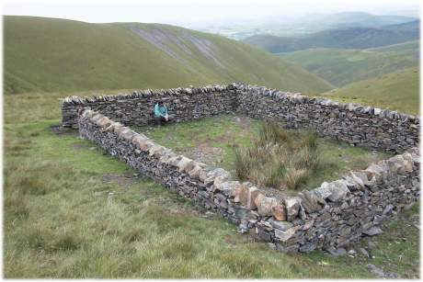
10:1-18
Sheepfold

Slide 3

10:1-18

Slide 4
10:1-18
Brings out ~ ekballō – same as 9:34

Slide 5
10:1-18

Slide 6
10:1-18
Illustration ~ paroimia ~ KJV, parable

Slide 7
10:1-18

Slide 8
10:1-18
Surah 2:256 ~ "There is no compulsion in religion"
Hadith 9:4 ~ "Wherever you find infidels kill them; for whoever kills them shall have reward on the Day of Resurrection."
Surah 2:106 ~ "Whatever a Verse (revelation) do We abrogate or cause to be forgotten, We bring a better one or similar to it. Know you not that Allah is able to do all things?"

Slide 9
10:1-18

Slide 10
10:1-18
4th of seven "I am" statements in John
11
6:35; 8:12; , ; 11:25: 14:6; 15:1
10:7

Slide 11
10:1-18

Slide 12
10:1-18
1 Pet. 5:1-4 ~ ¹ The elders who are among you I exhort, I who am a fellow elder and a witness of the sufferings of Christ, and also a partaker of the glory that will be revealed: ² Shepherd the flock of God which is among you, serving as overseers,
not by compulsion but willingly, not for dishonest gain but eagerly; ³ nor as being lords over those entrusted to you, but being examples to the flock;
⁴ and when the Chief Shepherd appears, you will receive the crown of glory that does not fade away.

Slide 13
10:1-18

