Slide 1
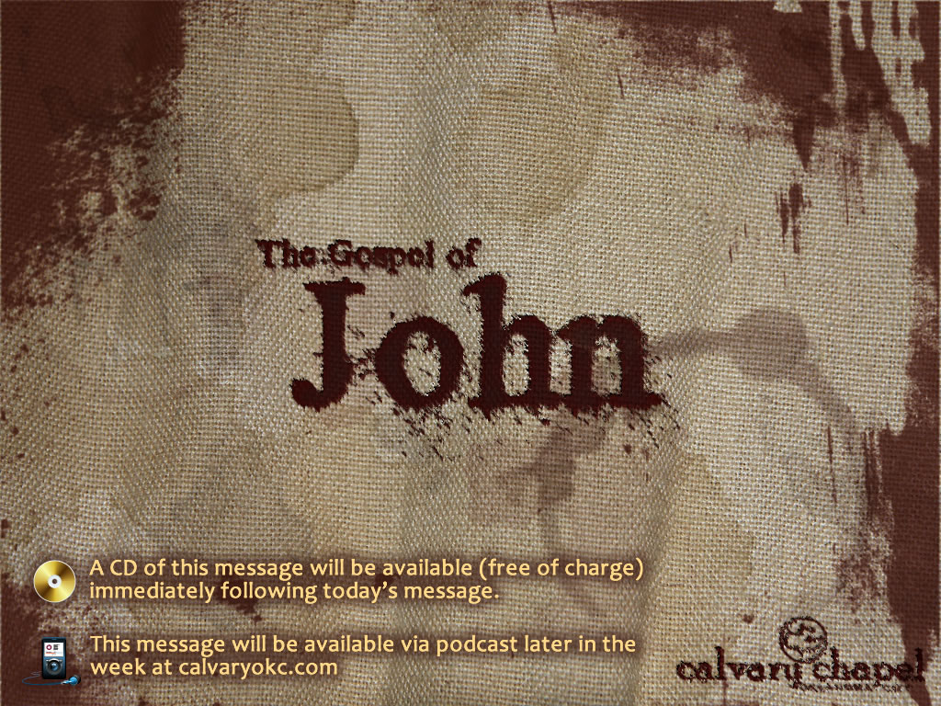
9:26-41

Slide 2
9:26-41
You
are not
an Artist
Internet access
an Intellectual
a Poet
just have
Deep
a Critic

Slide 3
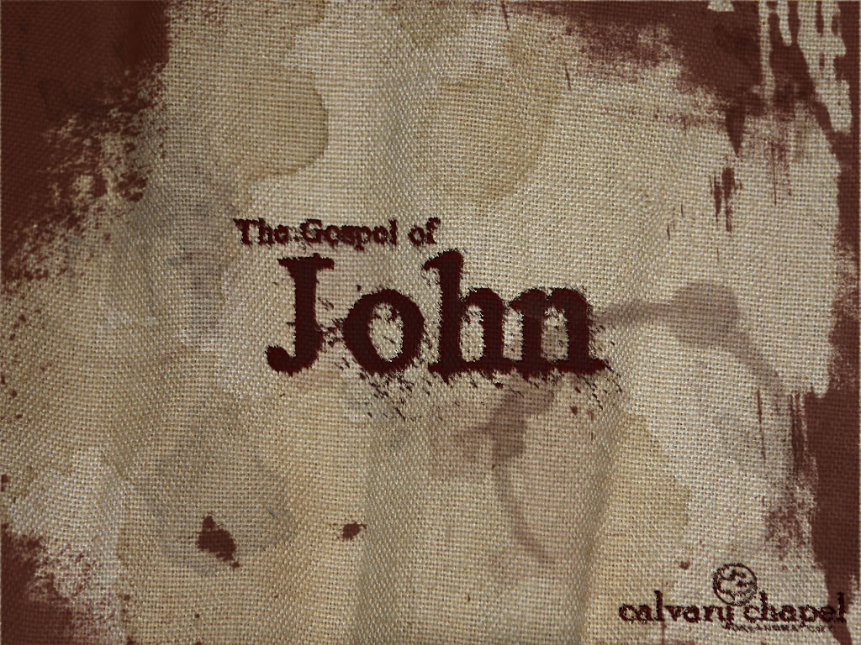
9:26-41

Slide 4
9:26-41
Exegesis ~
an explanation or critical interpretation (especially of the Bible).

Slide 5
9:26-41
Eisegesis ~
an interpretation, esp. of Scripture, that expresses the interpreter's own ideas, bias or the like, rather than the meaning of the text.

Slide 6
9:26-41

Slide 7
9:26-41
Cast…out ~ ekballō (ek, out + ballō, to throw) and exō (away)

Slide 8
9:26-41

Slide 9
9:26-41
Worshiped ~ prosuneō – pros (before) + kuōn (dog [canine])
54x in New Testament
53x used of worshipping God (or Jesus) or false gods
Exception: Rev. 3:9 ~ Indeed I will make those of the synagogue of Satan, who say they are Jews and are not, but lie—indeed I will make them come and worship before your feet, and to know that I have loved you.

Slide 10
9:26-41

Slide 11
9:26-41
v. 11 ~ a Man
v. 17 ~ a Prophet
v. 38 ~ Lord (Kurios)

Slide 12
9:26-41

Slide 13
9:26-41
John 3:17 ~ For God did not send His Son into the world to condemn the world, but that the world through Him might be saved.
1 Cor. 2:14 ~ But the natural man does not receive the things of the Spirit of God, for they are foolishness to him; nor can he know them, because they are spiritually discerned.

Slide 14
9:26-41

Slide 15
9:26-41
Matt. 12:30 ~ He who is not with Me is against Me, and he who does not gather with Me scatters abroad.

Slide 16
9:26-41
Matt. 6:23 ~ But if your eye is bad, your whole body will be full of darkness. If therefore the light that is in you is darkness, how great is that darkness!

Slide 17
9:26-41

