Slide 1
9:1-25

Slide 2
9:1-25
Rev. 3:20 ~ Behold, I stand at the door and knock. If anyone hears My voice and opens the door, I will come in to him and dine with him, and he with Me.
Gen. 3:10 ~ … I heard Your voice in the garden, and I was afraid because I was naked; and I hid myself.

Slide 3
9:1-25

Slide 4
9:1-25
Reasons why we suffer:
1. Reciprocity
2. Result of the Fall
3. Teach us lessons
4. Manifest God's glory

Slide 5
9:1-25

Slide 6
9:1-25
Syllogistic reasoning:
1. Men from God keep the Sabbath
2. Jesus doesn't keep the Sabbath
Conclusion: Jesus is not from God

Slide 7
9:1-25
Syllogistic reasoning:
1. Prophets do the miracles of God
2. Jesus did a miracle of God
Conclusion: Jesus is a prophet of God

Slide 8
9:1-25

Slide 9
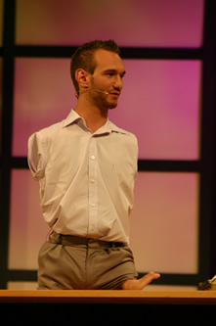
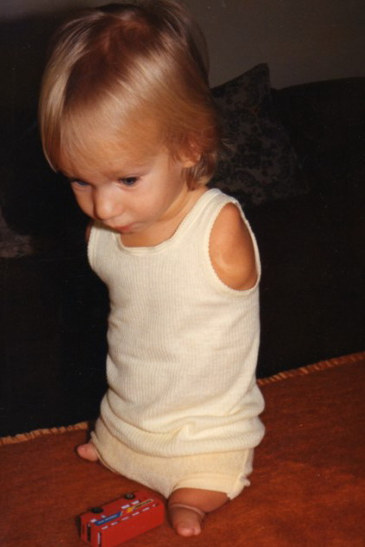
9:1-25
Nick Vujicic
www.lifewithoutlimbs.org

Slide 10
9:1-25

Slide 11
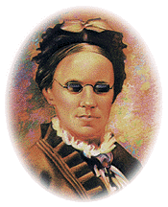
9:1-25
Oh, what a happy child I am,
Although I can not see.
I am resolved that in this world,
Contented I will be.
How many blessings I enjoy
That other people don't.
To weep and sigh
Because I'm blind,
I cannot and I won't! – Fanny Crosby

Slide 12
9:1-25

Slide 13
9:1-25

Slide 14
9:1-25

Slide 15
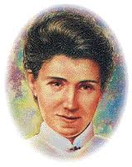
9:1-25
"Hast Thou No Wound?"
Hast thou no scar?
No hidden scar on foot, or side, or hand?
I hear thee sung as mighty in the land,
I hear them hail thy bright ascendant star:
Hast thou no scar?
No wound? No scar?
Yes, as the master shall the servant be,
And pierced are the feet that follow Me;
But thine are whole.
Can he have followed far
Who has no wound? No scar? – Amy Carmichael
Hast thou no wound?
Yet, I was wounded by the archers, spent.
Leaned me against the tree to die, and rent
By ravening beasts that compassed me, I swooned;
Hast thou no wound?

Slide 16
9:1-25

Slide 17
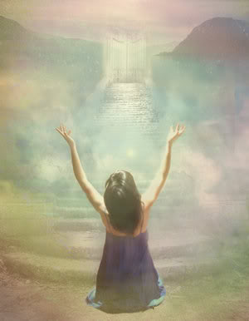
9:1-25
"Y?"
"O!"
1 Cor. 13:12 ~ For now we see in a mirror, dimly, but then face to face. Now I know in part, but then I shall know just as I also am known.

Slide 18
9:1-25

