Slide 1
8:21-59

Slide 2
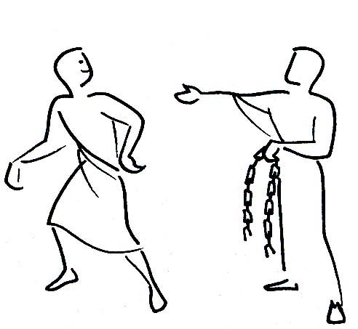
8:21-59
I am ~ egō eimi
Good News Bible ~ And you will die in your sins if you do not believe that "I Am Who I Am'

Slide 3
8:21-59

Slide 4
8:21-59
God
Job
Family
Family
Church
ME
God
Job
Church
Etc.
Etc.

Slide 5
8:21-59

Slide 6
8:21-59
What does it mean to believe?
1. Accept what He says about God's love
2. Accept what the Bible says about sin
3. Accept what the Bible says about the meaning of life
Is. 43:7 ~ Everyone who is called by My name, whom I have created for my glory: I have formed him, yes, I have made him.

Slide 7
8:21-59

Slide 8
8:21-59
KJV ~ We be Abraham's seed …

Slide 9
8:21-59

Slide 10
8:21-59
Commits (v. 34) ~ present participle (commiting)

Slide 11
8:21-59

Slide 12
8:21-59
"Of all the epithets that could be applied to Christ, 'mild' seems one of the least appropriate." – J. B. Phillips

Slide 13
8:21-59

Slide 14
8:21-59
The Father
The Son
The Spirit

Slide 15
8:21-59

Slide 16
8:21-59
egō eimi – eimi would've been enough
Literally, Before Abraham came into being, I existed

Slide 17
8:21-59

