Slide 1
8:1-20

Slide 2
8:1-20
The NIV: "The earliest manuscripts and other ancient witnesses do not have John 7:53-8:11"
The NASB: "Later mss add the story of the adulterous woman, numbering it as John 7:53–8:11"

Slide 3
8:1-20

Slide 4
8:1-20
In the very act ~ epautophōrō – (epi, upon + autos, self + phōr, thief ) i.e., like a thief caught red-handed

Slide 5
8:1-20

Slide 6
8:1-20
You ~ emphatic in the Greek
"But You … what do You say?"

Slide 7
8:1-20

Slide 8
8:1-20
Wrote ~ katagraphō – to write against

Slide 9
8:1-20

Slide 10
8:1-20
Deut. 17:7 ~ The hands of the witnesses shall be the first against him to put him to death, and afterward the hands of all the people. So you shall put away the evil from among you.

Slide 11
8:1-20

Slide 12
8:1-20
Alan Redpath ~
"Freedom from outward guilt does not mean freedom from inward sin."
"Outward guilt does not cut someone off from hope."
"Only Jesus can separate between the act (which He condemns) and the sinner (whom He forgives)."

Slide 13
8:1-20

Slide 14
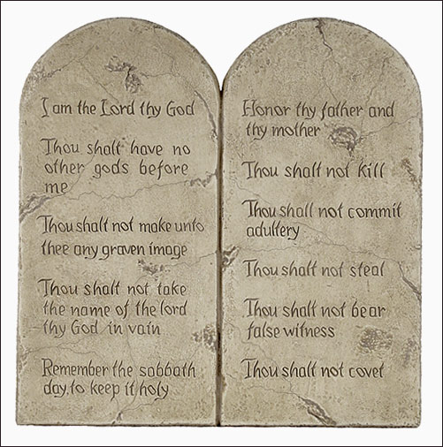
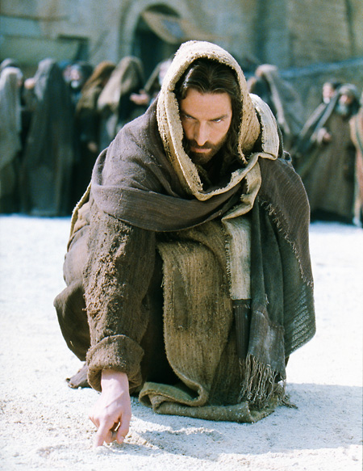
8:1-20
Exodus 31:18
John 8:6-8

Slide 15
8:1-20

Slide 16
8:1-20
1 Pet. 4:10 ~ As each one has received a gift, minister it to one another, as good stewards of the manifold grace of God.

Slide 17
8:1-20

Slide 18
8:1-20
Two main hindrances with extending grace:
1. Incorrect perspective

Slide 19
8:1-20

Slide 20
8:1-20
2nd of seven "I am" statements in John
6:35;
8:12
; 10:7, 11; 11:25; 14:6; 15:1
Follows ~ present participle – literally is following

Slide 21
8:1-20

Slide 22
8:1-20
Not true ~ i.e. insufficient

Slide 23
8:1-20

Slide 24
8:1-20
Message ~ vv. 14-16 – ¹⁴ Jesus replied, “You’re right that you only have my word. But you can depend on it being true. I know where I’ve come from and where I go next. You don’t know where I’m from or where I’m headed. ¹⁵ You decide according to what you can see and touch. I don’t make judgments like that. ¹⁶ But even if I did, my judgment would be true because I wouldn’t make it out of the narrowness of my experience but in the largeness of the One who sent me, the Father.

Slide 25
8:1-20

Slide 26
8:1-20
Two main hindrances with extending grace:
1. We have an incorrect perspective.
2. We have incomplete knowledge.

Slide 27
8:1-20

