Slide 1
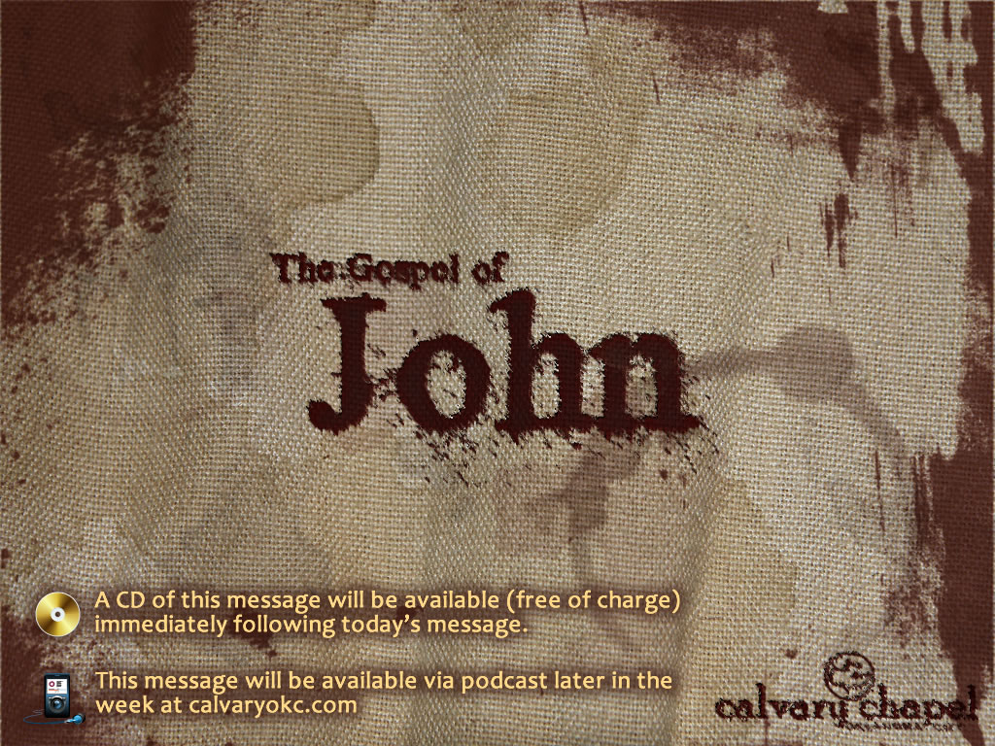
7:37-53

Slide 2
7:37-53
Drugs
Alcohol
Hobbies
Careers
Materialism
Self

Slide 3

7:37-53

Slide 4
7:37-53
Dan. 5:10-11a ~ ¹⁰ The queen, because of the words of the king and his lords, came to the banquet hall. The queen spoke, saying, "O king, live forever! Do not let your thoughts trouble you, nor let your countenance change. ¹¹ There is a man in your kingdom in whom is the Spirit of the Holy God."

Slide 5
7:37-53
Jud. 15:14-15 ~ ¹⁴ When he came to Lehi, the Philistines came shouting against him. Then the Spirit of the LORD came mightily upon him; and the ropes that were on his arms became like flax that is burned with fire, and his bonds broke loose from his hands. ¹⁵ He found a fresh jawbone of a donkey, reached out his hand and took it, and killed a thousand men with it.

Slide 6
7:37-53

Slide 7
7:37-53
John 14:16-17 ~ ¹⁶ And I will pray the Father, and He will give you another Helper, that He may abide with you forever— ¹⁷ the Spirit of truth, whom the world cannot receive, because it neither sees Him nor knows Him; but you know Him, for He dwells with you and will be in you.

Slide 8
7:37-53
John 20:19-22 ~ ¹⁹ Then, the same day at evening, being the first day of the week, when the doors were shut where the disciples were assembled, for fear of the Jews, Jesus came and stood in the midst, and said to them, "Peace be with you." ²⁰ When He had said this, He showed them His hands and His side. Then the disciples were glad when they saw the Lord. ²¹ So Jesus said to them again, "Peace to you! As the Father has sent Me, I also send you." ²² And when He had said this, He breathed on them, and said to them, "Receive the Holy Spirit."

Slide 9
7:37-53
Acts 1:4-8 ~ ⁴ And being assembled together with them, He commanded them not to depart from Jerusalem, but to wait for the Promise of the Father, "which," He said, "you have heard from Me; ⁵ for John truly baptized with water, but you shall be baptized with the Holy Spirit not many days from now."
⁶ Therefore, when they had come together, they asked Him, saying, "Lord, will You at this time restore the kingdom to Israel?"
⁷ And He said to them, "It is not for you to know times or seasons which the Father has put in His own authority. ⁸ But you shall receive power when the Holy Spirit has come upon you; and you shall be witnesses to Me in Jerusalem, and in all Judea and Samaria, and to the end of the earth."

Slide 10
7:37-53
Luke 11:10-13 ~ ¹⁰ For everyone who asks receives, and he who seeks finds, and to him who knocks it will be opened. ¹¹ If a son asks for bread from any father among you, will he give him a stone? Or if he asks for a fish, will he give him a serpent instead of a fish? ¹² Or if he asks for an egg, will he offer him a scorpion? ¹³ If you then, being evil, know how to give good gifts to your children, how much more will your heavenly Father give the Holy Spirit to those who ask Him!

Slide 11
7:37-53

Slide 12
7:37-53
Matthew 11:12 ~ And from the days of John the Baptist until now the kingdom of heaven suffers violence, and the violent take it by force.
NLT ~ And from the time John the Baptist began preaching and baptizing until now, the Kingdom of Heaven has been forcefully advancing, and violent people attack it.

Slide 13
7:37-53

Slide 14
7:37-53
Micah 5:2 ~ But you, Bethlehem Ephrathah,
Though you are little among the thousands of Judah,
Yet out of you shall come forth to Me
The One to be Ruler in Israel,
Whose goings forth are from of old,
From everlasting.

Slide 15
7:37-53

Slide 16
7:37-53
1 Cor. 1: 18-19 ~ ¹⁸ For the message of the cross is foolishness to those who are perishing, but to us who are being saved it is the power of God. ¹⁹ For it is written: "I will destroy the wisdom of the wise, And bring to nothing the understanding of the prudent."

Slide 17
7:37-53

Slide 18
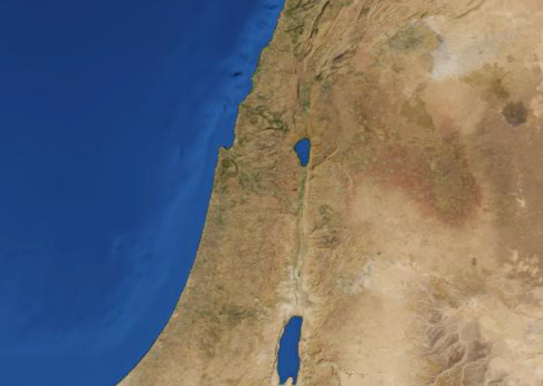
7:37-53
Nahum
Capernaum
(village of Nahum)
Elkosh?
Jonah
Gath Hepher
Nazareth
Shunem
Habakkuk

Slide 19
7:37-53

Slide 20
7:37-53
Rev. 1:3 ~ Blessed is he who reads and those who hear the words of this prophecy, and keep those things which are written in it; for the time is near.
1 Thess. 4:13 ~ But I do not want you to be ignorant, brethren, concerning those who have fallen asleep, lest you sorrow as others who have no hope.

Slide 21
7:37-53

Slide 22
7:37-53
John 17:17 ~ Sanctify them by Your truth. Your word is truth.
1 Pet. 2:2 ~ as newborn babes, desire the pure milk of the word, that you may grow thereby,
Job 23:12 ~ I have not departed from the commandment of His lips; I have treasured the words of His mouth
More than my necessary food.

Slide 23
7:37-53

Slide 24
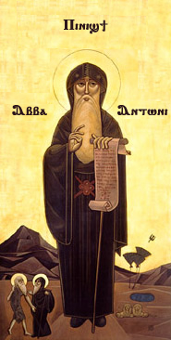
7:37-53
"Be astounded that God should have written to us." – Antony of Egypt (c. 251–356)

Slide 25
7:37-53

