Slide 1
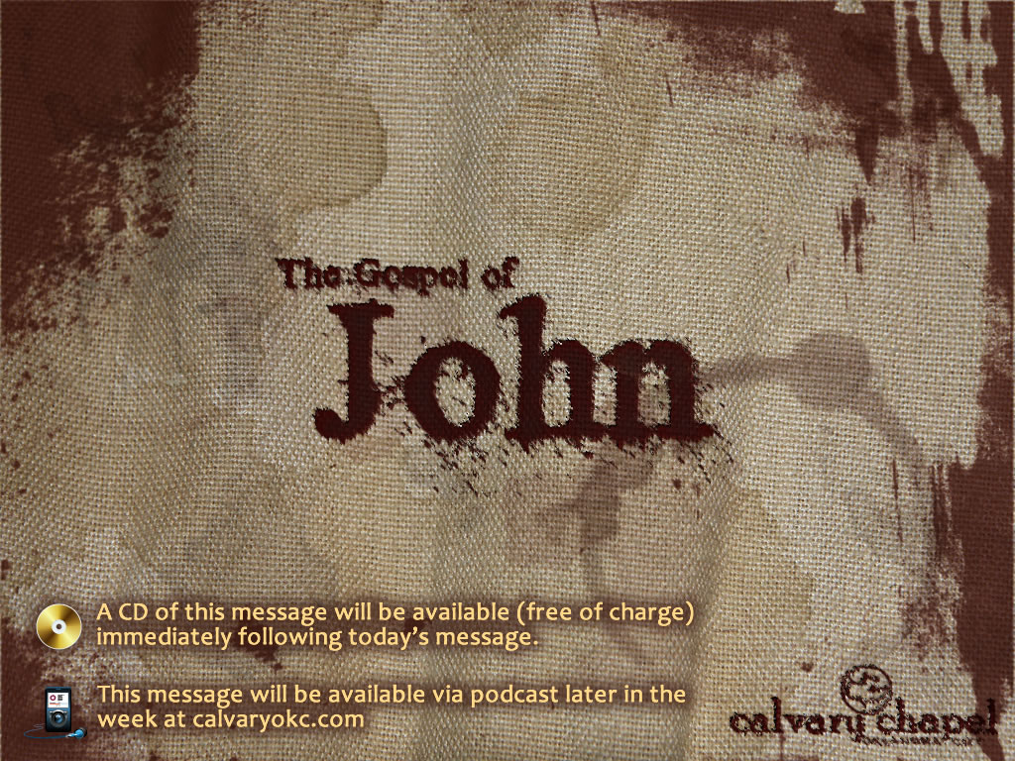
7:1-39

Slide 2
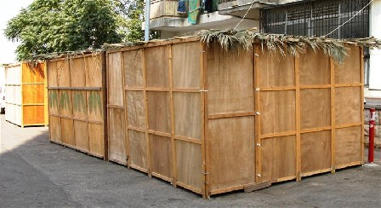
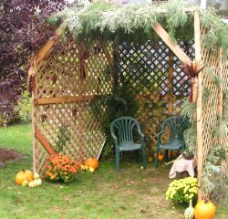
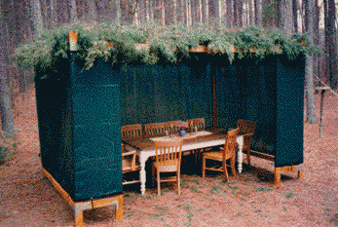
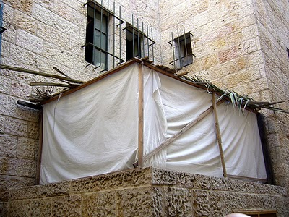
7:1-39

Slide 3
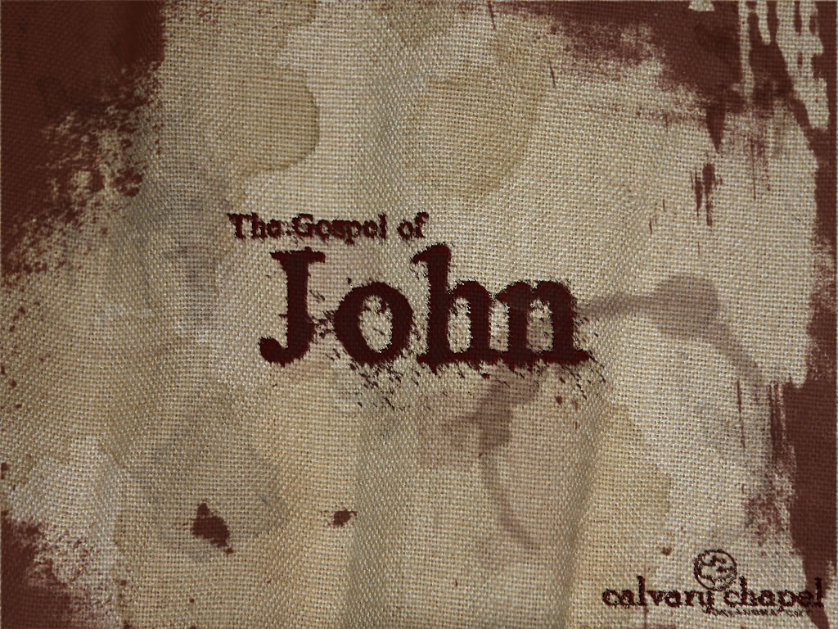
7:1-39

Slide 4
7:1-39
Letters ~ gramma
NLT ~ The Jewish leaders were surprised when they heard him. “How does he know so much when he hasn’t studied everything we’ve studied?”

Slide 5
7:1-39

Slide 6
7:1-39
Ps. 34:8 ~ Oh, taste and see that the Lord is good
Blessed is the man who trusts in Him!

Slide 7
7:1-39

Slide 8
7:1-39
John 3:19 ~ And this is the condemnation, that the light has come into the world, and men loved darkness rather than light, because their deeds were evil.

Slide 9
7:1-39

Slide 10
7:1-39
Completely well ~ literally wholly whole

Slide 11
7:1-39

Slide 12
7:1-39
Jewish Religious Feasts
6 mo.
Sep
Oct
Nov
Dec
Jan
Feb
Mar
Apr
May
Jun
Jul
Aug
Elul
Tishri
Heshvan
Kislev
Tevet
Shevat
Adar
Nisan
Iyar
Sivan
Tammuz
Av
Elul
Feast of Tabernacles
Passover
Also called:
"Sukkot"
"Feast of Ingathering"
"Feast of the Lord" or "The Feast"

Slide 13
7:1-39

Slide 14
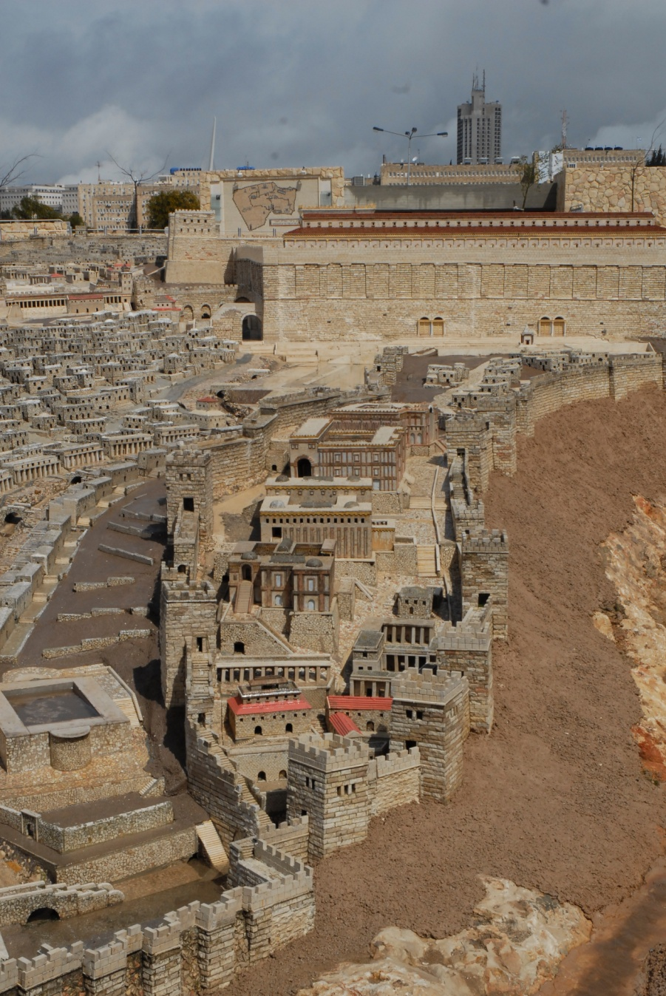
7:1-39
Pool of Siloam

Slide 15
7:1-39

Slide 16
7:1-39
Is. 44:3 ~ For I will pour water on him who is thirsty,
And floods on the dry ground;
I will pour My Spirit on your descendants,
And My blessing on your offspring;

Slide 17
7:1-39

Slide 18
7:1-39
Heart ~ KJV, belly – koilia (womb, hollow, cavity, void)
NIV ~ living water will flow from within him

Slide 19
7:1-39

