Slide 1
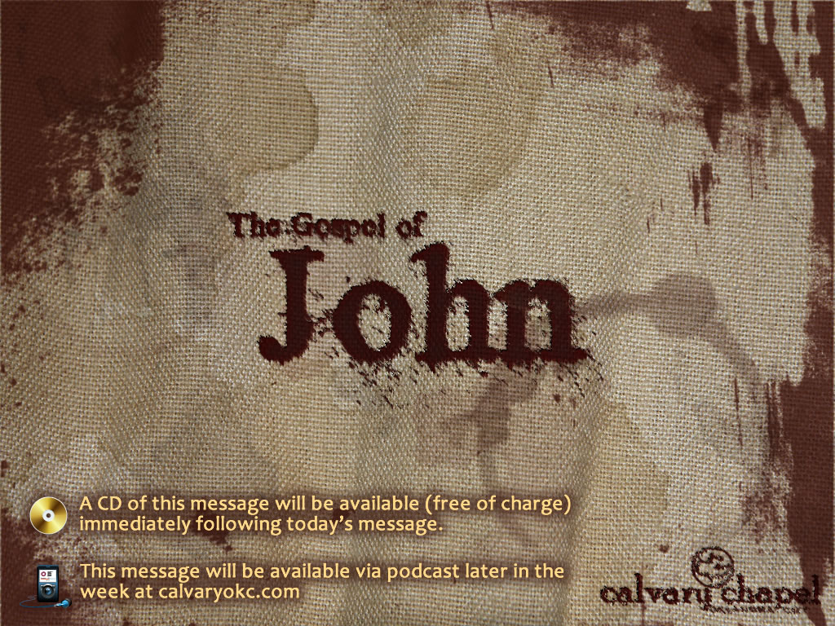
6:22-58

Slide 2
6:22-58
Capernaum
Bethsaida
Mt. Arbel
Sea of
Galilee
Tiberius
Jesus
Disciples
5 mi.

Slide 3
6:22-58
Capernaum
Golan Heights
Bethsaida
(Julia)
Bethsaida
(Galilee)
Mt. Arbel
Sea of
Galilee
Tiberius
Jesus
Disciples
Disciples
5 mi.

Slide 4
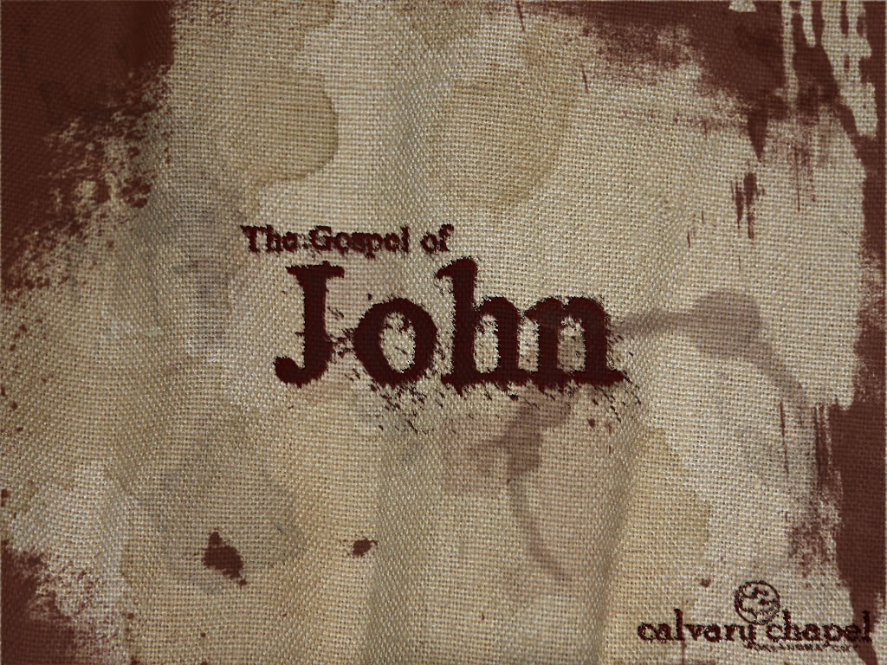
6:22-58

Slide 5
6:22-58
Got into boats ~ KJV, took shipping

Slide 6
6:22-58

Slide 7
6:22-58
Perishes ~ present participle – literally, perishing
Endures ~ present participle – literally, enduring

Slide 8
6:22-58

Slide 9
6:22-58
Believe in ~ eis – into

Slide 10
6:22-58

Slide 11
6:22-58
1 Thess. 5:21 ~ Test all things; hold fast what is good.

Slide 12
6:22-58

Slide 13
6:22-58
Lord ~ Kurios – probably the meaning Sir

Slide 14
6:22-58

Slide 15
6:22-58
I am ~ egō eimi
Eimi = I am (1st person singular state of being verb)
Estin = he is (3rd person singular state of being verb)
Egō = I (1st person singular pronoun)

Slide 16
6:22-58
1st of seven "I am" statements in John
6:35; 8:12; 10:7,11; 11:25; 14:6; 15:1

Slide 17
6:22-58

Slide 18
6:22-58
Barnhouse's "Zeroes"
1
0
1
00
1
000

Slide 19
6:22-58

